Slide 1
Unit4 There are seven days in a week.
人教精通版四年级下册
WWW.PPT818.COM

Slide 2
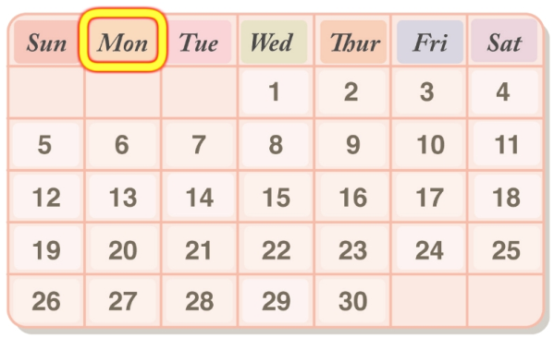
Review
Look and say
What’s the first day of the week in China?
What’s the second day of the week in China?
Monday
Tuesday

Slide 3
Review
Look and say
When do you have PE lessons?
Monday
Tuesday
8:30
Chinese
Maths
9:20
Maths
Chinese
10:30
English
PE
11:20
PE
art
We have PE lessons on Monday and Tuesday.

Slide 4
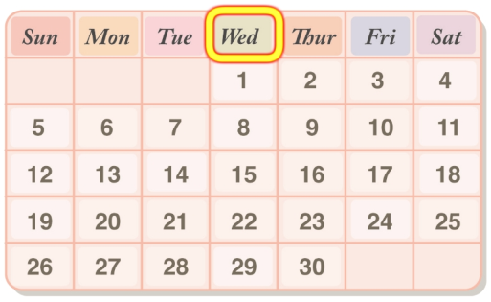
Presentation
Let’s learn
What’s the third day of the week in China?
Wednesday

Slide 5
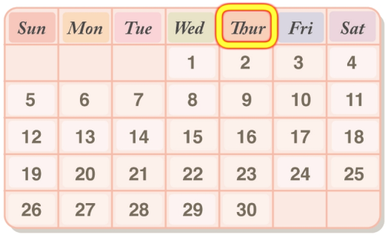
Presentation
Let’s learn
Thursday
Thursday is the fourth day of the week in China.

Slide 6
Presentation
Let’s learn
What day is today?
It’s Wednesday.

Slide 7
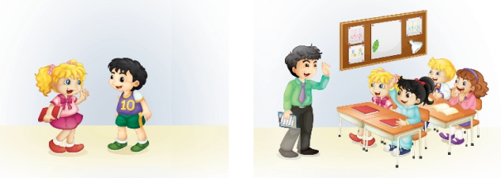
Presentation
Look and say
What are they talking about?

Slide 8
Presentation
Let’s learn
1
4
What day is today?
Good morning, boys and girls!
2
It’s Wednesday.
3
Mr Black will come to our school today.
Good morning! Welcome to our class!
5

Slide 9
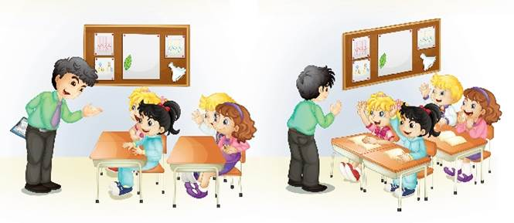
Presentation
Let’s learn
6
8
How many English lessons do you have in a week?
When do you have English?
7
We have three.
We have English on Monday, Wednesday and Thursday.
9

Slide 10
Practice
Read it by groups for one minute .
小组读对话一分钟。
一分钟倒计时
60
Learning tip :
50
10
10
四人一组，比赛读句子，看谁能在一分钟内读完，并且读得准确、流利！
20
20
40
30
30
开始

Slide 11
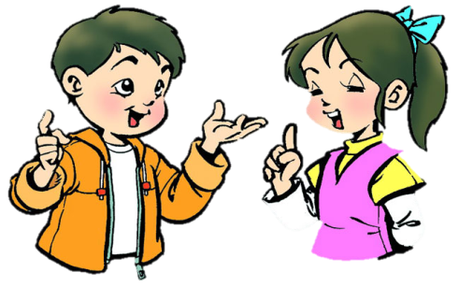
Practice
Role-play
分角色朗读对话，注意模仿语音语调。
六人一组，试着表演出来吧。

Slide 12
Practice
Ask and answer
What day is today?
How many English lessons do you have today?
How many English lessons do you have in a week?
When do you have English lessons?

Slide 13
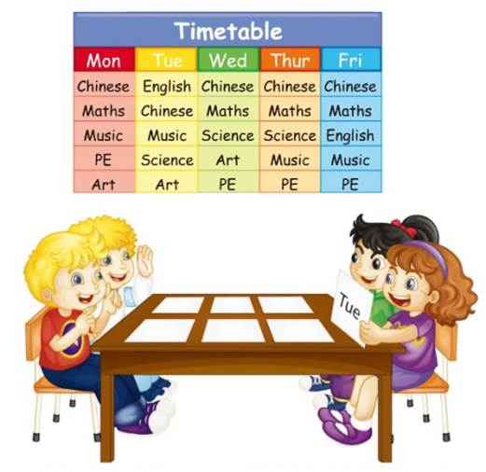
Practice
Let’s play
2
1
It’s Wednesday.
What day is today?
4
We have Chinese, maths, science, art and PE.
3
What subjects do we have?

Slide 14
Summary
本课学到的重点单词：
Wednesday Thursday today
本课学到的重点句型：
—What day is today?
—It’s Wednesday.

Slide 15
Homework
1. 跟读课文Just talk部分的录音，注意语音、语调。
2. 在四线三格中正确抄写本课新单词，不少于5遍，并默写1遍。
3. 预习Lesson 22。
Close

