Slide 1
Unit 2
I’ll help to clean up the city parks.
Section B (第2课时)
WWW.PPT818.COM

Slide 2
Ⅰ. 根据句意及汉语提示写出相应的单词和短语
1. Who wrote the _____(信)to ____(女士)Li?
2. I’m sure you know that this group was ______(建立)
to help ________(有残疾的)people like me.
3. Lucky ______ __ big _________(影响)to my life.
letter
Miss
set up
disabled
makes
a
difference

Slide 3
blind
deaf
4. What would it be like to be _____ (失明的)or ____(聋
的)?
5. Or _______ (想象)you can’t walk or use your hands
easily.
6. Most people would never think about this, but many
people have these __________(困难).
imagine
difficulties

Slide 4
7. I can’t use my arms or legs well, so normal things
like answering the telephone, opening and ______
_____ (关门), or ________ (提)things are difficult for me.
8. I love animals and I was ______(兴奋)about the idea
of having a dog.
closing
doors
carrying
excited

Slide 5
9. I’m only able to have a “dog helper” because of your
________ (仁慈)!
10. Lucky is very ______ (聪明)and ___________(理解)
many English words.
11. Thank you again for ________(改变)my life.
kindness
clever
understands
changing

Slide 6
Ⅱ. 将下列句子补充完整
1. 我很感谢你捐钱给“动物帮手”。
I’d ____ __ thank you for ______ money __ Animal
Helpers.
2. 你的帮助使我拥有幸运儿成为了可能。
You helped to make __ possible ___ me __ _____ Lucky.
like
to
giving
to
it
for
to
have

Slide 7
3. 她向“动物帮手”要求给我一只受过专门训练的狗。
She ______ __ Animal Helpers about ______ me a
special _______ dog.
4. 和一只狗一起在“动物帮手”经过了六个月的训练后,
我能把它带回家了。
After six months of _______ ____ a dog at Animal
Helpers, I ____ ____ __ _____him home.
talked
to
getting
trained
training
with
was
able
to
bring

Slide 8
考点1 difficulty n. 困难;难题
*Most people would never think about this, but many people have these difficulties.
大多数人从来没有想过这些, 但是很多人有这些困难。
*The old man has difficulty (in) standing and walking.
那位老人站立和行走都有困难。

Slide 9
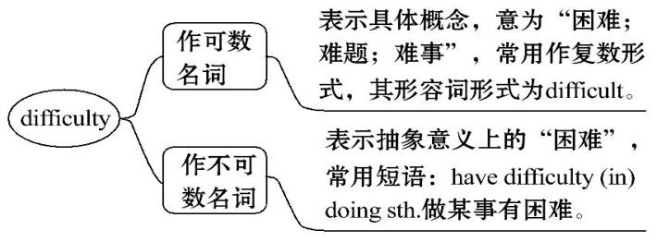
【自主归纳】 difficulty的用法

Slide 10
【即学活用】
①(2016·泰州中考)—Mr Ling, I have some difficulty ______ the article.
—Remember______ it three or four times at least.
A. to understand;reading B. understanding;reading
C. understanding;to read D. to understand;to read

Slide 11
【解析】选C。考查非谓语动词。句意: ——凌先生, 我很难理解这篇文章。——记住至少要读它三到四遍。have difficulty(in)doing sth. 意为“做某事有困难”, 是固定搭配用法;remember to do sth. 意为“记得去做某事”, 表示事情还未做。故选C。

Slide 12
difficulties
②He could find no way out in the face of __________
(difficulty).
③(2015·扬州中考)Sandy had no difficulty________ (爬)
up the Great Wall last Sunday.
climbing

Slide 13
考点2 carry v. 拿;提;扛
*Carrying things is difficult for me.
提东西对我来说很困难。
*She always carries a pocket dictionary with her.
她总是随身携带一本袖珍字典。

Slide 14
【妙辨异同】 carry, bring, take与get/fetch辨析
carry | 拿;提;扛 | 表示携带、搬运、运载, 具有负重的含义, 没有方向性
bring | 拿来;带来 | 指把人或物从别处带到说话者所在的地方
take | 拿走;带走 | 指把人或物从说话者所在的地方带到别处
get/fetch | 去取来;去拿来 | 指到某地把某人或某物带来或拿来, get更口语化

Slide 15
*Don’t forget to bring your homework to school tomorrow.
明天不要忘记把你的作业带到学校来。
*Take these fruits to your grandparents, please.
请把这些水果带给你爷爷、奶奶。
*Could you fetch me a bag, Jane?
简, 你能去给我拿个袋子来吗?

Slide 16
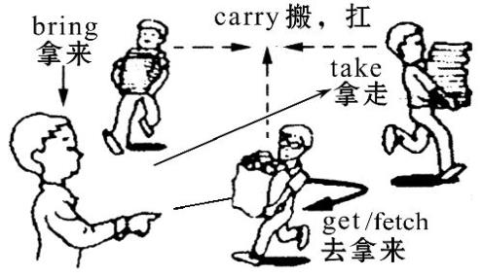
【图解助记】

Slide 17
【即学活用】
①—Look! What’s in that kangaroo’s stomach?
—Its baby. A kangaroo usually______ its baby in a pouch.
A. carries B. brings C. takes D. gets

Slide 18
【解析】选A。考查动词辨析。carry携带;bring拿来;take带走;get去拿。答语第二句句意: 袋鼠通常把它幼儿携带在育儿袋中。空白处意为“携带”, 故选A。

Slide 19
②—I’m sorry I______ my exercise book at home this morning.
—It doesn’t matter. Don’t forget______ it here this afternoon.
A. left;to take B. forgot;bringing
C. left;to bring D. forgot;to bring

Slide 20
【解析】选C。考查动词辨析和非谓语动词。take拿走;bring拿来;forget忘记(某物或某事), 但后面不能跟地点;leave忘记(某物), 表示“把某物忘在某地”。根据句意“——对不起, 今天早上我把我的练习本落在家里了。——没关系。今天下午不要忘了带到这里来。”可以判断用leave和bring。故选C。

Slide 21
考点3 make it +形容词+(for sb. )to do sth.
*You helped to make it possible for me to have Lucky.
你的帮助使我能够拥有“幸运儿”。
*Computers make it easy for us to look for information at home. 电脑使我们轻松在家就能找到信息。

Slide 22
【自主归纳】
“make it +形容词+(for sb. )to do sth. ”结构, 意为“使(某人)做某事成为……”。在此结构中, it作形式宾语, 真正的宾语是其后的动词不定式结构to do sth. 。

Slide 23
【即学活用】
①Mr Black’s classes are very interesting, and he helped
to make it easy for me _______(learn)English well.
②(2016·十堰中考)新机场让十堰人乘飞机到全国许多
不同的城市成为可能。
The new airport _____ __ _______ for people in Shiyan
to fly to many different cities of China.
to learn
make
it
possible

Slide 24
【备选要点】
考点1 open v. 开;打开

Slide 25
*I can’t use my arms or legs well, so normal things like answering the telephone, opening and closing doors, or carrying things are difficult for me.
我无法自如地使用我的胳膊和腿, 所以像接听电话、开关门、扛(拿)东西这些普通的事情对我来说都是困难的。

Slide 26
*Tom can’t wait to open his gift box.
汤姆迫不及待要打开礼品盒。

Slide 27
【妙辨异同】open/turn on的辨析
open | 指打开门、窗、箱子、盒子等, 其反义词为close
turn on | 指打开电灯、电视、电脑等的电源或自来水开关等, 其反义词为turn off

Slide 28
【一言辨异】
He opened the door, went into the room and turned on the light. 他打开门, 进入房间, 开了灯。

Slide 29
【即学活用】选词填空
①Could you help me _____ (turn on/open)the window,
please?
②It’s too dark. ________(turn on/open)the light, please.
open
Turn on

Slide 30
考点2 excited adj. 激动的;兴奋的
*I love animals and I was excited about the idea of having a dog.
我喜爱动物, 并且对拥有一只狗的主意感到兴奋。
*When I drink coffee, I’ll get excited and can’t sleep well.
当我喝了咖啡后, 我会很兴奋而睡不好觉。

Slide 31
*It was the most exciting holiday I’ve ever had.
那是我经历的最令人兴奋的假期。
*Her voice rose in excitement. 她激动得提高了嗓门。

Slide 32
【妙辨异同】 excite, excited, exciting与excitement的辨析
单 词 | 含义及用法
excite | 及物动词, 意为“使激动;使兴奋”, 后面可以直接接宾语
excited | 形容词, 意为“激动的;兴奋的”, 常用来修饰人, 常用短语: ①be excited about对……感到激动/兴奋②be excited by被……激动/兴奋③become/get excited变得兴奋

Slide 33
单 词 | 含义及用法
exciting | 形容词, 意为“令人激动的;令人兴奋的”, 常用来修饰物
excitement | 名词, 意为“兴奋, 激动”

Slide 34
【即学活用】
①What an _______ (excite)experience it was!
②Everybody was ______(excite)by the news of victory.
③—What______ news! The Chinese Women’s
Badminton Team won the Uber Cup again.
—Really? That’s great!
A. interesting B. interested C. exciting D. excited
exciting
excited

Slide 35
【解析】选C。考查形容词辨析。interesting有趣的;interested感兴趣的;exciting令人兴奋的;excited兴奋的。根据句意“——多么令人兴奋的消息啊! 中国女子羽毛球队再次赢得尤伯杯。——真的吗? 那太好了! ”故选C。

