Slide 1
Unit 8 Fashion Reading (II)
WWW.PPT818.COM

Slide 2
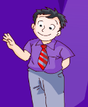
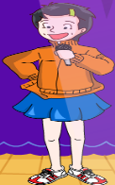
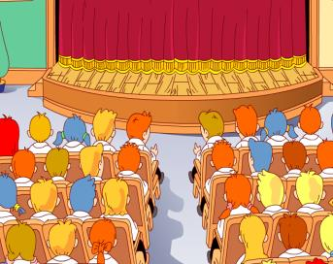
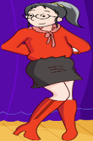
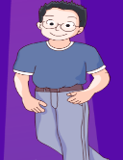
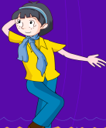
The fashion show
model
look modern and beautiful
red silk blouse
black wool skirt
red boots
model
purple shirt
grey trousers
red and grey tie
hostess and model
sports clothes
trainers
models
look cool
yellow cotton blouse
blue scarf
blue jeans
blue T-shirt
blue jeans

Slide 3
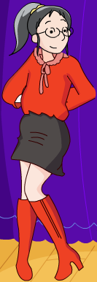
What are the students going to show?
show us clothes
They are going to _______________.
show clothes to us
They are going to _______________.
show sb sth
show sth to sb

Slide 4
What does Mary do?
show sb sth/ show sth to sb
hamburgers/Mary/her cousin/shows
2. a CD/me/Mary/shows
Mary shows her cousin hamburgers.
Mary shows hamburgers to her cousin.
Mary shows me a CD.
Mary shows a CD to me.
Notes:
4

Slide 5
What is Sandy wearing?
a red silk blouse
a black wool skirt
Sandy’s red blouse ________ silk.
Sandy’s black skirt __________ wool.
is made of
is made of
be made of

Slide 6
What is Amy wearing?
be made of
Amy is wearing a yellow cotton blouse.
Amy’s yellow blouse is made of
cotton..
2. Amy is wearing a blue silk scarf.
Amy’s blue scarf is made of silk.

Slide 7
Are they wearing the same kind of clothes?
Amy is wearing blue jeans.
Both of them wear blue jeans.
They both wear blue jeans.
Both Amy and Daniel wear blue jeans.
Daniel is wearing blue jeans too.

Slide 8
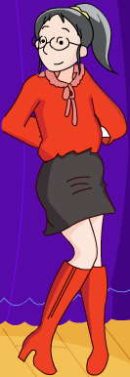
Are they wearing the same kind of clothes?
both of/both/both … and …
blouse
Both of the girls
______________ wear a blouse.
____________ wear a blouse.
______ Amy ______ Sandy wear a blouse.
The girls both
Both
and

Slide 9
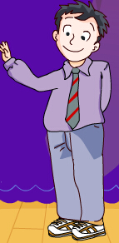
Are trainers popular?
among
Trainers are popular _______(among/ between) young people.
between
Simon stands _______(among/between) Millie and Daniel.
among
_____ (three or more)
_______ (two)
between

Slide 10
Are trainers popular?
among/between
The teacher is sitting _________ the students, telling them a story.
He tries to find the differences ________ the two pictures.
among
between

Slide 11
How do they look?
Simon looks _____.
smart
cool
Amy and Daniel look _____.
modern and beautiful
Sandy looks _________________.
look + _____
(linking verb)
adj.

Slide 12
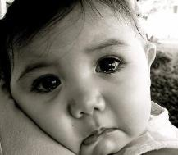
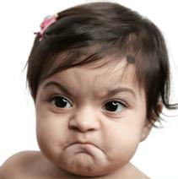
How do they look?
look + adj.
The baby boy _______.
looks sad
The baby girl _________.
looks angry

Slide 13
A report
about the fashion show
Today I go to a fashion show. Millie is ___
a hostess ____ a model. She wears sports
clothes and trainers. Trainers are _____
______ young people. Simon wears a purple
shirt and grey trousers. He ____ _____.
Amy and Daniel wear jeans. _____ __ ____
look cool. Sandy wears a red blouse. It
___ ____ ____ silk. She looks modern and
beautiful. We thank them for _____ us
_______ _____ ___ clothes.
both
and
popular
among
looks
smart
Both
of
them
made
is
of
showing
different
styles
of

Slide 14
Discussion
A green fashion show
Some students want to hold a green fashion show.
Do you have any good ideas about how to make
use of waste?
* make old jeans into shorts;
* make an old skirt into a handbag;
* use old CDs to make a skirt;
…

Slide 15
Your ideas
What is waste?
How can you make good use of old clothes?
What is good about the things made of waste?
Will you buy clothes made from waste?
What will you use to make clothes for the green fashion show?

Slide 16
Conclusion
Fashion is fun!

Slide 17
Homework
1. Write a short passage about your design for the green fashion show and share it with your partner.
2. Preview Grammar.

