Slide 1
Unit 2 Topic 2
I must ask him to give up smoking.
Section B
WWW.PPT818.COM

Slide 2
Review
What living habits do you have?
Are they good or bad for your health?

Slide 3
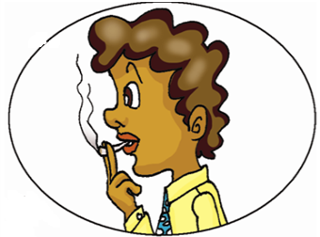
Ask and answer
What’s he doing？
He is .
smoking
What do you think of smoking？

Slide 4
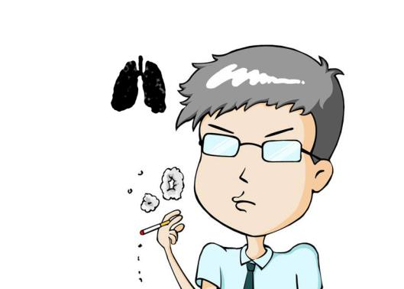
Is smoking good or bad for our health?
It’s bad for our health.

Slide 5
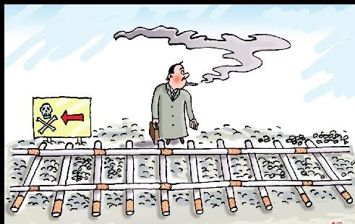
Smoking is bad for our lungs.
It can even cause cancer.

Slide 6
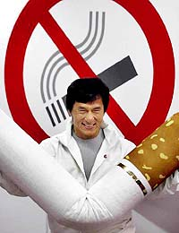
So everyone should give up smoking.
放弃

Slide 7
1a
Look, listen and say.
Maria: Hi, Wang Junfeng! What are you reading ? You’d
not read in the sun. It’s bad for your eyes.
Wang Junfeng: Oh, thank you. I’m reading an article
about smoking in the newspaper. Does your father
smoke, Maria ?
Maria: Yes, he thinks smoking can help him relax.
Wang Junfeng: But, you know, smoking is bad for his health.
Maria: yes,his teeth are yellow and he often coughs.
Wang Junfeng: That’s too bad. Look, the article says
smoking is bad for our lungs and it can even
cause cancer.

Slide 8
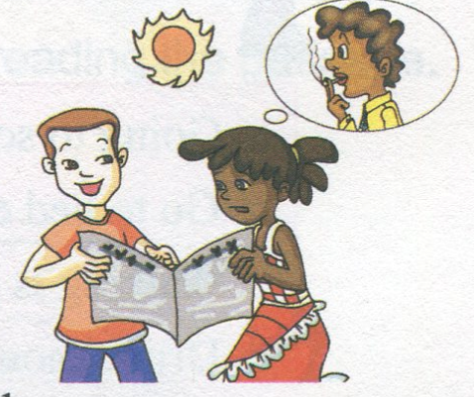
Maria: Oh! How terrible! I must ask him to give up smoking.
May I borrow your newspaper and show it to my father?
Wang Junfeng: Sure.

Slide 9
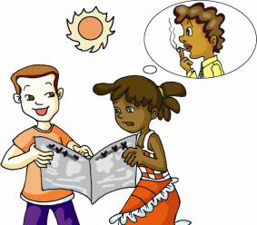
1b
Listen to 1a and answer the following questions.
①What is Wang Junfeng doing?
②Why does Maria’s father like smoking ？
③Why does Maria want to ask her father to give up smoking？
He is reading an article about smoking in the newspaper.
Because he thinks smoking can help him relax.
Because smoking is bad for our lungs and it even may cause cancer.

Slide 10
1c
Listen again and fill in the blanks.
article
Wang Junfeng is reading an ______ about smoking in the newspaper . Maria’s father ________ because he thinks smoking can help him ________. But the article says smoking is _______ for our lungs and it can even _____ cancer. Maria’s going to ask her father to ______ _____ smoking.
smokes
relax
bad
cause
give up

Slide 11
Key points
I must ask him to give up smoking.
ask sb. to do sth. 叫某人做某事
e.g. 我妈妈叫我晚上不要外出。
My mother asks me not to go out at night.
give up sth./doing sth. 放弃某事/做某事
e.g. 我不会放弃我的计划。
I won’t give up my plan.

Slide 12
Retell 1a
Maria: What … reading ?…read in the
sun.
Wang Junfeng: … an article about smoking in the
newspaper.
Does …smoke … ?
Maria: Yes … smoking … help…relax.
Wang Junfeng: …smoking … bad for …
Maria: … teeth … yellow and … coughs.
Wang Junfeng: …too bad …the article says
smoking …our lungs …
cause cancer.
Maria: … How … ! I … ask …
give up smoking. May I borrow …
show… father?
Wang Junfeng: Sure.

Slide 13
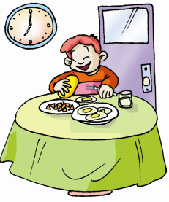
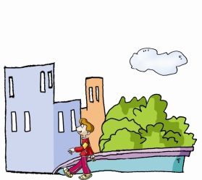
2a
Look at the pictures and choose the correct sentence to complete each description.
Breakfast gives you energy for the morning.
______________________________________________________
a. Going to school without breakfast is bad for your health.
c. Walking is good exercise.
___________________________
It’s necessary for your health.

Slide 14
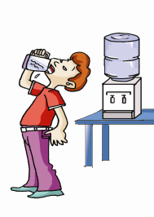
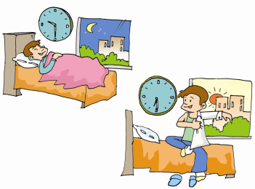
2a
Look at the pictures and choose the correct sentence to complete each description.
Water is good for your health.
______________________________________________________
d. Drink enough water every day.
__________________________________________________
It will keep you active during the day.
b. Go to bed early and get up early.

Slide 15
Key point
enough ① adj. 足够的，既可以放在名词之前，
也可以放在名词之后。
e.g. Do you have enough money/money enough
to buy it?
There are enough people / people enough
to do the work.
②adv. 足够地 ，放在形容词或副词之后。
e.g. It’s good enough, I think.
If you get up early enough, you will catch the bus.

Slide 16
2b
Read 2a and mark H (Healthy) or U (Unhealthy).
Li Hua often goes to school without breakfast. ( )
Zhang Ming usually takes a walk after the meal. ( )
Wang Peng gets up at 10 o’clock on weekends. ( )
Hu Fei always studies late in the night.( )
Mr. Smith drinks enough water every day.
( )
U
H
U
U
H

Slide 17
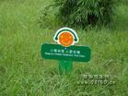
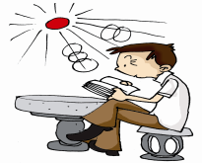
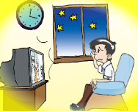
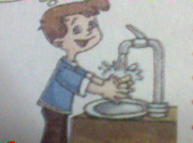
Practice
Look at the pictures. Work in pairs and talk about what we should
do to keep healthy habits, using must, mustn’t, should, shouldn’t,
had better, had better not or don’t.
Eg: Don’t walk on the lawn ( 草坪 ).
You should take care of the lawn.
…

Slide 18
Task
Make a survey to find out your classmates’ bad habits and then give some advice to them.
Name | Bad habit | Advice

Slide 19
3a
Read the pairs of words and pay attention to the difference among / ʌ /, / a: / and / D /. Then think of more words for each group.
/ ʌ /-- / ɑː/
fun --- farm cut --- card come --- calm
/ ʌ /-- / ɒ ː /
fund --- fond duck --- dock luck --- lock

Slide 20
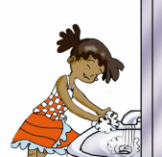
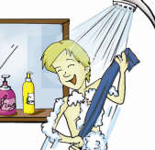
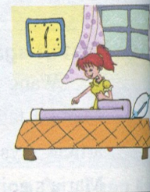
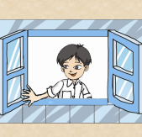
3b
Listen to the chant and write the key phrase for each picture.
wash hands
have a bath
open the window
early to rise

Slide 21
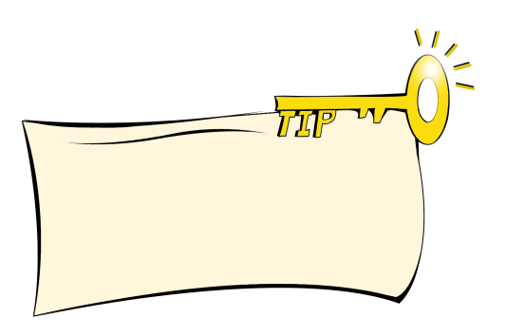
3b
Listen again and repeat, paying attention to the liaison.
Wash your hands, have a bath.
Open the window, take a fresh breath.
Early to bed, early to rise.
Having good habits,
makes a man healthy,
Wealthy and wise.
Liaison makes our English sounds smooth, and one type of it is to link consonant with vowel.

Slide 22
summary
How to use should, shouldn’t, must, mustn’t.
2. Go on talking about how to cultivate good habits to keep healthy.

Slide 23
Homework
Discuss with your partner and
write some class regulations.
Eg: We must keep the classroom
clean every day.
2. Finish the exercises in Section B.

