Slide 1
Unit 1
I go to school at 8:00
WWW.PPT818.COM

Slide 2
Just read and talk
Kate: Hi,Peter! tomorrow is saturday,what do you do on saturdays?
Peter:I often go and see films with my parents,what about you?
Kate: I usually have piano lessons
Peter:Is it difficult to play the piano?
Kate: Yes,but Zhou Pei always helps me

Slide 3
Peter:Does she play the piano at saturdays?
Kate:Yes,she practises it at home,but sometimes she helps her mum to do the housework.
Peter:really?
Kate:Sure,we should learn from her

Slide 4
Find out the phrases
1.在每个周六 on Saturdays
2.去看电影 go and see a film
3.你呢？/你怎么样 How/what about you?
4.上钢琴课 have piano lessons
5. 做某事是困难的 be difficult to do sth

Slide 5
6.弹钢琴play the piano
7.练习做某事practise doing sth
8.在家at home
9.帮助某人做某事help sb. (to) do sth
help sb. with sth

Slide 6
10.做家务do the housework
11.应该做某事should +V原
12.向某人学习learn from sb.

Slide 7
What do you do on Saturdays?
第一个do是个助动词，没有实际意义；
第二个do是实意动词，意为：做，干。

Slide 8
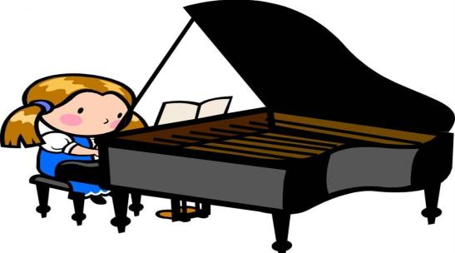
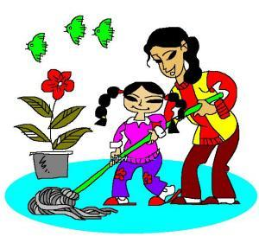
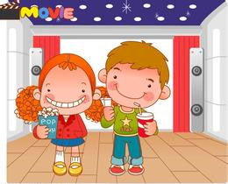
play the piano
do housework
see a movie

Slide 9
星期几
星期一 Monday
星期二 Tuesday
星期三 wedesday
星期四 Thusday
星期五 Friday
星期六 Saturday
星期天 Sunday

Slide 10
What does she do on saturday?

Slide 11
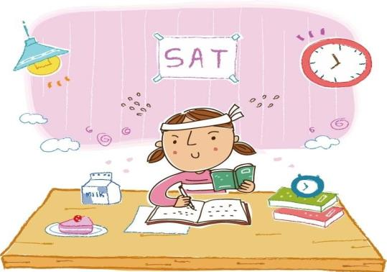
study English
do the homework

Slide 12
What does he do in saturday

Slide 13
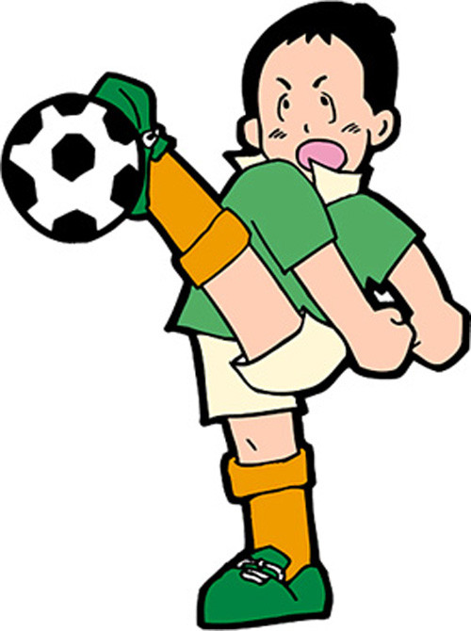
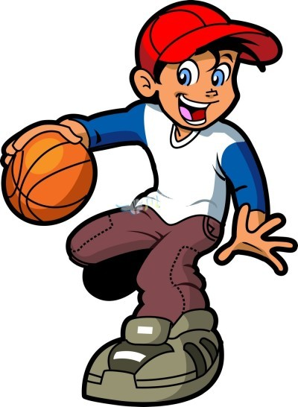
play basketball
play football

Slide 14
Exercises
my colour weekends
On weekends I have a lot of things to do…
1.I often _________ in the morning.
2.Then I usually __________
3.In the afternoon, I often________
4.After dinner, I always ________
What about your weekends?
play football
watch TV
play the piano
read stories

