Slide 1
Unit 3 The world of science
Part Ⅱ Using language——现在完成时的被动语态
WWW.PPT818.COM

Slide 2
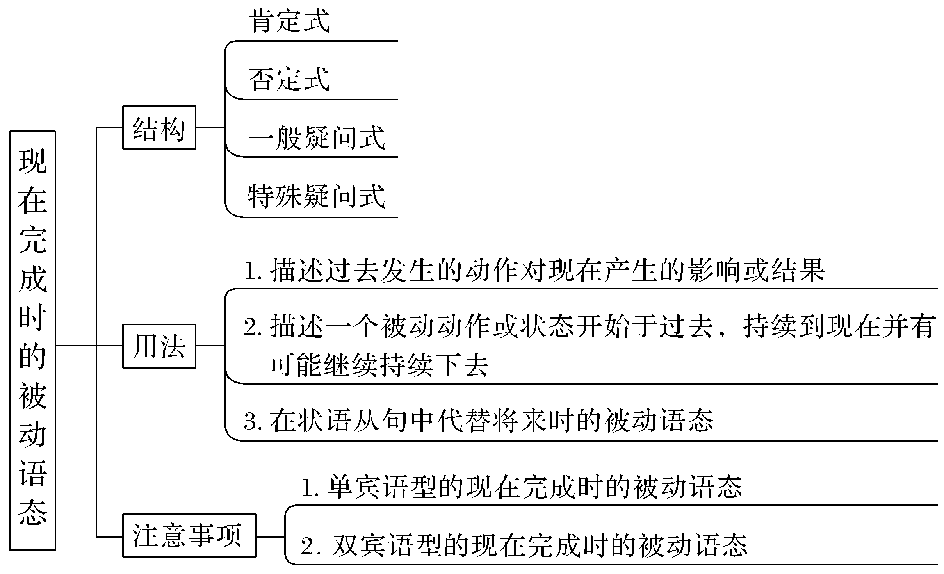
【思维导图】

Slide 3
一、基本特征感悟
【感悟用法】
①Over time I have been changed quite a lot.
②Since the 1970s many new applications have been found for me.
③The important problem has been discussed for nearly two weeks.
④The ink has not been removed from the clothes.
⑤Haven’t your problems been solved?
⑥How many buildings have been built in your school?

Slide 4
【自我总结】
1.以上例句中都使用了________________________。
2.以上例句中第①②③句是该时态的____________句式；第④句是____________句式；第⑤句是____________句式；第⑥句是____________句式。
现在完成时的被动语态
肯定
否定
一般疑问
特殊疑问

Slide 5
二、主要用法精讲
1.结构
肯定式 | 主语＋have/has been done...
否定式 | 主语＋have/has not been done...
一般疑问式 | Have/Has＋主语＋been done...？
特殊疑问式 | 疑问词＋have/has＋主语＋been done...？

Slide 6
Already this year，115 measles cases have been reported in the USA，compared with 189 for all of last year.
今年美国已经报告了115例麻疹病例，而去年全年共189例。
The construction of the bridge has not been finished.桥的建设还没有完成。
Has the date for the next meeting been decided？下次会议的日期已决定了吗？
How long has the battery not been changed？电池多久没有更换了？

Slide 7
2.用法
(1)现在完成时的被动语态同它的主动语态一样，强调过去的动作对现在造成的影响或结果，通常与already，yet，just，never，recently等副词连用。
The machine has already been repaired.机器已经修好了。
(2)表示一个被动的动作或状态开始于过去，持续到现在，并可能持续下去，常与for或since引导的时间状语连用，或用于“How long...？”句型中。
Financial problems of the company have been discussed for nearly two hours.
公司的财务问题已被讨论了近两个小时了。
How long has this film been shown？这部电影已放映多长时间了？

Slide 8
(3)用在时间或条件状语从句中，表示将来某时已完成的动作，即用现在完成时的被动语态代替将来完成时的被动语态。
You shouldn’t leave school before your homework has been finished.
在你的作业完成之前你不应该离开学校。

Slide 9
3.注意事项
(1)只带有一个宾语的动词变为被动语态时，将主动语态的宾语变为被动语态的主语。
His boss has already punished him.
→He has already been punished (by his boss).

Slide 10
(2)带有双宾语的动词，如give，send，bring，take，teach，show，tell，make，sing，write，read，sell，buy，pay，lend，pass，promise等，变为被动语态时，一般将间接宾语变为被动语态的主语，若将直接宾语变为被动语态的主语时，间接宾语前面要用相应的介词。
The company has given him a chance to work abroad recently.
→He has been given a chance to work abroad recently (by the company).
→A chance to work abroad has been given to him recently (by the company).

Slide 11
被动语态的句子中的主语是行为动作的承受者。需要注意的是，并不是所有的动词或词组都有被动形式。
如：happen，take place，break out，belong to，cost，last等不及物动词或词组就没有被动形式。

Slide 12
即学即练1
(1)变换句子
The children have already been told the good news.
①将上面的句子变为否定句
The children ________________________ the good news yet.
②将原句变为一般疑问句
____________ the children ____________ the good news yet?
③对原句中的the children进行提问
________________________ the good news yet?
haven’t been told
Have
been told
Who has been told

Slide 13
(2)补全句子
①I’m sorry，but the letters ____________________ yet.
很抱歉，但是这些信件还没有被打印出来。
②The plan ________________________ for nearly two hours.
这项计划已被讨论了近两个小时了。
③She ________________________ since then.
从那时候起，她就没来过信。
haven’t been typed
has been discussed
hasn’t been heard from

Slide 14
名师提醒
常与现在完成时连用的时间状语：
already已经
yet 已经
recently/lately 最近
ever 曾经
since then 从那时起
ever since 自那以来

Slide 15
so far 迄今为止
for a long time 很长一段时间
by now 到现在为止
in recent years 在最近几年里
in/during/over the past/last years 在过去的几年里

Slide 16
即学即练2
用现在完成时的被动语态改写句子
①They have found a good place to build a temple in the village.
→A good place ________________________ to build a temple in the village.
②We haven’t yet decided how to solve that difficult technological problem.
→How to solve that difficult technological problem ________________________ yet.
has been found
hasn’t been decided

Slide 17
即学即练3
将下面句子变为被动语态
①I have asked her to help you.
→She ________________________ you.
②We have planted many trees on the hill in the last 5 years.
→Many trees ________________________ on the hill in the last 5 years.
③He has sent me an e－mail.
→I ________________________ an e－mail.
→An e－mail ________________________ me.
has been asked to help
have been planted
have been sent
has been sent to

