Slide 1
Unit 4 Topic 3
What time is it now?
Section A
WWW.PPT818.COM

Slide 2
Teaching aims and demands
1. (1) Learn some words about animals:
panda, monkey, lion, tiger, elephant
(2) Learn other useful words:
zoo, past, quarter, half, show
2. Learn how to make appointments:
(1) —Do you have time tomorrow?
—Yes.
(2) —Let’s meet at 9 o’clock at my home.
—OK.

Slide 3
3. Talk about time:
—What time is it, please? / What’s the time, please?
—It’s one o’clock. / It’s five past one.

Slide 4
Review
归纳的邀请，应答及打电话用语
Hello.
Hello. May I speak to ×××?
Yes, this is ××× … Who’s this?
This is ××× …
He/She isn’t at home/in now. Can I take a message?
I’ll give him/her the message.
There is no Lisa here. I’m afraid you have the wrong number.
Pardon?
I’m so sorry!
That’s OK!

Slide 5
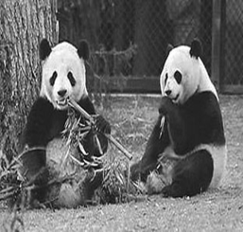
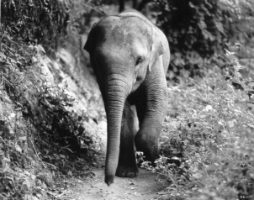
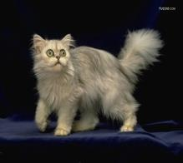
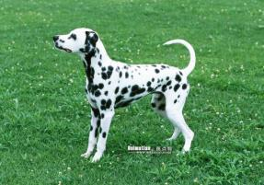
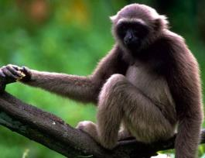
What is your favorite …?
What’s your favorite animal?

Slide 6
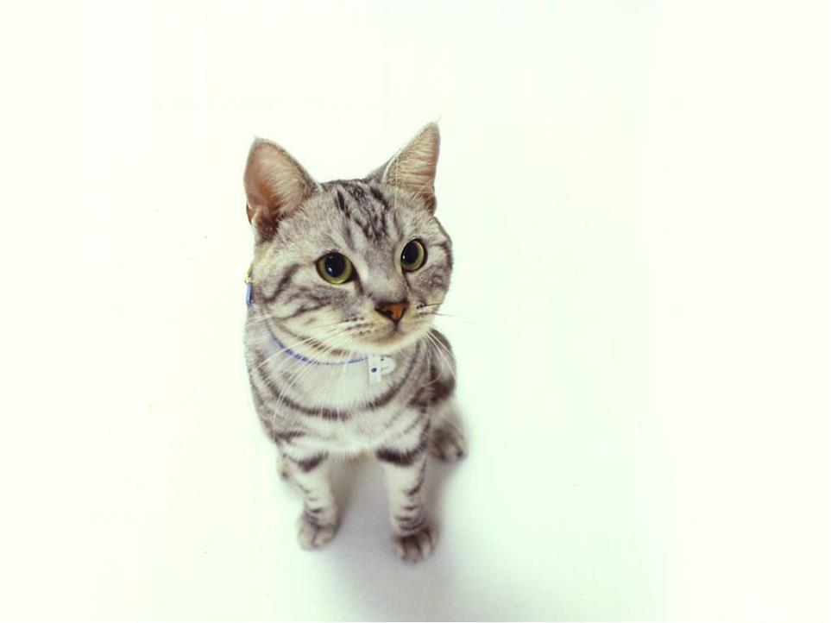
a cat

Slide 7
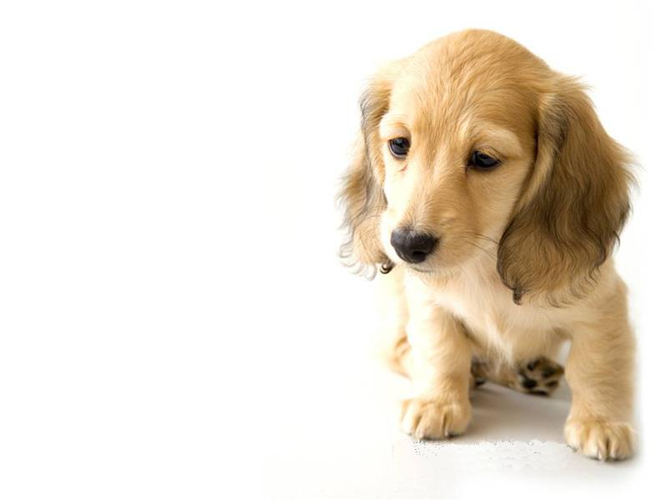
a dog
Notes:
7

Slide 8
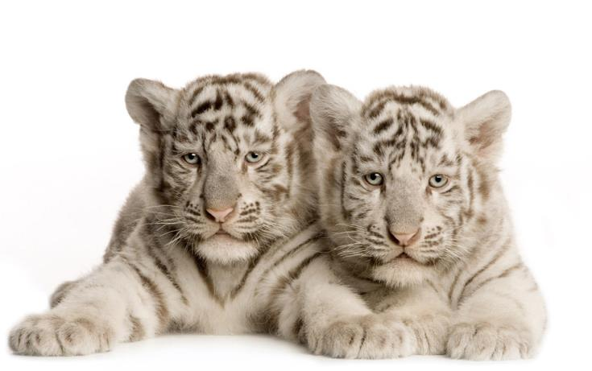
tigers

Slide 9
a monkey

Slide 10
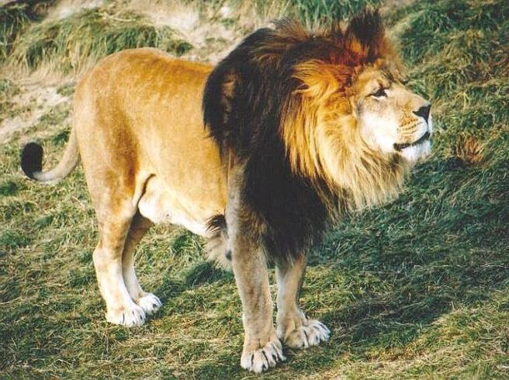
a lion

Slide 11
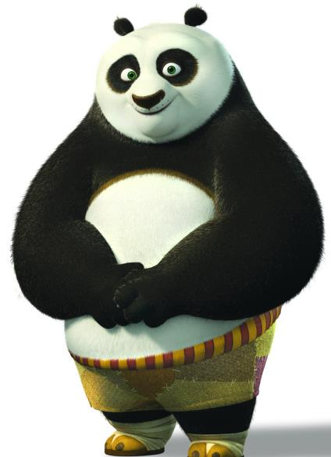
panda

Slide 12
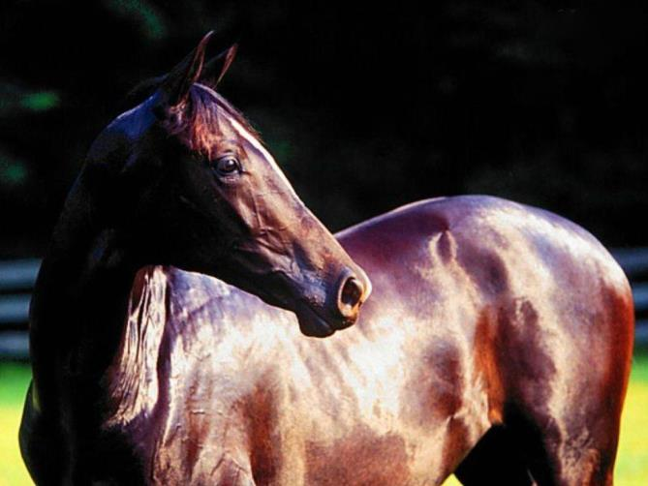
a horse

Slide 13
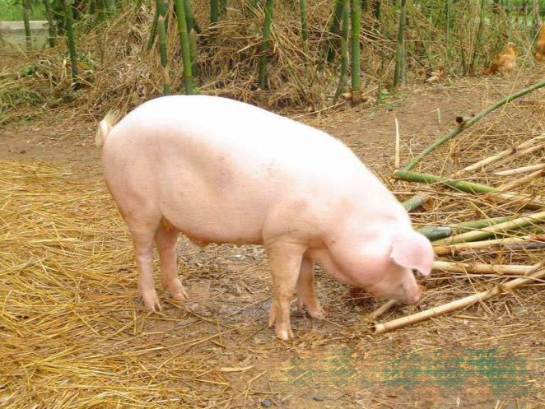
a pig

Slide 14
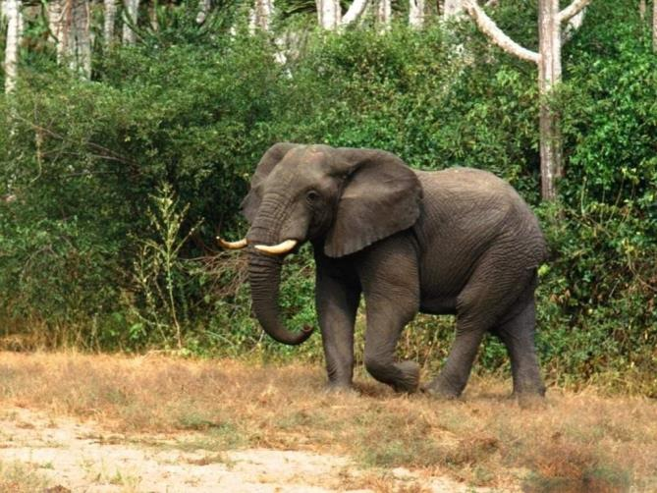
an elephant

Slide 15
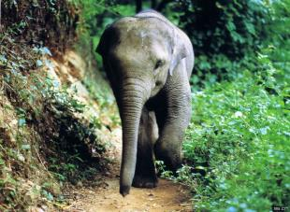
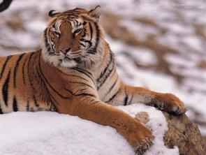
A: What animals do you like best?
B: I like pandas.
A: Why do you like pandas?
B: Because they are very cute.
2
3
1

Slide 16
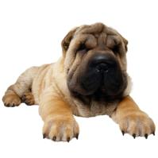
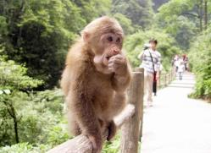
Listen and number the pictures.
3
4
a dog
a panda
2
1
an elephant
a monkey

Slide 17
—What time is it? / What is the time?
— It is one o’clock.
five past one
a quarter past one
half past one
five to two \ quarter to two
Note: 半点之前的介词用past,半点之后用to,一刻钟用quarter ．
Notes:
17

Slide 18
Play this game
Perform actions or make sounds, guess: what animals are they?
Group A
Group B

