Slide 1
Unit2 What’s your number?
人教精通版四年级上册
WWW.PPT818.COM

Slide 2
Warm-up
Let’s sing

Slide 3
Lead-in
Free talk
Hello, Boys and girls! Nice to meet you! We are in Class One, Grade Three. Which class are you in?
We are in Class One, Grade
Three.

Slide 4
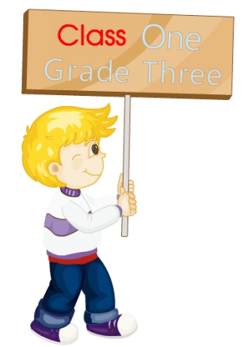
Presentation
Let’s learn
class
一 班
二 班
三 班
Class One
Class Two
Class Three

Slide 5
Presentation
Let’s learn
grade
一年级
二年级
三年级
Grade One
Grade Two
Grade Three

Slide 6
Presentation
四年级一班
Class One, Grade Four.
我在
三年级二班
I’m in
Class Two, Grade Three.
一年级四班
Class Four, Grade One.

Slide 7
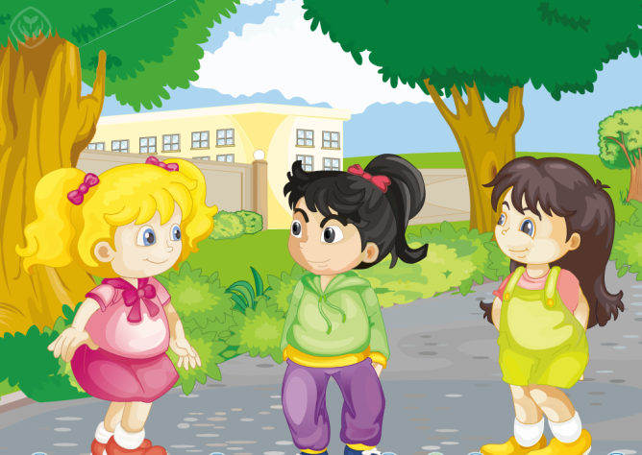
Presentation
Listen and say
Li Yan正在向Kate介绍新朋友，猜一猜他们在说些什么？

Slide 8
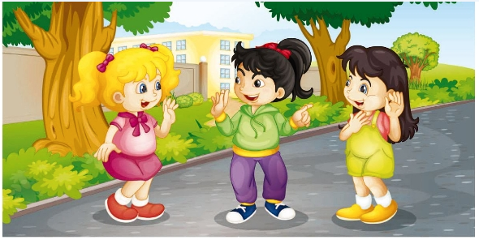
Presentation
Read and answer
1. Who is the girl?
She’s Sue.
2. What do Kate and Sue say?
Pleased to meet you!
Pleased to meet you, too.

Slide 9
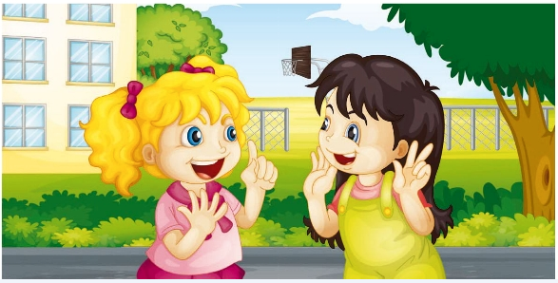
Presentation
Read and answer
3. Which class is Kate in?
She’s in Class One, Grade Four.
4. Which class is Sue in?
She’s in Class Two, Grade Three.

Slide 10
Presentation
Listen and imitate
1
2
Hi, Kate. This is my new friend, Sue.
Hi, Sue. Pleased to meet you!
3
Pleased to meet you, too!

Slide 11
Presentation
Listen and imitate
4
5
Which class are you in?
I’m in Class Two, Grade Three. How about you?
6
I’m in Class One, Grade Four.

Slide 12
Show time
三人一组，练习对话并表演，其他同学评价。
 | 模仿录音中的语音语调，有感情地朗读。
 | 可以脱离课本，适当改动其中部分，语音地道。
 | 适当添加内容，意思完整，有创新，表演生动。
Good
Great
Excellent

Slide 13
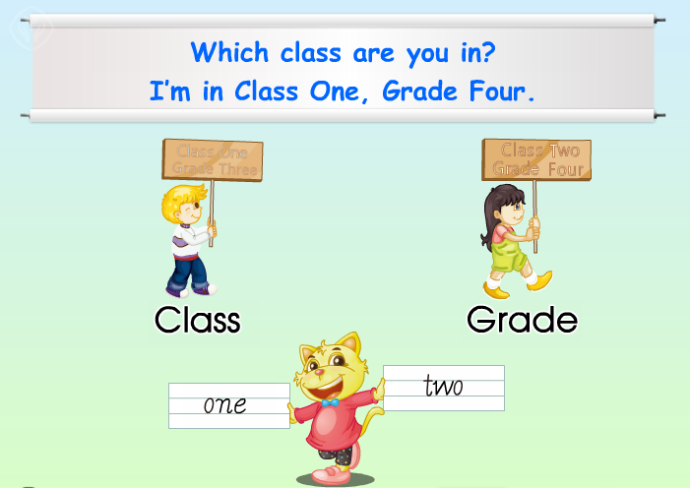
Presentation
Just read and write

Slide 14
Practice
Let’s write
class
Can you write them?
grade
one
two

Slide 15
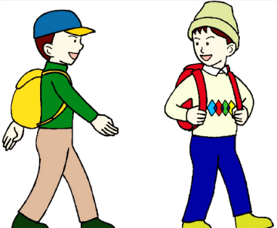
Practice
Look and say
Which class are you in?
I’m in Class Two, Grade Six.

Slide 16
Practice
Look and say
Which class are you in?
I’m in Class Two, Grade Three.

Slide 17
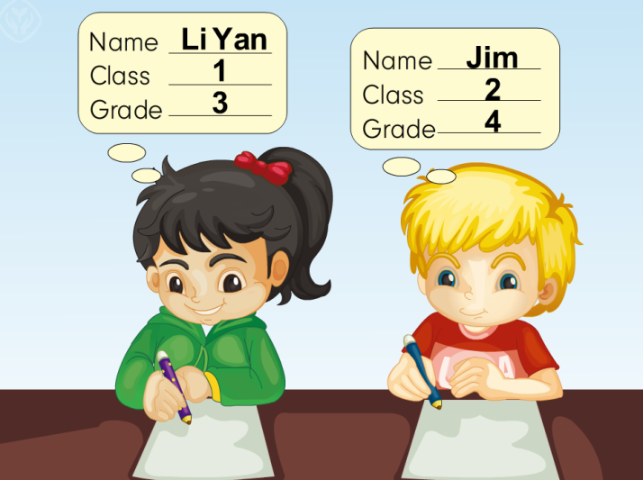
Practice
Look and write

Slide 18
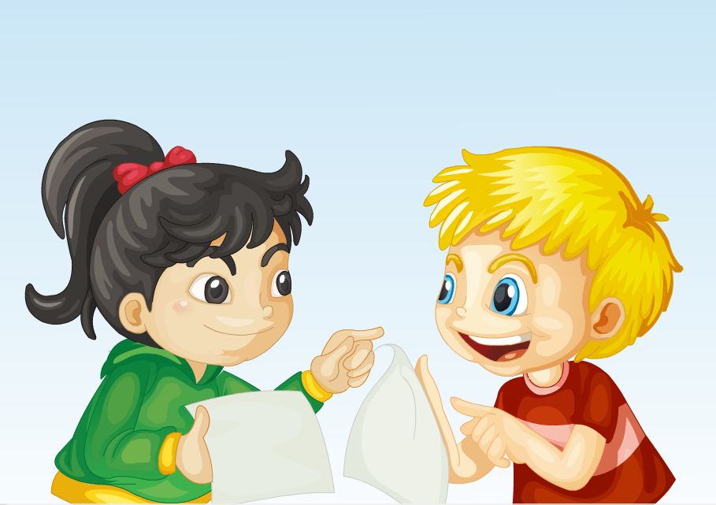
Practice
Let’s play
1
What’s your name?
2
My name’s Jim.
Which class are you in?
I’m in Class Two, Grade Four.
3
4

Slide 19
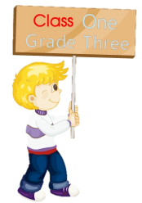
Summary
本课学习的重点单词有:
class
grade

Slide 20
Summary
如何询问某人在哪个班级和年级，并作相关回答？
—Which class are you in?
—I’m in Class ..., Grade …

Slide 21
Homework
1. 跟读Just talk部分的课文录音，并注意语音、语调。
2.运用本课所学句型“Which class are you in?”询问你的朋友，并把你们之间的对话记录下来。
3. 预习Lesson 8。
Close

