Slide 1
人教精通版三年级上册
Unit4 I have a ball.
WWW.PPT818.COM

Slide 2
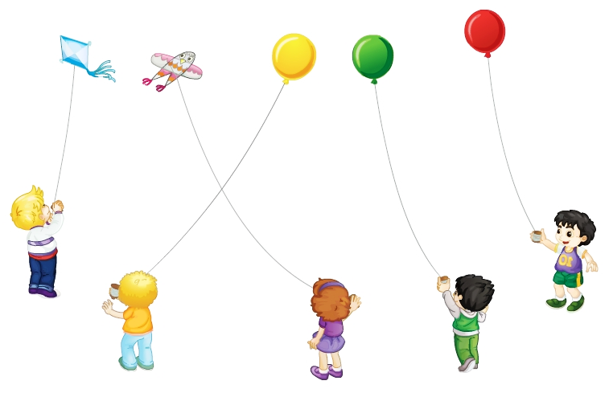
Review
Let’s chant
Fly, fly, fly my balloon.
Fly, fly, fly my kite.
Fly, fly, fly very high.
Up, up, up to the sky.

Slide 3
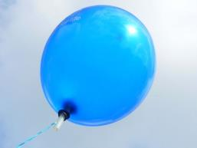
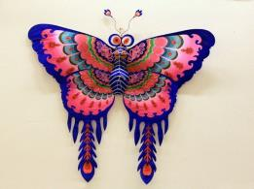
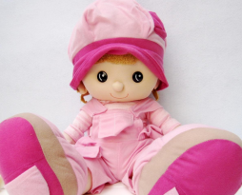
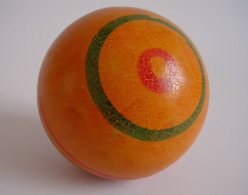
Review
Game
What’s missing?

Slide 4
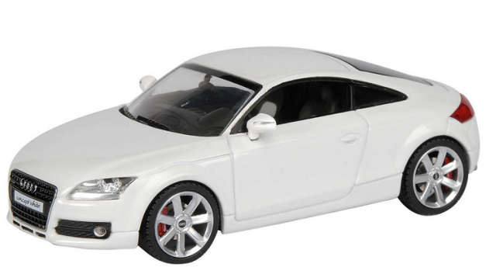
Presentation
Just learn
car

Slide 5
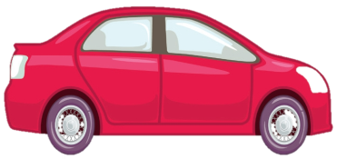
Presentation
I have a new bus.
Really?

Slide 6
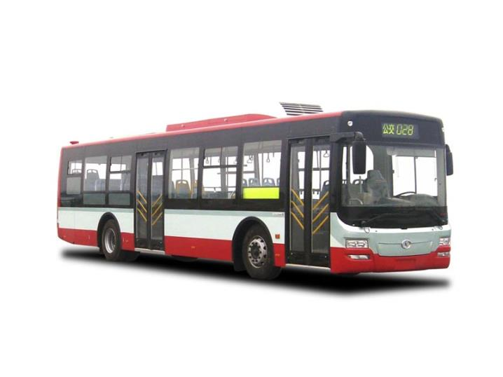
Presentation
Just learn
bus

Slide 7
Presentation
Wow! It’s super!
I have a bus.

Slide 8
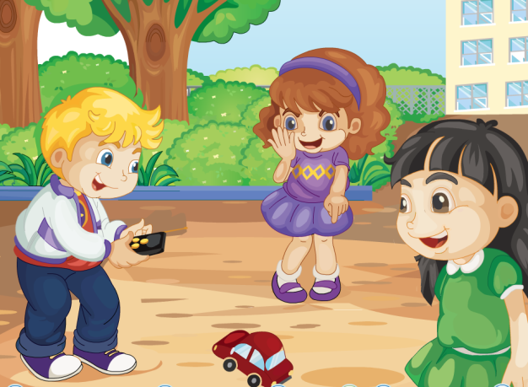
Presentation
Look and say
Look! What are they talking about?

Slide 9
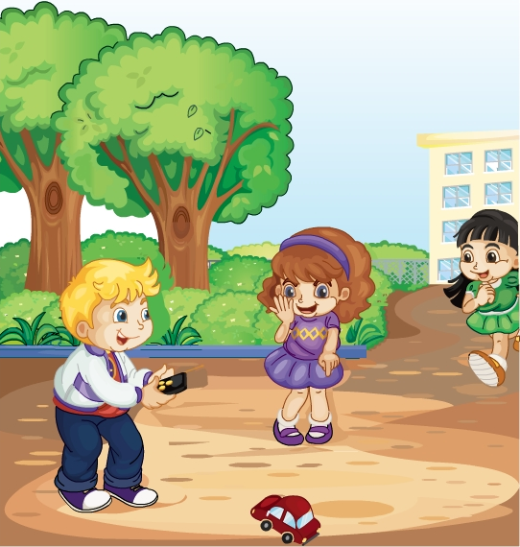
Presentation
Listen and imitate
Really?
Lisa, Lisa! I have a new car.
Wow! It’s super!
Yes. Look here!

Slide 10
Show time
两人一组，练习对话并表演，其他同学评价。
 | 模仿录音中的语音语调，有感情地朗读。
 | 可以脱离课本，适当改动其中部分，语音地道。
 | 适当添加内容，意思完整，有创新，表演生动。
Good
Great
Excellent

Slide 11
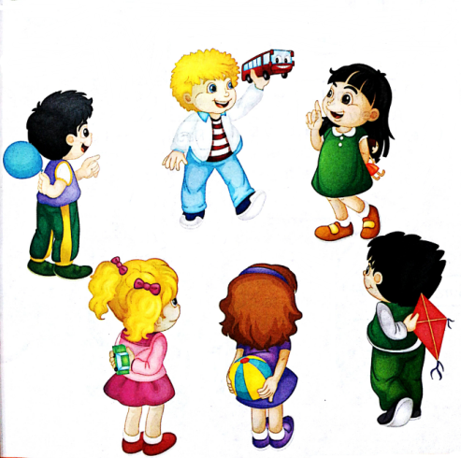
Practice
Let’s play
Look! I have a bus.
Wow! It’s super!
Cool!
Plane!

Slide 12
Practice
Chain game
活动时间：2分钟
活动内容：四人一小组，每人说一个句子，后者
要在前一名学生说的句子上增加一个
新词，看说得又多又准确。
S1: I have a new car.
S2: I have a new car and a bus.
S3: I have a new car, a bus and a doll.
S4: I have …

Slide 13
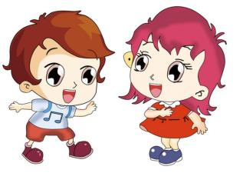
Make a conversation
A: I have …
B: Really?
A: Yes. Look here!
B: Wow! It’s super/nice/big/cool.

Slide 14
Consolidation
Look and say
Lisa, Lisa! I have a new ___.
_____?
Really
car
Wow! It’s ____!
super
Yes. Look here!

Slide 15
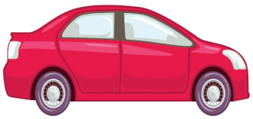
Summary
本课学习的单词有:
car
bus

Slide 16
Summary
如何介绍自己所拥有的物品呢？
I have (a/an) …

Slide 17
Homework
1.跟读Just talk部分的课文录音，并注意语音、语调。
2.制作本课单词卡片，并运用本课所学的句子给自己的家人介绍它们。
3.预习Lesson22。
Close

