Slide 1
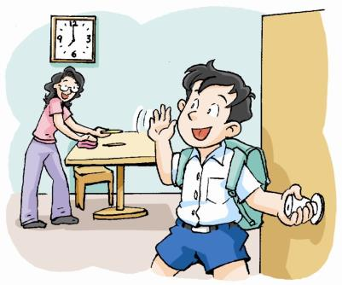
My day
第二课时
WWW.PPT818.COM

Slide 2



Let’s Chant
Up, up, I get up.
Teeth, teeth, I brush my teeth.
Face, face, I wash my face.
Breakfast, breakfast, I have breakfast.
School, school, I go to school.
Lunch, lunch, I have lunch.
Homework, homework, I do my homework.
Dinner, dinner, I have dinner.

Slide 3
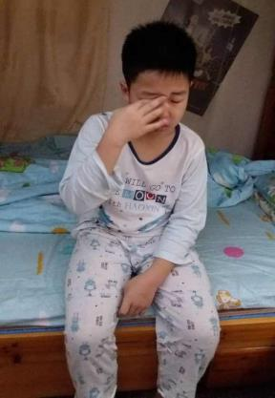
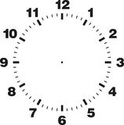
Look and say
What time does he get up?
He gets up at _________.
seven five

Slide 4
Look and say
past 过
five past…
ten past…
fifteen past…
twenty past…
twenty-five past…
thirty past…

Slide 5
Look and say
What time is it ?
It’s….
five past seven
ten past seven
twenty past seven

Slide 6

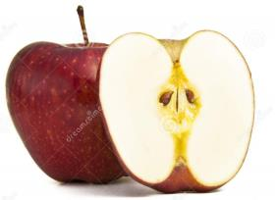
Look and say
a quarter
_____ past seven
____ past seven
half
A red apple big big,
A half for you and a half for me!
A red apple sweet sweet,
A half for you and a half for me!
fifteen minutes =
a quarter

Slide 7
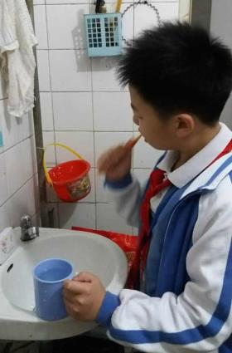
Look and say
What time does he brush his teeth?
He brushes his teeth at ______ past _____.
a quarter
seven

Slide 8
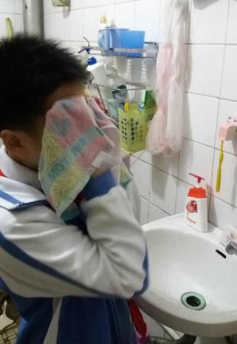
Look and say
a quarter past seven
He washes his face at __________, too.

Slide 9
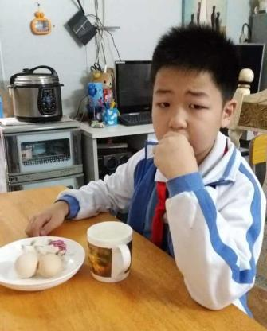
Look and say
What time does he have breakfast?
He has breakfast at ________________.
half past seven

Slide 10
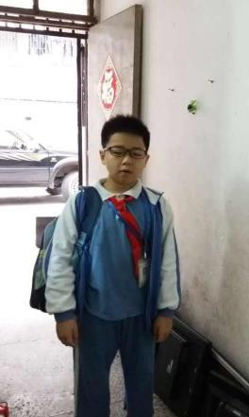
Look and say
What time does he go to school?
He goes to school at ________________.

Slide 11
a quarter
to + 下一个小时
a quarter to eight

Slide 12
Look and say
What time does he go to school?
He goes to school at ________________.
a quarter to eight

Slide 13
Look and say
five to eight
ten to eight
a quarter to eight
（差..分钟数） to 下一个小时

Slide 14
Look and say
a quarter to twelve
a quarter to six
five to six

Slide 15
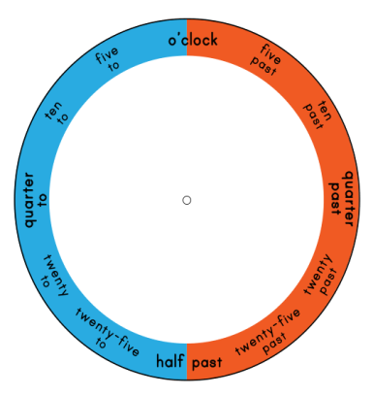
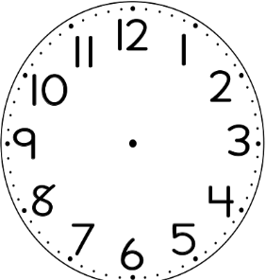
Play a game
a quarter past seven
half past twelve
a quarter to nine

Slide 16
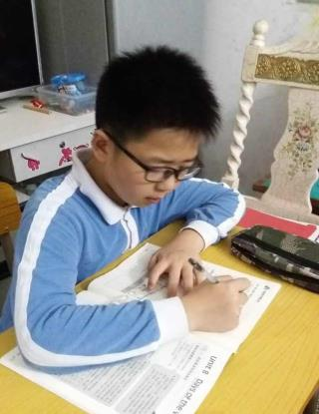
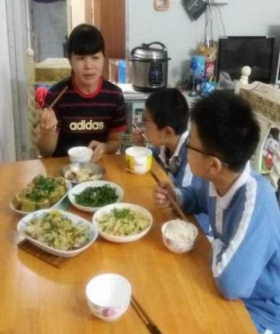
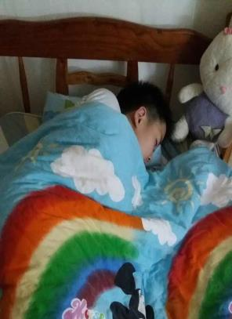
Discuss
What time does he…?
5:30
6:45
9:15
He does homework at __________.
half past five
He has dinner at ______________.
a quarter to seven
He goes to bed at _____________.
a quarter past nine

Slide 17

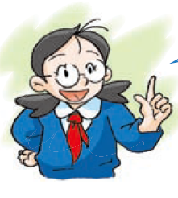
Kitty is a good student.
She has good habits (习惯).

Slide 18


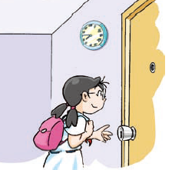

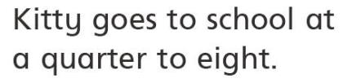
Look and read
at half past seven.

Slide 19
Make a dialogue
Look at your friends’ timetable and make a dialogue with your desk mate
S1: What time does he / she…?
S2: He / She…at….
He’s / She’s (early, clean…)
S1: What time does he / she…?
S2: He / She…at….
He’s / She’s (early, clean…)

Slide 20
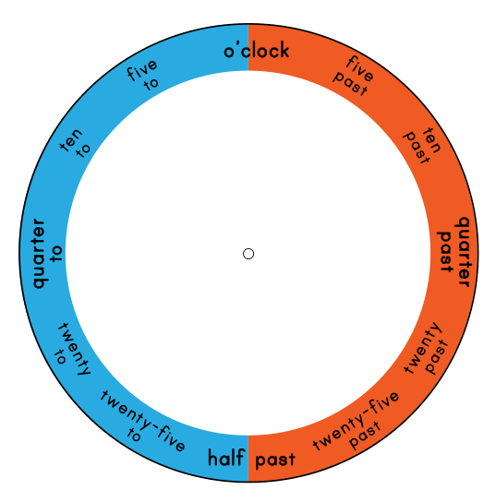
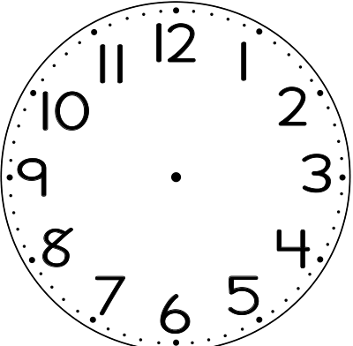
Summary
to
past

Slide 21
Summary
he she it 人名 the sun, the moon等第三人称单数
动词在什么情况下需要变第三人称单数+s或es？
以s, x, ch, sh结尾的动词变第三人称单数时，在词尾+es。如：
wash – washes
touch – touches
mix –mixes
guess – guesses
brushs
brush – brushes
×
wash – washes
washs
×

Slide 22
Summary
What time does she brushes her teeth?
She brushes her teeth at 7:15.

Slide 23

Homework
Read and recite “Listen and say”
on page 34.
2.问一问你同桌，他们的父母作息时间是怎样的？几点起床，几点吃早餐，几点出门上班（go to work）等，他们的习惯好吗？请相互评价一下。

