Slide 1
Unit6 Would you like to take a trip?
人教精通版四年级下册
WWW.PPT818.COM

Slide 2
Review
Let’s chant

Slide 3
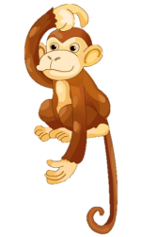
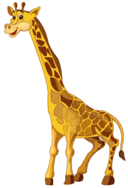
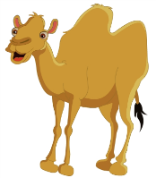
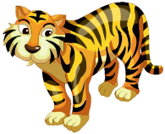
Review
Play a game
Game
What’s missing?

Slide 4
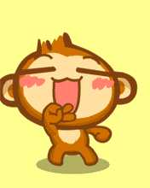
Presentation
Look and say
Look! What’s this in English?
It’s a monkey.

Slide 5
Presentation
Look and say
What’s the monkey doing?
It is dancing.

Slide 6
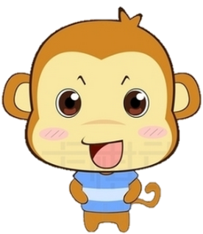
Presentation
Look and say
Hello! I have three friends. They are vey cute(可爱的). Do you want to know them?

Slide 7
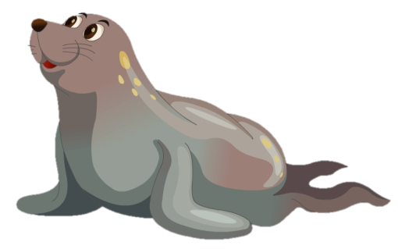
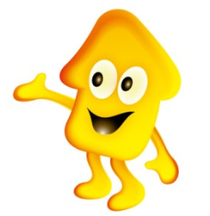
Presentation
Let’s learn
What’s that in English?
It’s a seal.

Slide 8
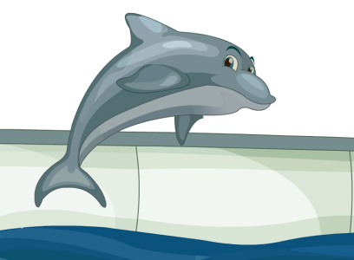
Presentation
Let’s learn
What’s that in English?
It’s a dolphin.

Slide 9
Presentation
Let’s learn
What’s that in English?
It’s a hippo.

Slide 10
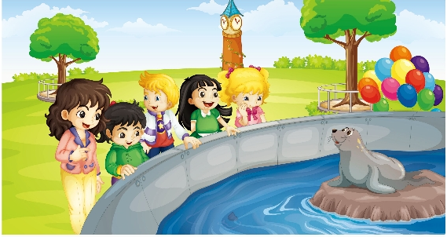
Presentation
Look and say
Where are they?
What are they looking at?

Slide 11
Presentation
Let’s learn
1
Look! What’s that in English?
2
It’s a seal.
Good!
3

Slide 12
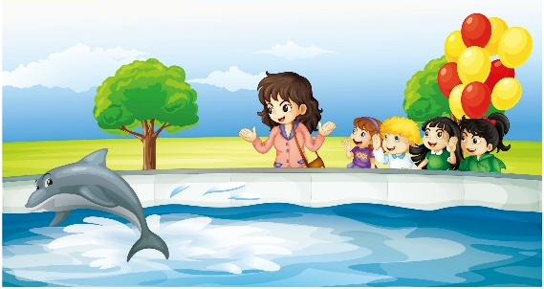
Presentation
Let’s learn
4
Guess, Lisa! What’s that in English?
5
It’s a dolphin.
Look! The dolphin is dancing!
Look! The dolphin is dancing!
Look! The dolphin is dancing!
6

Slide 13
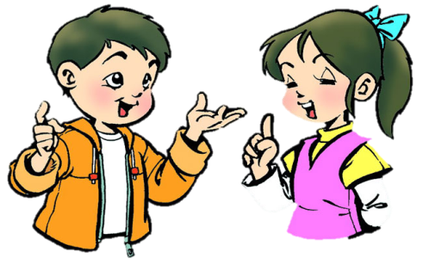
Practice
Role-play
分角色朗读对话，注意模仿语音语调。
小组合作，试着表演出来吧。

Slide 14
Practice
Read it by groups for one minute .
小组读对话一分钟。
一分钟倒计时
60
Learning tip :
50
10
10
四人一组，比赛读句子，看谁能在一分钟内读完，并且读得准确、流利！
20
20
40
30
30
开始

Slide 15
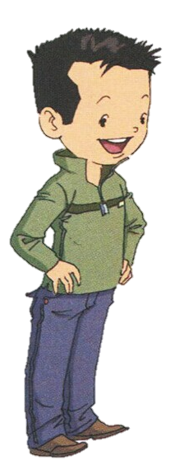
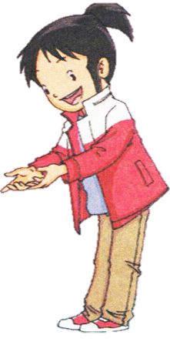
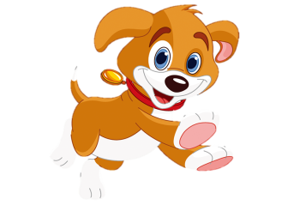
Presentation
What’s that in English?
It’s a dog.

Slide 16
Presentation
Look at the dog!
The dog is running.

Slide 17
Presentation
What’s that in English?
It’s a cat.

Slide 18
Presentation
Look at the cat!
The cat is singing.

Slide 19
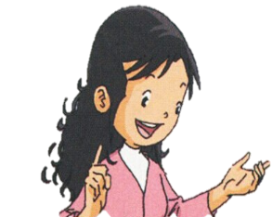
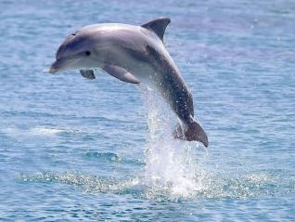
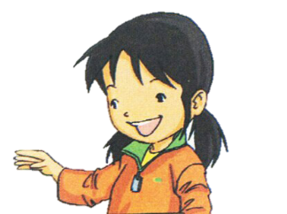
Practice
Look and say
What’s that in English?
It’s a dolphin.

Slide 20
Practice
Look and say
Look at the dolphin. What’s it doing?
It’s swimming.

Slide 21
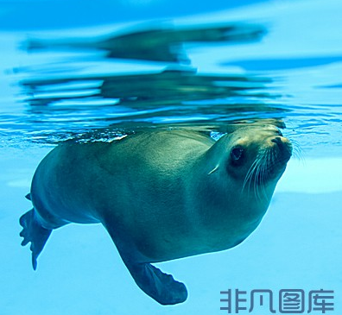
Practice
Look and write
A: What’s that in English?
B: _________.
A: Look! The seal is ________.
B: Wow, great!
It’s a seal
swimming

Slide 22
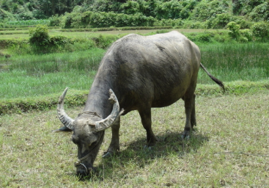
Practice
Look and write
A: What’s that in English?
B: __________.
A: Look! The hippo is ______.
B: Yes.
It’s a hippo
eating

Slide 23
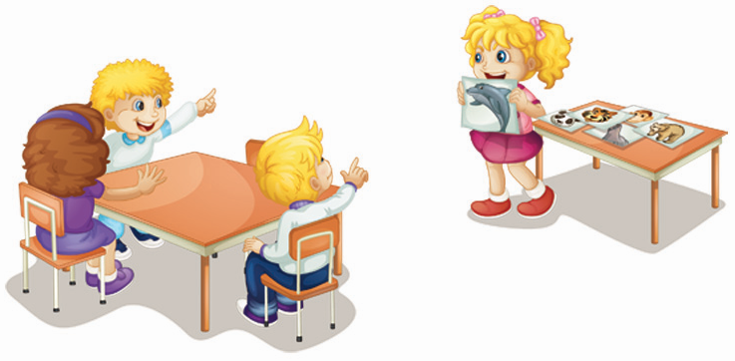
Practice
Let’s play
What’s that in English?
It’s a dolphin.

Slide 24
Summary
本课学到的重点单词：
seal
dolphin
hippo
dog
cat

Slide 25
Summary
本课学到的重点句型：
—What’s that in English?
—It’s a/an …

Slide 26
Homework
1. 跟读课文Just talk部分的录音，注意语音、语调。
2. 观察生活中的小动物，绘制成一张动物乐园的海报，并附上它们的英文名字。
3. 预习Lesson 34。
Close

