Slide 1
七年级英语（JJ下）教学课件
Li Ming's Summer Holiday
WWW.PPT818.COM

Slide 2
Learning targets
➢Key words & phrases:
organize, camp, share, fish at the lake, do well in,
summer camp, at the same time, write down,
share... with
➢Key sentences:
1. Our school organized a special two­week summer
camp.
2. I will experience a new life in another part of
China.
3. I am going to write down all of my experiences
and share them with you.

Slide 3
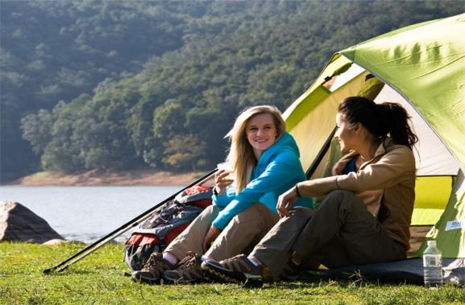
Lead in
What will you do for the summer holiday?
Will you go camping ?

Slide 4
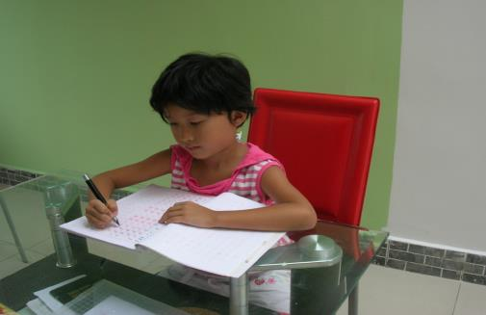
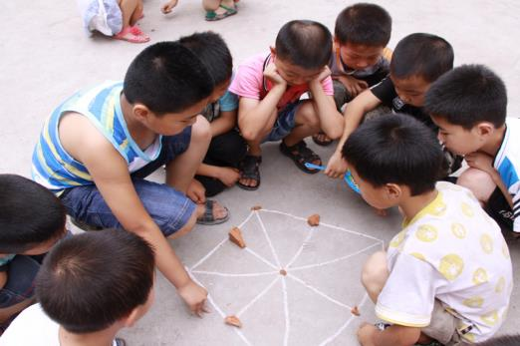
do homework
play games
with friends

Slide 5
Words and expression
organize
camp
share
fish at the lake
do well in
summer camp
at the same time
take part in
write down
share...with...
组织
露营；营地
分享；合用
在湖边钓鱼
在…...方面做得好
夏令营
与此同时
参加
写下
与……分享……

Slide 6
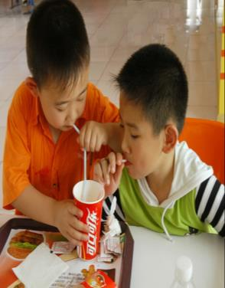
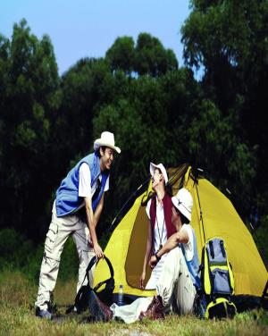
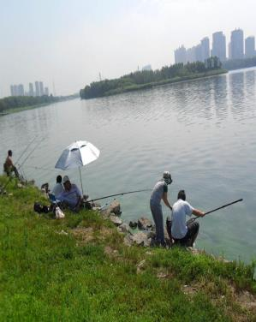
share with
friend
summer camp
fish at the
lake

Slide 7
Presentation
Hi Jenny,
Walk in the forest! Fish at the lake! Listen to the birds! You are so lucky!
Yes, another school year is over! I did well in my exams, too. Our school organized a special two-week summer camp. I am going to the countryside.

Slide 8
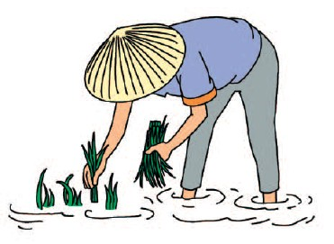
I will stay with a family in their home. At the same time, a kid from the countryside will come and live in my home. During the two weeks, we are going to take part in many activities. I will experience a new life in another part of China. I am going to write down all of my experiences and share them with you. It will be fun. I am really looking forward to it!
Enjoy your summer!
Your friend,
Li Ming

Slide 9
Let’s Do It!
1. Read the lesson and write true (T) or false (F).
1. Li Ming did not do well in his exams. ( )
F
2. Li Ming is going to visit his grandparents in
the countryside. ( )
F
3. Jenny is going to stay at Li Ming’s home
during the summer holiday. ( )
F
4. Li Ming will stay in the countryside for
fourteen days. ( )
T
5. Li Ming is going to write down all of his
experiences. ( )
T

Slide 10
2. Listen to the passage and tick the correct
answers.
1. Bob lives in _______.
□Beijing □New York □Shanghai
2. Bob is a _______.
□policeman □doctor □nurse
3. Bob is going to visit _______.
□Hong Kong □Beijing □Xi’an
4. Bob is going to _______ during his holiday.
□go bike riding □go shopping □go swimming





Slide 11
3. What are you going to do? Answer the
questions using “will” or “be going to”.
Will you study at the library this afternoon?
No, I won’t. I have English class this afternoon.
2. Are you going to take a walk after dinner?
________________________________________
3. Will you cook for the family this evening?
_________________________________________
__________
No, I’m not. I’m going to stay at home after dinner.
No, I won’t. My mother will cool for the family
this evening.

Slide 12
4. Are you going to visit your grandparents this weekend?
_________________________________________
5. Will you fish at the lake?
________________________________________
6. Will you go to the countryside this summer?
__________________________________________
No, I’ m not. I’m going to visit my aunt this weekend.
No, I won’t. I will fish by the river.
No, I won’t. I will go to the Great Wall this summer.

Slide 13
Work in groups
4. Work in pairs. Suppose you will go on your
dream summer holiday. Write about it.
Task tips:
Where will you go?
How will you get there?
Who will you go with?
What will you do there?
How long will you stay there?

Slide 14
Language points
1. Our school organized a special two­week summer
camp.
（1）organize 作动词，意为“组织，安排”。
例：We will organize a speech contest. 我们将组织一
次演讲比赛。
【拓展】organized adj. 有组织的；
organization n．组织，机构，系统。
如：a very organized person 做事很有条理的人

Slide 15
(2) two­week summer camp为期两周的夏令营。数词与名词用连字符连接时，相当于形容词，注意此时的名词须用单数形式。
例：We will have a seven­day holiday. 我们将有一个为期七天的假期。
学以致用
In this exam，you're asked to write a ____ composition.
A. 90­words B. 90­word
C. 90 words D. 90 word's

Slide 16
2. I will experience a new life in another part of China.
experience 在本句中为动词，意为“体验”。
例：Did you experience an earthquake？
你经历过地震吗？
【拓展】experience 还可以作名词，表示“经历”时，为可数名词；表示“经验”时，是不可数名词。
例：He is an old teacher with much experience. 他是一位很有经验的老教师。
He has so many experiences during the trip.
他在旅行途中有如此多的经历。

Slide 17
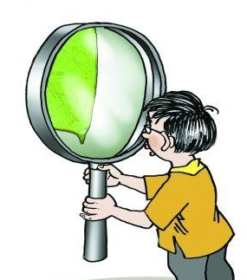
中考链接
—I don't know how to use the App Fun Dubbing.
—Ask Jimmy for help. He has lots of in doing
it.（2018福建A卷）
A. experience
B. trouble
C. courage

Slide 18
3. I am going to write down all of my experiences and
share them with you.
share 是动词，意为“分享，合用”。常用短语：
share... with... 与……分享……
例：The six students share one dormitory.
这六名学生合住一间寝室。
Don't be too selfish, Jenny! You should share this cake
with your sister.
珍妮，别太自私！你应该和你的妹妹分享这块蛋糕。

Slide 19
中考链接
根据句意及所给单词的首字母写出所缺单词。
The kind boy was happy to s his food with the hungry man.（2018福建A卷）
—Would you like to share your study experience _____
me?
— Sure. It's my pleasure.
A. of B. with C. to D. for
答案 share
学以致用

Slide 20
一般将来时的用法
1、表示将来某一时刻的动作或状态：
例：We will come to see you the day after tomorrow.
There will be a wonderful show next week.
2、表示将来某一段时间内经常发生的动作或状态：
例：The students will come and work in the lab once
a week.
We will come and work in this factory every year.

Slide 21
我们除了用“be going to＋动词原形”表示一般将来时外，还可以用“will＋动词原形”结构。
will 引导的一般将来时:表示将来发生的动作或存在的状态，最基本的结构：will + 动词原形
肯定句：主语+ will +动词原形+（宾语）+其他.
例：Some day people will go to the moon.
否定句：在will 的后面加not。will not 缩写为won’t。
例：They won’t use books.
一般疑问句：把will 提到句子主语之前，结尾用问号。
例：Will students go to school in the future?
特殊疑问句：特殊疑问词+will +主语+动词原形+其他？
例：What will you do in the future?

Slide 22
一般将来时两种基本句式的区别
在初中阶段，“be going to+动词原形”和“will+动词原形”这两种表示将来时态的结构不作过多的区分。但在现代英语中，特别是在口语中，表示将来时多用“be going to+动词原形”这一形式。“be going to+动词原形”表示一个事先考虑好的意图，相当于“打算、计划、准备”，而will则表示未经事先考虑的意图。例：There is going to be a meeting in the hall.
She will be eighteen next year.

Slide 23
Exercises
一、单项选择。
1. We have a club. Please____ it .
A. join B. join in C. take part in D. take part
2.The winter holiday is coming, We’ll have a ______
holiday.
A. four-week’s B. four week’s
C. four-week D. four weeks

Slide 24
3. I really look forward to_____ Hong Kong.
A. visited B. visiting C. visits D. visit
4. We are going to share our _______ on learning
foreign languages with you.
A. experience B. experiences C. the experience
5. Take out your notebooks. Please_______ what I tell
you.
A. write it down B. write down
C. write down it D. will write it down

Slide 25
6. Look at those clouds. I'm afraid it _____ soon.
A. is going to rain B. is raining
C. will not rain D. does rain
7. He _______ in his garden every morning next year.
A. will work B. works
C. worked D. is working
8. They _______ a basketball match next Sunday.
A. watch B. will watch
C. watched D. are watching

Slide 26
二、根据汉语意思完成句子。
1. 他设立一个组织，专门帮助贫穷的人。
He set up an to help the poor.
organization
2. 我想参加夏令营活动。
take part in
I want to the Summer Camp.
3. 我们常常同甘共苦。
We always happiness and sadness with each other.
share
4. 将来每个人都有一台计算机。
Everyone will have a computer in the future
.

Slide 27
Summary
1. Words and phrases: organize, camp, share,
fish at the lake, do well in, summer camp,
at the same time, write down, share...with
2. Sentences：
(1) Our school organized a special two­week summer
camp.
(2) I will experience a new life in another part of
China.
(3) I am going to write down all of my experiences
and share them with you.

Slide 28
Homework
1. Read and recite the words in this unit.
Read the texts from Lesson 43 to
Lesson 48 carefully.
2. Try to plan your summer holiday and
write it down.

