Slide 1
Unit6 Lesson 1
My father has short hair.
WWW.PPT818.COM

Slide 2
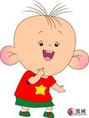
Head head I have big head
Eyes eyes I have small eyes
Ears ears I have big ears.

Slide 3
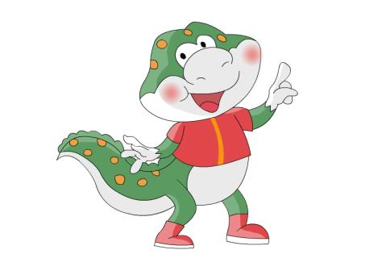
He has big head.

Slide 4
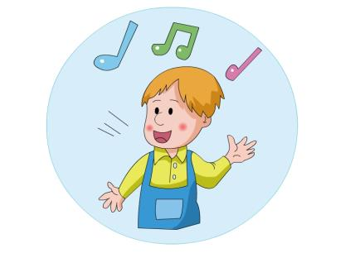
猜一猜
Is that…?

Slide 5
Listen and answer
What is Tom’s mother like?
(Tom的爸爸是什么样子？)

Slide 6
Listen and answer
2、What’s Tom’s mother like?
Tom的妈妈是什么样子？
She has long hair.

Slide 7
Listen and answer
What’s Tom’s father like?
(Tom的爸爸是什么样子？)

Slide 8
Listen and answer
What’s Tom’s father like?
(Tom的爸爸是什么样子？)
He is _______ and ________.
He has_________
tall
strong
short hair

Slide 9
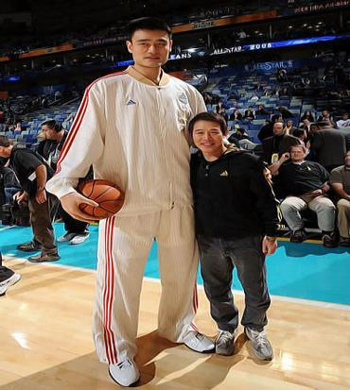
b
t
all
tall
short

Slide 10
Listen and circle the new words:

Slide 11
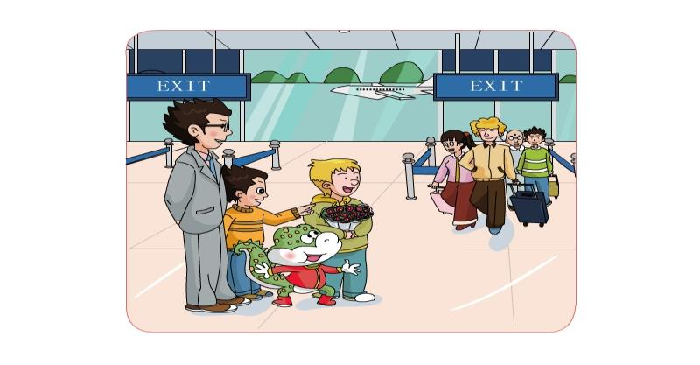
Is that your
father?
No. My father is
_____and______.
tall
strong

Slide 12
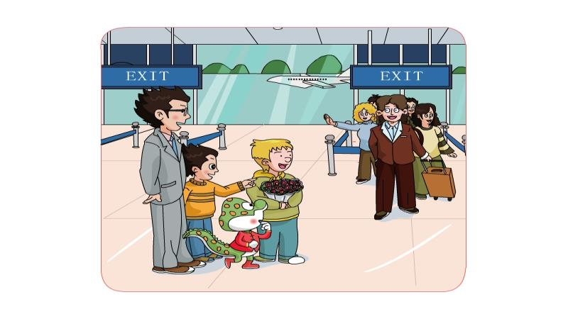
Is that your
father?
No. My father has ______ hair.
short

Slide 13
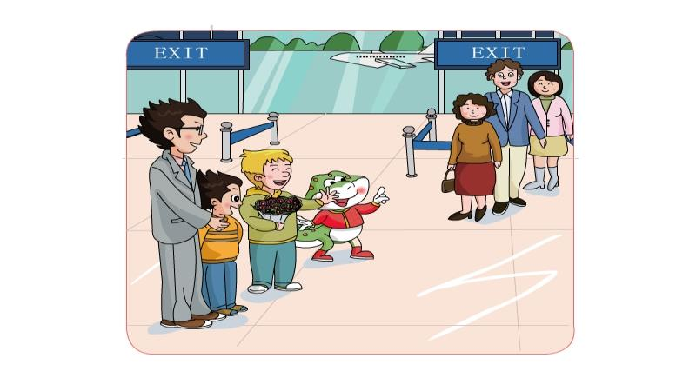
Is that your mother?
No. My mother has _____ hair.
long

Slide 14
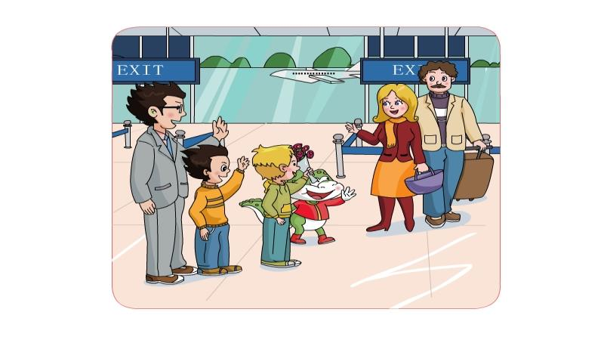
Look!
My ______
are coming
parents

Slide 15
Let's chant.
Is that your father?
No No
My father is tall.
My father is strong
Is that your mother?.
No No
My mother has long hair.

Slide 16
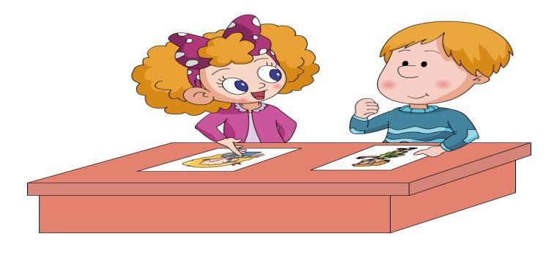
Let’s talk
This is my brother.
He’s tall. He has big eyes.
Look! This is my sister.
She has long hair.

Slide 17
Group work
He is\She is ______.
He\She has ______.
He\She likes__________.

Slide 18
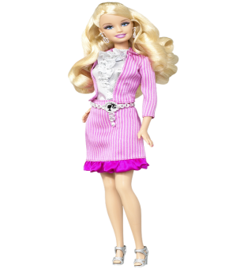
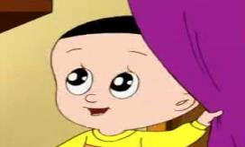
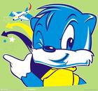
芭比

Slide 21
芭比

Slide 23
芭比
I like _____.
He\she has ____.

Slide 24
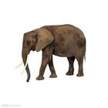
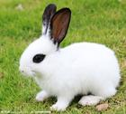
It’s an animal. It’s big and strong.
It has four legs. It has two big ears. It has long nose.
What is it? Guess.
你能猜到吗？
It’s an animal. It’s small.
It has two long ears. It has two red eyes.
And it’s has a short tail.
What is it? Guess.

Slide 25
Homework：
1、 Listen to the tape and read after the tape
2、用今天所学的句型向你爸爸妈妈描述你的朋友。

