Slide 1

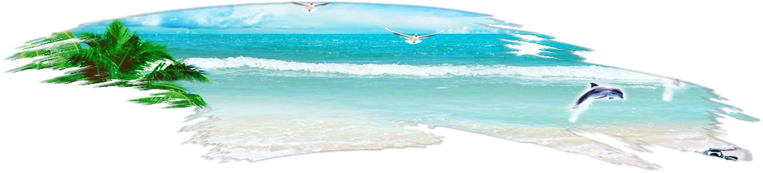

海边
Travel the world
Share the happiness
印象
畅游世界 分享快乐

Slide 2

目
录
01.
Don't let your ego get too close to your position, so that if your position gets shot down, your ego doesn't go with it. Create Simple & Creative Slide Presentation With Us.
02.
Don't let your ego get too close to your position, so that if your position gets shot down, your ego doesn't go with it. Create Simple & Creative Slide Presentation With Us.
03.
Don't let your ego get too close to your position, so that if your position gets shot down, your ego doesn't go with it. Create Simple & Creative Slide Presentation With Us.

Slide 3
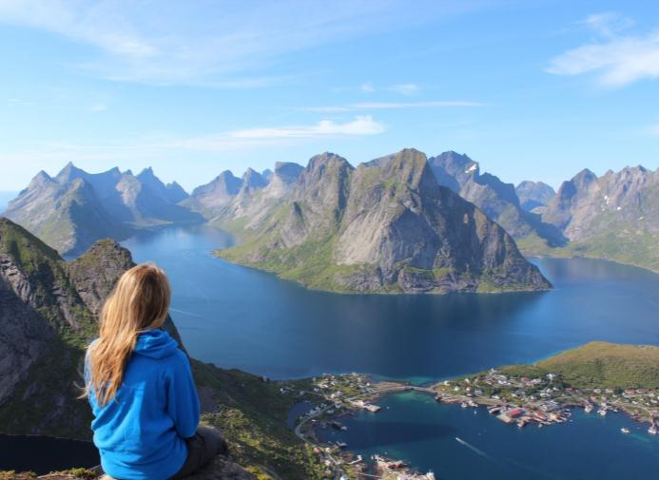
此处添加标题
Consetetur sadipscing elitr, sed diam nonumy eirmod tempor invidunt ut labore.
Being good in business is the most fascinating kind of art. Making money is art and working is art and good business is the best art.
Consetetur sadipscing elitr, sed diam nonumy eirmod tempor invidunt ut labore et dolore magna aliquyam erat tempor invidunt ut labore .
此处添加标题
FRONT-END DEVELOPER

Slide 4

此处添加标题
Consetetur sadipscing elitr, sed diam nonumy eirmod tempor invidunt ut labore.
Being good in business is the most fascinating kind of art. Making money is art and working is art and good business is the best art. Consetetur sadipscing elitr, sed diam nonumy eirmod tempor invidunt ut labore et dolore magna aliquyam erat.
此处添加标题

Slide 5
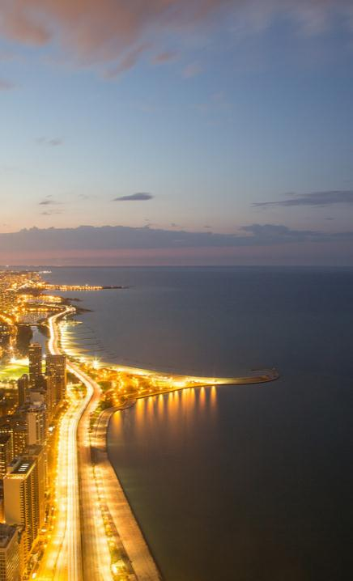

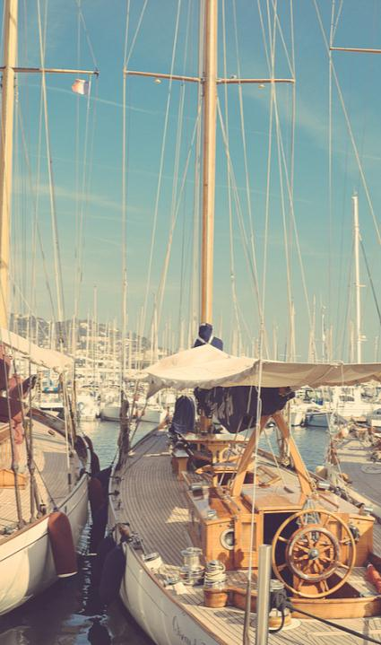
MBAH
SURADAL
BARIDHIK
MANJA
CAH
JOXZIN
JAVASCRIPT EXPERT
FRONT-END DEVELOPER
SOFTWARE ENGINEER

Slide 6
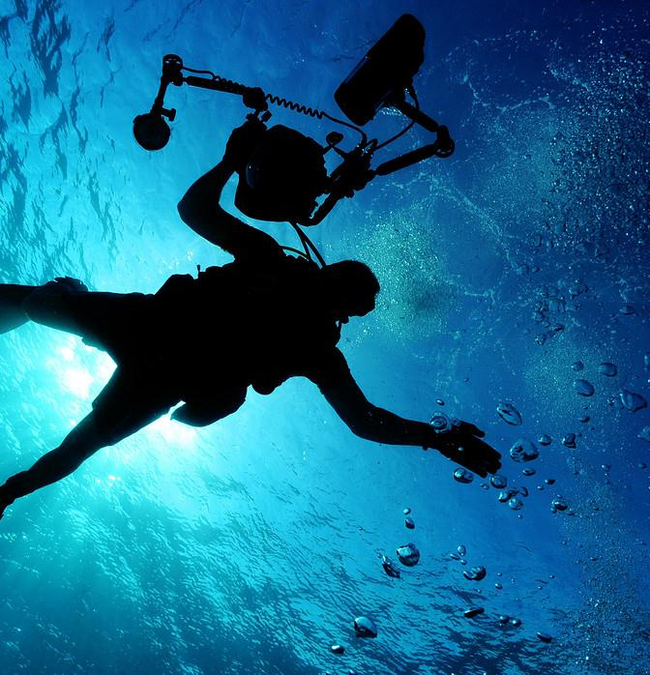
此处添加标题
Don't let your ego get too close to your position.
Don't let your ego get too close to your position, so that if your position gets shot down, your ego doesn't go with it.
Don't let your ego get too close to your position, so that if your position gets shot down, your ego doesn't go with it. Create Simple & Creative Slide Presentation With Us. Don't let your .

Slide 7



此处添加标题
Create Simple & Creative Slide Presentation With Us

Slide 8

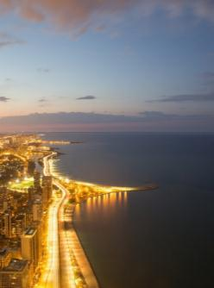

此处添加标题
Create Simple & Creative Slide Presentation With Us

Slide 9

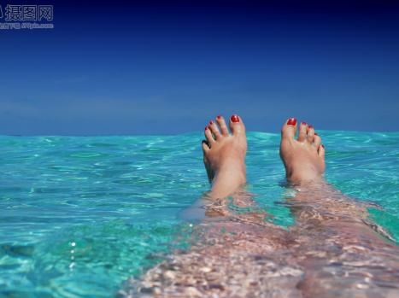


此处添加标题
Create Simple & Creative Slide Presentation With Us

Slide 10

此处添加标题
Don't let your ego get too close to your position.
Don't let your ego get too close to your position, so that if your position gets shot down, your ego doesn't go with it. Create Simple & Creative Slide Presentation With Us. Don't let your .

Slide 11


此处添加标题
Create Simple & Creative Slide Presentation With Us

Slide 12
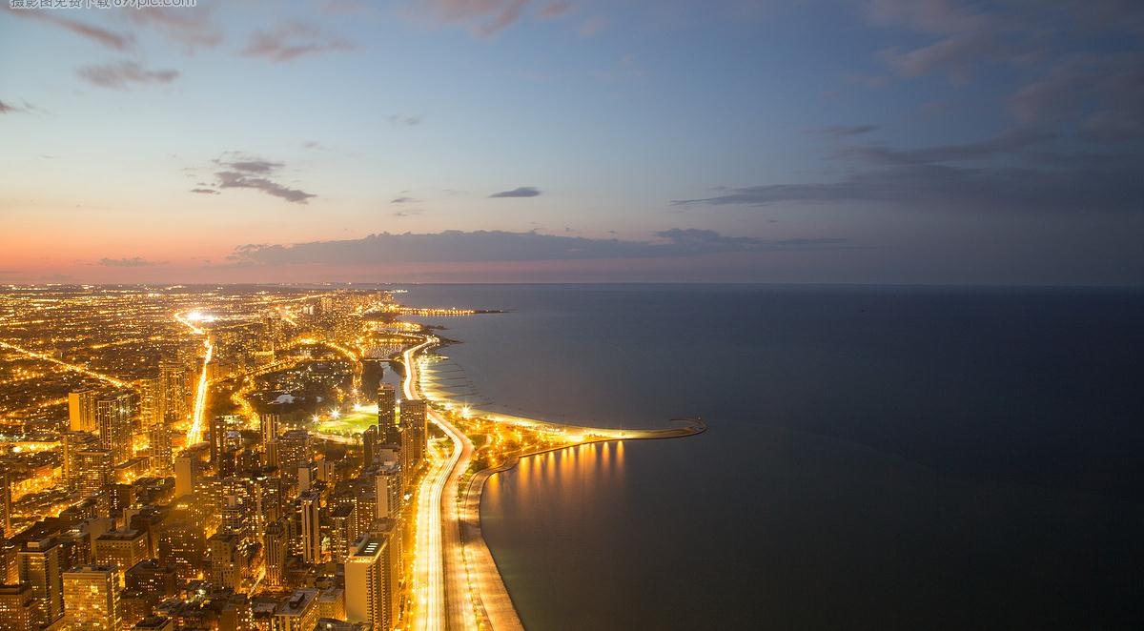
此处添加标题
Create Simple & Creative Slide Presentation With Us

Slide 13



此处添加标题
Simple & Creative Slide Presentation
THE ARCHIE.
Don't let your ego get too close to your position, so that if your position gets shot down, your ego doesn't go with it.
Create Simple & Creative Slide Presentation With Us. Don't let your ego get too close to your position, so that if your position gets shot down, your ego doesn't go with it.

Slide 14
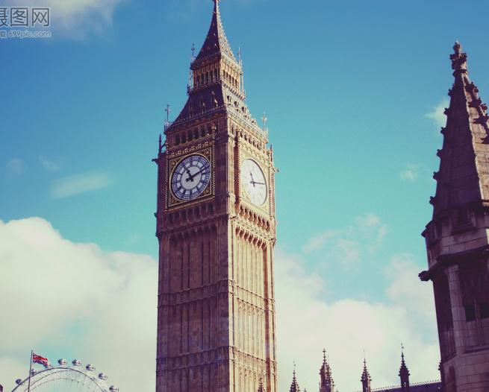
此处添加标题
Don't let your ego get too close to your position.
Don't let your ego get too close to your position, so that if your position gets shot down, your ego doesn't go with it.
Don't let your ego get too close to your position, so that if your position gets shot down, your ego doesn't go with it. Create Simple & Creative Slide Presentation With Us. Don't let your .

Slide 15




此处添加标题

Slide 16


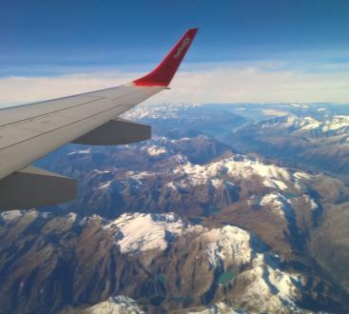
THE ARCHIE.
Don't let your ego get too close to your position, so that if your position gets shot down, your ego doesn't go with it. Create Simple & Creative Slide Presentation With Us. Don't let your ego get too close to your position, so that if your position gets shot down, your ego doesn't go with it.

Slide 17
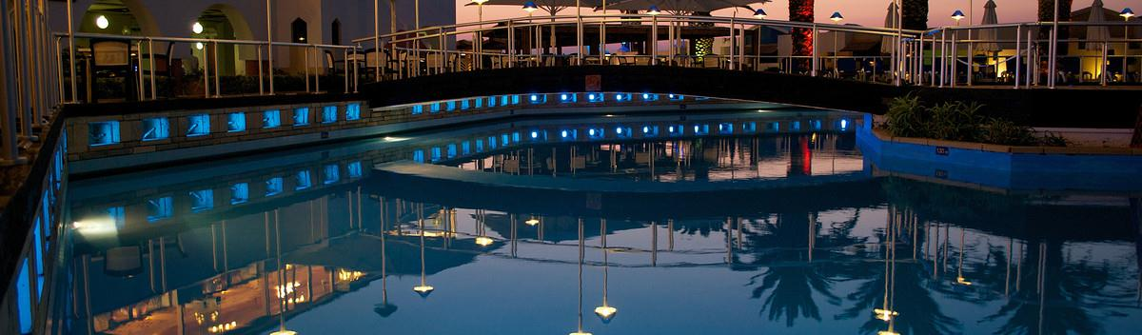
Don't let your ego get too close to your position.
Don't let your ego get too close to your position, so that if your position gets shot down, your ego doesn't go with it. Create Simple & Creative Slide Presentation With Us. Don't let your ego get.
此处添加标题

Slide 18

01.
02.
03.
Don't let your ego get too close to your position, so that if your position gets shot down, your ego doesn't go with it.
Being good in business is the most fascinating kind of art. Making money is art and working is art and good business is the best art.
Being good in business is the most fascinating kind of art. Making money is art and working is art and good business is the best art.
此处添加标题

Slide 19
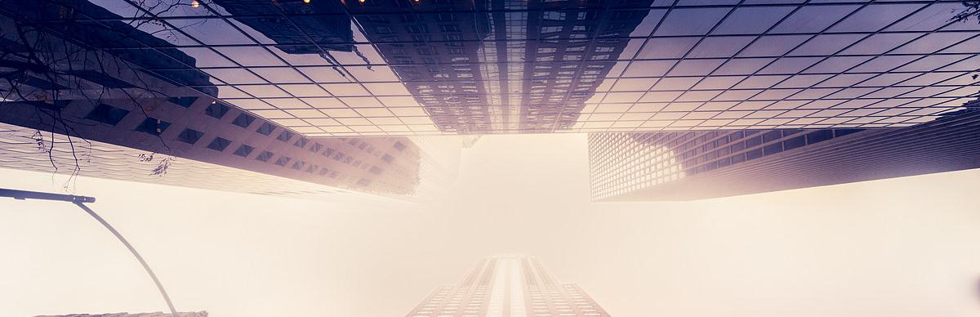
01.
02.
Don't let your ego get too close to your position, so that if your position gets shot down, your ego doesn't go with it.
Being good in business is the most fascinating kind of art. Making money is art and working is art and good business is the best art.
Don't let your ego get too close to your position, so that if your position gets shot down, your ego doesn't go with it. Create Simple & Creative Slide Presentation With Us. Don't let your ego get too close to your position. Don't let your ego get too close to your position, so that if your position gets shot down, your ego doesn't go with it. Create Simple & Creative Slide Presentation With Us. Don't let your .

Slide 20
添加标题
Being good in business is the most fascinating kind of art. Making money is art and working is art and good business is the best art. Consetetur sadipscing elitr, sed diam nonumy eirmod tempor invidunt ut labore et dolore magna aliquyam erat.
First Step
Fourth Step
Sit amet, consetetur sadipscing elitr, sed diam tempor invidunt. At vero eos.
Sit amet, consetetur sadipscing elitr, sed diam tempor invidunt. At vero eos.
Second Step
Fifth Step
Sit amet, consetetur sadipscing elitr, sed diam tempor invidunt. At vero eos et accusam.
Sit amet, consetetur sadipscing elitr, sed diam tempor invidunt. At vero eos et accusam.
Third Step
Sixth Step
Sit amet, consetetur sadipscing elitr, sed diam tempor invidunt. At vero eos et.
Sit amet, consetetur sadipscing elitr, sed diam tempor invidunt. At vero eos et.

Slide 21
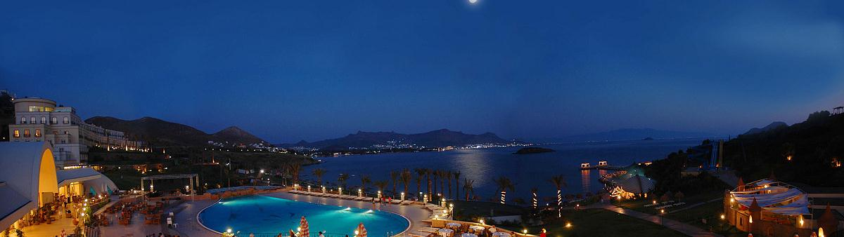
01.
02.
ARCHIE
SLIDES.
Don't let your ego get too close to your position, so that if your position gets shot down, your ego doesn't go with it.
Being good in business is the most fascinating kind of art. Making money is art and working is art and good business is the best art.

Slide 22
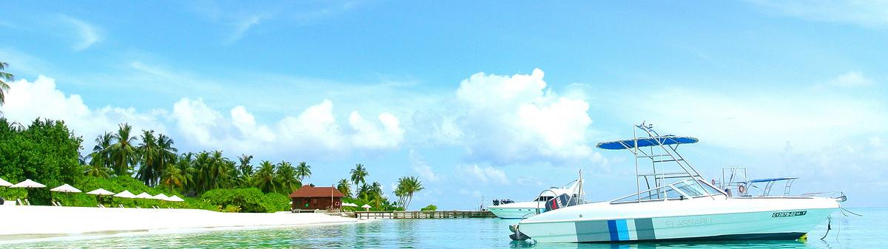
此处添加标题
Don't let your ego get too close to your position, so that if your position gets shot down
Don't let your ego get too close to your position, so that if your position gets shot down, your ego doesn't go with it. Create Simple & Creative Slide Presentation With Us. Don't let your ego get too close to your position. Don't let your ego get too close to your position, so that if your position gets shot down, your ego doesn't go with it. Create Simple & Creative Slide Presentation With Us. Don't let your .

Slide 23

此处添加标题
Don't let your ego get too close to your position.
Don't let your ego get too close to your position, so that if your position gets shot down, your ego doesn't go with it.
Don't let your ego get too close to your position, so that if your position gets shot down, your ego doesn't go with it. Create Simple & Creative Slide Presentation With Us. Don't let your .

Slide 24
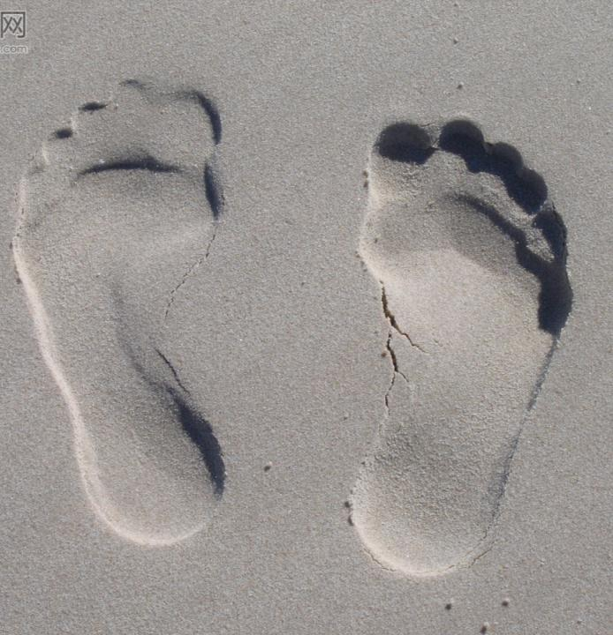
此处添加标题
WORK
Vel illum dolore eu feugiat nulla facilisis at vero eros et accumsan et iusto odio.
PROFIT
Ut wisi enim ad minim veniam, quis nostrud exerci tation ullamcorper.
VISION
Don't let your ego get too close to your position, so that if your position gets.

Slide 25

此处添加标题
PHOTOS
WORK
Vel illum dolore eu feugiat nulla facilisis at vero eros et accumsan et iusto odio.
Vel illum dolore eu feugiat nulla facilisis at vero eros et accumsan et iusto odio.
TALK
PROFIT
Ut wisi enim ad minim veniam, quis nostrud exerci tation ullamcorper.
Ut wisi enim ad minim veniam, quis nostrud exerci tation ullamcorper.

Slide 26

谢谢收看
Leadership is a potent combination of strategy and character. But if you must be without one, be without the strategy.

