Slide 1
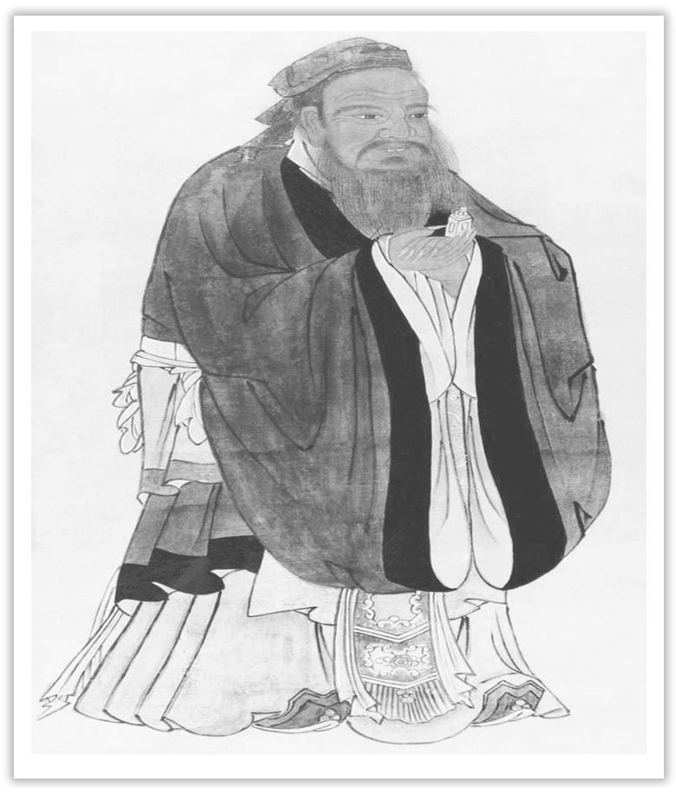
Unit 4 History and Traditions
Section Ⅷ Assessing Your Progress
WWW.PPT818.COM

Slide 2
Ⅰ.单句语法填空
1.Modern science has given clear evidence that smoking can lead ____________ many diseases.
2.The physics problem remained ____________ (confuse) to the boy although explained over and over.
3.Six days later, the police arrested him and charged him ____________ murder.
4.I’ll ask the teacher about the attributive clause.I’m very ____________ (puzzle) about it.
to
confusing
with
puzzled

Slide 3
5.The new policy will encourage more people to speak to the media and break away ____________ the traditions of “Silence is golden”.
6.The rolling green hill is dotted ____________ a variety of flowers.
7.The purse was given back to the passenger when she proved that it belongs ____________ her.
8.Could you please buy me an MP5 as well ____________ a digital camera, Dad?
9.Some think that students should be trained ____________ defence of some attacks.
10.Since the family often have quarrels with each other, the living ____________ (surround) is becoming worse and worse.
from
with
to
as
in
surroundings

Slide 4
Ⅱ.补全句子
1.____________________________________ in space are surprising and pleasing.
我们中国人在太空所取得的成就令人惊喜。
2.It is widely believed that ______________________________________ along with the rapid economic development.
许多人认为随着经济的发展自行车可能会消失。
3.______________________________ that day was that she found her lost necklace.
那天让她感到高兴的是找到了丢失的项链。
The achievements we Chinese have made
the bicycle is likely to die out
What made her happy

Slide 5
4.They have already _____________________________ the new edition of the dictionary.
他们已经在新版本的词典中增加了一些日常用语。
5._____________________________________ it can prove his innocence.
很明显，这可以证明他是清白的。
had some everyday words added to
It’s evident that

Slide 6
Ⅲ.按要求做题
(一)用过去分词作定语改写句子
1.The girl is dressed in red.The girl is my friend.
→__________________________________________________________________
2.The time is lost.The time can never be found again.
→__________________________________________________________________
3.This is the soldier who has been wounded in the battle.
→__________________________________________________________________
The girl dressed in red is my friend.
The time lost can never be found again.
This is the soldier wounded in the battle.

Slide 7
(二)用过去分词作宾语补足语改写加黑部分
1.After the hurricane, I saw the roofs of houses had been blown off.
→After the hurricane, ____________________________________________.
2.Though I’ve learnt English for years, I still can’t make people understand me quite well.
→Though I’ve learnt English for years, ______________________________________.
I saw the roofs of houses blown off
I still can’t make myself understood quite well

Slide 8
3.I’ll just wash the dishes and then I’ll come.
→___________________________________________________ and then I’ll come.
4.I won’t hear anyone say anything against him behind his back.
→________________________________________________ behind his back.
I’ll just get/have the dishes washed
I won’t hear anything said against him

