Slide 1
What can we do at home to protect the environment?
Unit 2 Topic 3
Section C
WWW.PPT818.COM

Slide 2
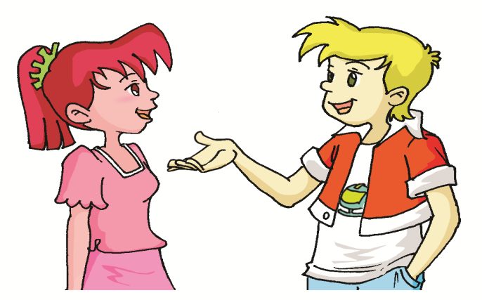
Are you a greener person?

Slide 3
How can we become a greener person?
Turn off the lights when we leave a room.
Walk or ride a bike instead of taking a bus or a taxi.
Take a cloth bag when we go shopping.
Don’t drive a car if you travel a short distance.
Write on both sides of the paper.
Don’t use the things that can be used only once.
After we wash faces, we can use the water to wash clothes.
Turn off the TV set while we are away.
…

Slide 4
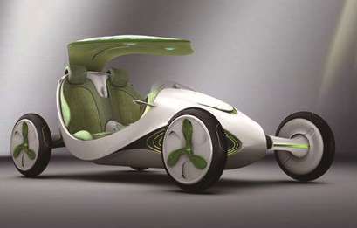
Do you know them?
It’s an electric car. It works well, but it’s slow and can’t run for long.
electric (adj.) — electricity (n.)

Slide 5
Do you know it ?
It’s a maglev train. Its advantages are quiet, fast and clean, but it’s too expensive.
磁悬浮列车

Slide 6
Do you know it ?
China is one of the first countries in the world to use biogas technology .
n.技术
沼气

Slide 7
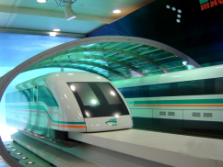
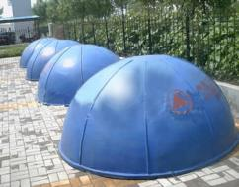
1a Read and understand. Look at the pictures. Do you know what they are? Choose the right picture for each paragraph.
paragraph 2
paragraph 3
Paragraph 4

Slide 8
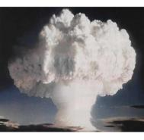
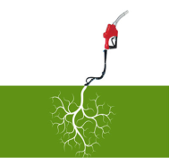
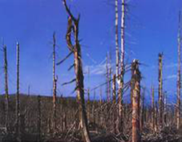
1b Read 1a and match the words with the pictures on Page 48.
A. acid rain B. nuclear energy C. biogas
adj.原子核的，
原子能的
酸雨
C
A
B

Slide 9
Read Paragraph 1 again, and then mark True (T) or False (F).
F
( ) It’s good that people produce power from coal.
( ) Nuclear power is dangerous. So we can’t use it.
( ) To solve the energy problem, people all over the world are looking for new ways to produce power.
T
T
Paragraph 1

Slide 10
Paragraph 2
Its key disadvantage is that the process requires a long time (up to 30 days )and the cost is high.它最大的缺陷是生产过程需要很长时间（长达30天）和成本高。
process n.步骤，过程 v.加工，处理
require v.需要，需求
require 有两种用法： *require (doing) sth. 表示主语“该...了”。 如： The floor requires washing. 地板该洗了。 *be required to do sth.表示主语必须（被要求）...
如:Students are required to attend classes. 学生必须按规定上课。

Slide 11
Paragraph 3
develop, electric, name, save, large
Electric vehicles were __________ in the 1990s. On April 11, 2010, a new kind of electric vehicle _______ “Yezi” was shown in the 2010 Shanghai World Expo. It produces _________ from the sun, the wind and CO2. It can not only protect the environment but also _____ energy. It’s too small to hold many people, but _______ models will be developed in the near future.
developed
named
electricity
save
larger

Slide 12
Paragraph 4
1.去30公里以外的飞机场只需花费人们七分钟的时间。
It takes people just 7 minutes to go to the airport 30 km away.
2.火车最高时速能够达到每小时431公里。
The train can reach a top speed of 431 km per hour.

Slide 13
1c Read 1a again and complete the table.
Item | Advantage | Disadvantage
biogas
electric vehicle
maglev train
long process and high cost for its building
renewable
save energy,
no pollution
too small to hold many people
much more expensive than traditional steel railways
quiet, quick, energy-efficient, no pollution

Slide 14
Retell 1a
coal--- dirty, acid
nuclear energy --- dangerous
electric vehicles --- the sun, the wind andCO2---protect the environment, save energy, small
maglev train ---German-built, quiet, quick, no wheel noise, energy-efficient, not pollute the air
biogas technology – straw, grass and animal waste, everyday lives, require, the high cost

Slide 15
language points
German
n.德国人，德语
pl. Germans
Germany n. 德国
E.g. They are Germans, and they are from Germany.
wheel n. 轮， 车轮， 轮子

Slide 16
2a Read the passage below and match the pictures with the sentences. Then discuss in detail the use of one energy source.
The sun, wind, waves and heat from deep in the earth are energy sources. They will never run out so they are called renewable sources. In 2011, about 16% of energy used worldwide came from renewable sources. The use of it is increasing rapidly each year.
deep adj.深的，厚的 adv.深深地， 在深处
run out 用完，耗尽
E.g. He has run out of food, so his children are hungry.

Slide 17
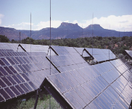
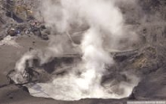
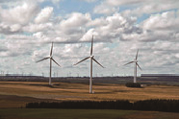
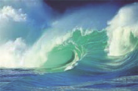
2a Read the passage below and match the pictures with the sentences. Then discuss in detail the use of one energy source.
Wind can produce electricity in many places.
People use sunlight to produce electricity.
Sea waves are used for producing electricity.
People use hot water or steam from deep in the earth to produce electricity and heat for factories, schools and homes.
阳光，日光
水蒸汽，蒸汽，水汽

Slide 18
2b Take notes on your discussion and write a passage with them.
You may begin like this:
Sunlight can produce a lot of energy. People began to use the energy from the sunlight in different ways many years ago…

Slide 19
You can write it like this:
Sunlight can produce a lot of energy. People began to use the energy from the sunlight in different ways many years ago. We can use it to warm the house in the winter, to heat the water for baths, and to produce electricity. What’s more, we can even use it to run vehicles directly in the near future.
As is known to us, the energy from the sunlight has a lot of advantages. For example, it is clean, renewable and non-polluting. Besides, it does no harm to our nature. So we’d better use it as much as possible.

Slide 20
We learn: 1. Some words: technology, wheel, steel, require, German, guide , deep
2.Some phrases: run out
3.Some sentences:
(1)In many countries, people produce power from coal, but it is very dirty and causes acid rain.
(2)They will never run out so they are called renewable sources.
We can: Talk about the advantages and disadvantages of some kinds of energy.
Summary

Slide 21
Assignment
Read 1a.
Memorize the useful expressions and key sentences which we learn today.
Finish Section C in your workbook.
Review Section A-C.

