Slide 1
Unit 4 January is the first month.
WWW.PPT818.COM

Slide 2
January is the first month of he year.
February is the second month of the year.

Slide 3
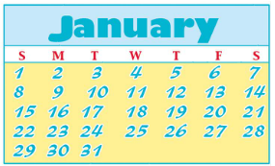

Slide 4
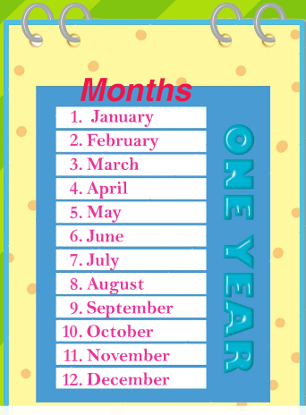

Slide 5
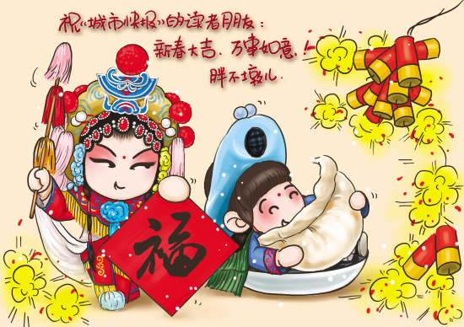

Slide 6
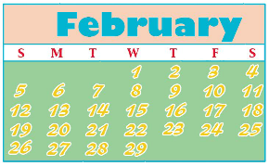

Slide 8
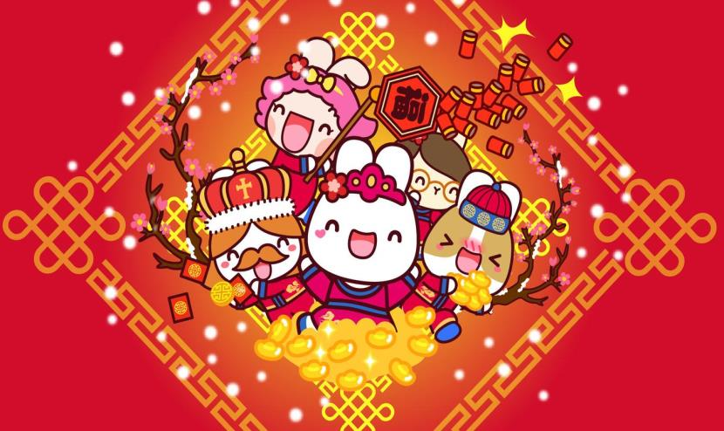

Slide 9
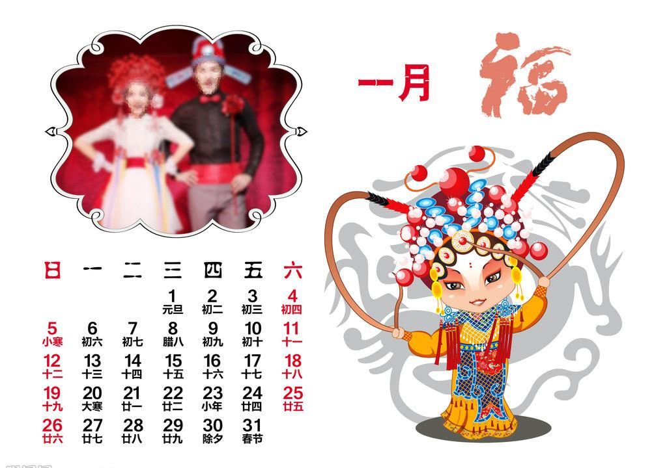
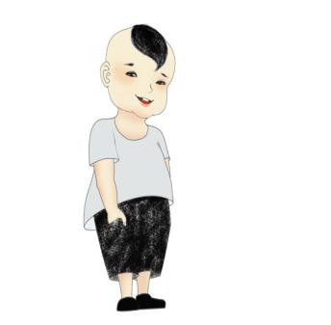
Just write
January

Slide 10
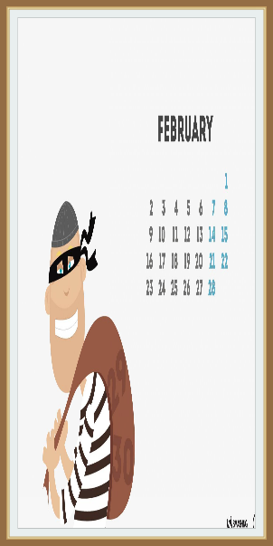
Just write
February

Slide 11
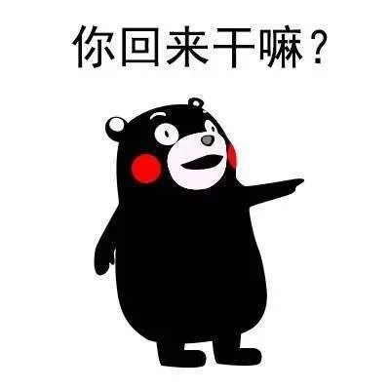
Just write
back

Slide 12
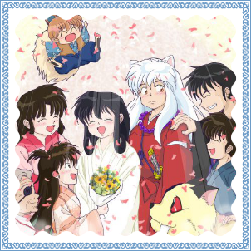
Just write
their

Slide 13
现在进行时态你还记得吗？
The children are playing football.
孩子们正在踢足球
They are having a party.
他们正在聚会
构成：主语+be+动词现在分词。
意思：某人正在做某事

Slide 14
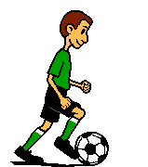
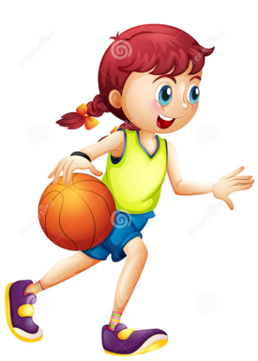
What are the children doing ？
He is playing football.
She is playing basketball.

Slide 15
Let’s talk
I love Spring Festival.
When is Spring Festival?
It’s in January. January is the first month of the year.
What do you do on Spring Festival?
Look at these pictures. I can…
What about you?

