Slide 1
Unit 8 Have you read Treasure Island yet?
Section A 3a—4c
WWW.PPT818.COM

Slide 2
A survey
Please report your result of the survey to the whole class.
Friend’s name
Book

Slide 3
Brainstorm

Slide 4
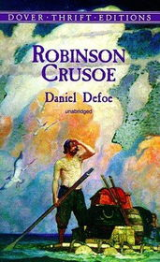
Dr. Known
I have known …

Slide 5
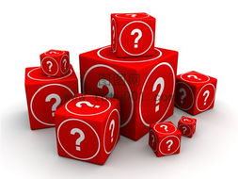
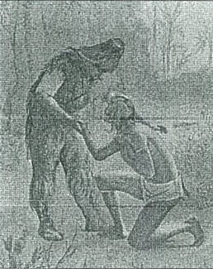
Guessing game
What has happened ?
Who are they?

Slide 6
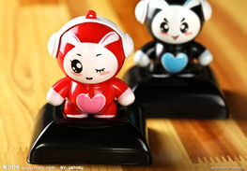
Have a race!
Questions:
1. What does Robinson Crusoe wait for?
2. Why does Robinson Crusoe call the man Friday?

Slide 7
Read and Find
You can use these to shoot things:
Something you use to travel in the sea:
A piece of land in the middle of the sea:
You can use these to cut things:
Signs left behind by someone or something:
gun
ship
island
knife
mark

Slide 8
Try to find the sentences using the words
gun
Robinson Crusoe
island
ship
Robinson Crusoe
knife
mark

Slide 9
island
When I first arrived on this island, I had nothing.( place)
Who else on the island?( refer to some characters)

Slide 10
gun &knife
I have brought back many things I can use—food and drink, tools, knives and guns.( tools)
I go out with my gun almost every day to kill animals and birds for food.

Slide 11
ship
But I have found the ship and make a small boat.
So I will not give up and I will wait for another ship. (hope)
I saw some cannibals trying to kill two men from a broken ship.

Slide 12
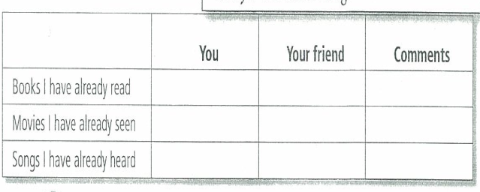
Homework
Complete the chart with information about you and a friend.

