Slide 1
陕旅版小学英语三年级上册
Unit3 Good Morning! 第3课时
WWW.PPT818.COM

Slide 2
教学目标
1．能正确认读、书写字母Rr，Ss, Tt，并通过相关词汇了解这些字母的基本读音规则。
2．能听、说、读、写单词rabbit, sun, tiger并能在日常会话中灵活运用。

Slide 3
Let’s sing---I Can Say My A B C

Slide 4
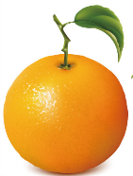
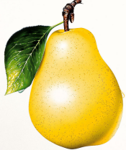
Let’s play
Orange: Hello, Pear!
Pear: Hi, Orange!
Orange: Nice to meet you!
Pear: Nice to meet you, too. This is Question . Mr. Question, this is Orange.
Mr. Question: Glad to meet you.
Orange: Me, too.

Slide 5
Let’s learn
Rr
Ss
Tt

Slide 6
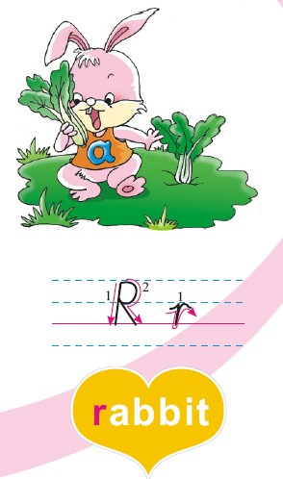
This is Rr. Rr is in “rabbit”．

Slide 7
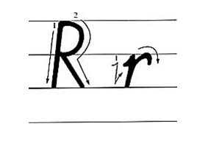

Slide 8
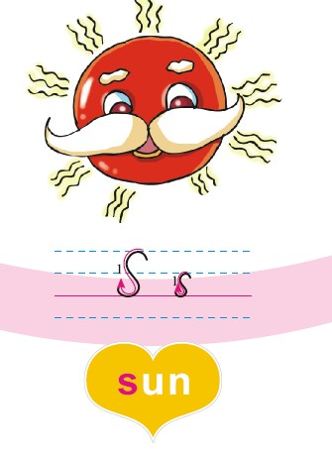
This is Ss. Ss is in “sun”．

Slide 9
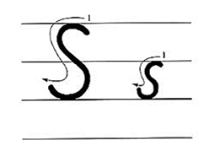

Slide 10
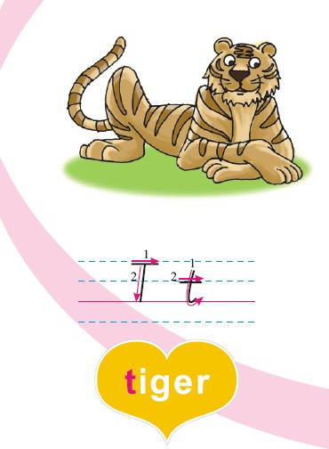
This is Tt. Tt is in “tiger”.

Slide 11
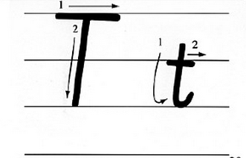

Slide 12
游戏一: 耳音接力
全班同学分为两队，每队队首的同学会听到一句话如：Rr is in “rabbit”，听到的同学把这句话传给下一个，传到最后一个的同学要迅速跑到教师跟前大声将自己得到的信息反馈给老师，又快又对的那组获胜！

Slide 13
游戏二：Point, stand up and say!
黑板上有6张单词卡片：orange，pear，question，tiger，sun和rabbit，当老师指向除了orange的5个卡片时，同学们要说orange。当老师指向真正图片orange时，同学们要迅速站起来并大声喊出单词orange!

Slide 14
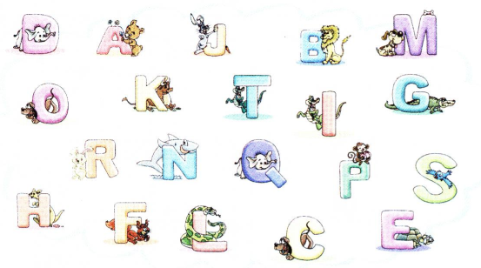
Listen and tick the letters
想一想学过的单词哪些是以H，I，J,K开头的？

Slide 15
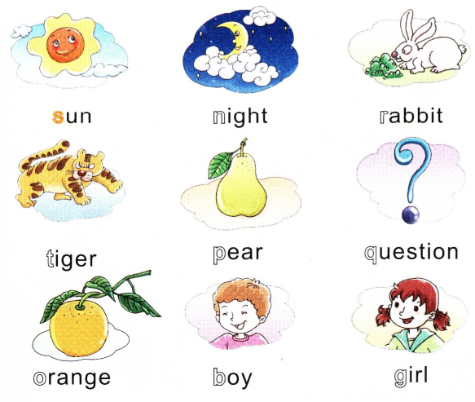
Read and color the letters
想一想学过的单词哪些是以H，I，J,K开头的？

Slide 16
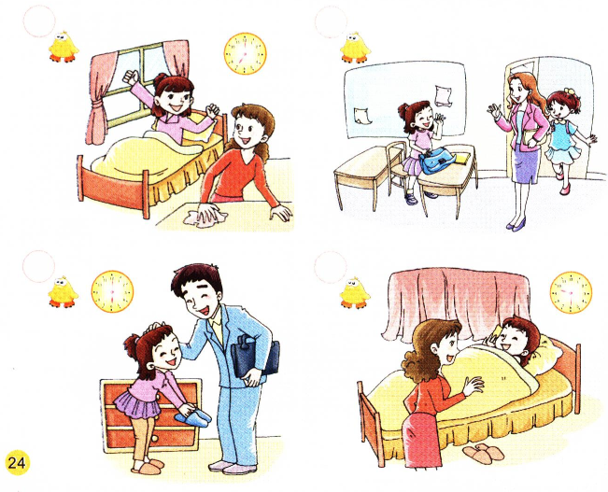
Listen and number
想一想学过的单词哪些是以H，I，J,K开头的？
3
2
4
1

Slide 17
Listen and number录音材料
1. —Good night, Mom.
—Good night，dear.
2. —Good afternoon, Miss White.
—Good afternoon.
3. —Good morning, Mom.
—Good morning, dear.
4. —Good evening, Dad.
—Good evening.
想一想学过的单词哪些是以H，I，J,K开头的？

