Slide 1
It will snow
WWW.PPT818.COM

Slide 2
How is the weather tomorrow?

Slide 3
Watch and answer.
Q1：How is the weather in Shenyang tomorrow?
Q2：How is the weather in Hong Kong tomorrow?

Slide 4
Q1：How is the weather in Shenyang tomorrow?
Mum,how's the weather tomorrow?
Come and watch TV.
It will snow in Shenyang.

Slide 5
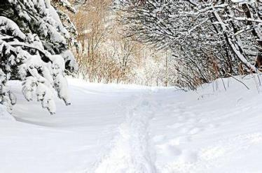
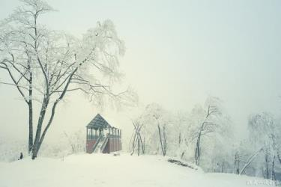
吉林
It will snow in Jilin.
哈尔滨
It will snow in Harbin。

Slide 6
Q2：How is the weather in Hong Kong tomorrow?
It will rain in HongKong.

Slide 7
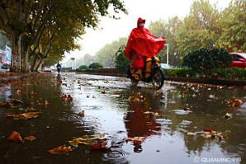
It will rian in Qingdao.
青岛
济南
It will rian in Jinan

Slide 8
It will be sunny tomorrow.
Shall we go to the zoo?
OK!

Slide 9
北京
It will be suuny in Beijing.
西宁
It will be sunny in Xining

Slide 10
上海
It will be windy in Shanghai.
广州
It will be windy in Guangzhou.

Slide 11
How is the weather in Zibo tomorrow ?
It will rain in Zibo.

Slide 12
How is the weather tomorrow?
上海
It will be windy in Shanghai.

Slide 13
I am the best reporter.

Slide 14
let's do
B
1.How is the weather ______(明天)?
A. today B.tomorrow C.yeasterday
A
2.It will ______in Beijing tomoroow.
A. snow B. be snow
A
3._____we go to the zoo?
A. Shall B.Should

