Slide 1
Unit7 What do you do when you have free time?
WWW.PPT818.COM

Slide 2
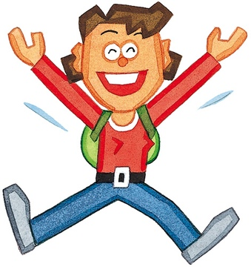
f
t
ree
空闲的、自由的
free time
f
ee
l
感觉
I feel happy.

Slide 3
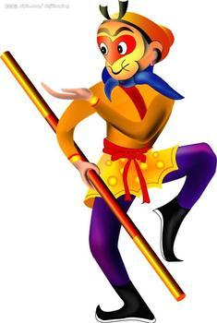
k
ing
国王
Monkey King
猴王
Let's watch The Monkey King.

Slide 4
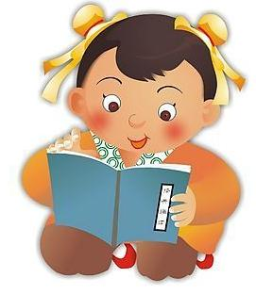
do some
rea
d
ing
读点书
I often do some reading
on Sunday morning.

Slide 5
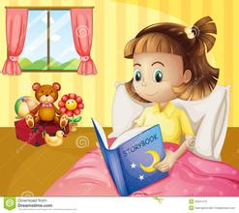
in
tere
s
t
ing
有趣的
an interesting book
I'm reading an interesting book.

Slide 6
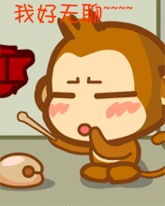
b
or
ed
无聊的
I feel bored.
I am bored.
The film isn't interesting, it's bored.
bored — interesting
反义词

Slide 7
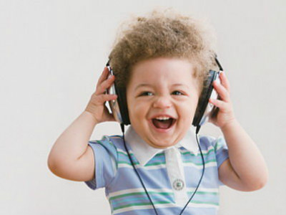
of
lis
ten
听
listen to music
I often listen to music
in the morning.

Slide 8
sh
all
将要
Shall we...?
我们...好吗？
Shall we listen to music?

Slide 9
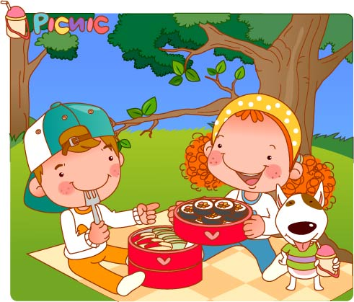
pic
ture
nic
野餐
have a picnic
野餐
Shall we have a picnic?
OK.
All right.

Slide 10
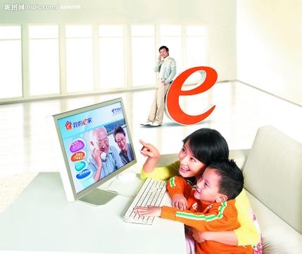
e
m
ai
l
发电子邮件
email my friends
发邮件给我朋友
I often email my
friends.

Slide 11
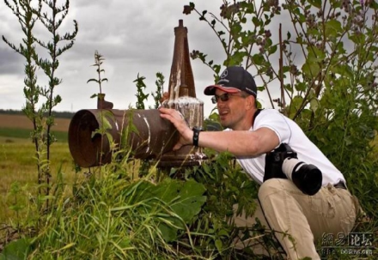
take photos
What do you do
when you have free time?
I often take photos.

Slide 12
go shopping
What do you do
when you have free time?
I often go shopping.

Slide 13
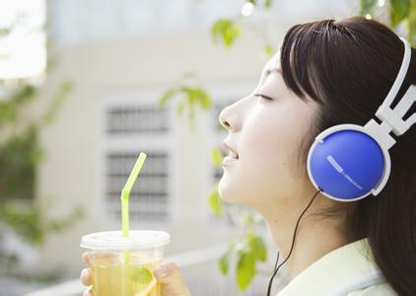
listen to music
What do you do
when you have free time?
I often listen to music.

Slide 14
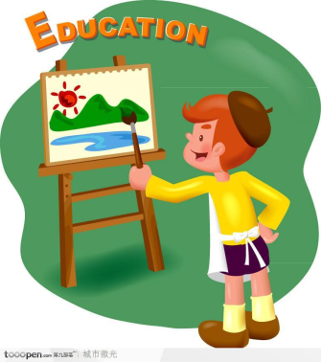
draw a picture
What do you do
when you have free time?
I often draw a picture.

Slide 15
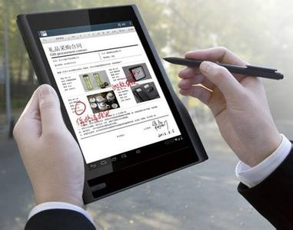
email my friends
What do you do
when you have free time?
I often email my friends.

Slide 16
have a picnic
What do you do
when you have free time?
I often have a picnic.

