Slide 1
Section B Using language
外研版高中英语必修二
Unit 3 On the move
WWW.PPT818.COM

Slide 2
Ⅰ
Ⅱ
Ⅲ
Ⅰ.知识体系图解
chart
ideal
display
monitor
setting
adjustable
available
skip
balance
bar
upper
bone
involve
master
response

Slide 3
Ⅰ
Ⅱ
Ⅲ
掌握……的最新消息;追踪
订购
数百万的
保持……静止
对……有好处
放松心情

Slide 4
Ⅰ
Ⅱ
Ⅲ
Ⅱ.释义匹配
1.available A.a person who is skilled at sth
2.adjustable B.to include or affect someone or something
3.balance C.a state in which all your weight is evenly spread so that you do not fall
4.involve D.able to be changed or moved to suit particular needs
5.master E.able to be obtained,used,or reached
答案:1.E 2.D 3.C 4.B 5.A

Slide 5
Ⅰ
Ⅱ
Ⅲ
Ⅲ.介(副)词填空
1.Our monitor is always the first (get) to school every morning.
2.I can’t go to the concert with you because I have a report
(write).
3.If you have a chance (study) abroad,which country will you go to?
4.Can you tell me the best way (learn) a foreign language?
5.You have an opportunity (develop) a greater understanding of each other.
to get
to write
to study
to learn
to develop

Slide 6
重点词汇
重点句式
重点语法
随堂练习
1.balance n.平衡
【课文原句】Using only a rope,you can develop your footwork and balance.
只需一根绳子,就可以训练你的脚步动作和平衡。
【词汇精讲】句中的balance是名词,意为“平衡”,balance也可作及物动词,意为“使平衡”。
When he was running after his brother,the boy lost his balance and had a bad fall.
当这个男孩追赶哥哥的时候,他失去了平衡,重重地摔了一跤。
You have to balance the advantages of living in a big city against the disadvantages.
你必须权衡住在大城市的利与弊。

Slide 7
重点词汇
重点句式
重点语法
随堂练习
【词汇拓展】

Slide 8
重点词汇
重点句式
重点语法
随堂练习
The little girl tried to keep herself balanced on the balance,but she lost her balance and fell to the ground.
小女孩试图在平衡木上保持平衡,但是她失去了平衡,摔到了地上。
【佳句写作】
Finding and keeping the right balance between progress and the protection of cultural sites can be a big challenge.
在进步和保护文化遗址之间找到和保持适当的平衡可能是一个巨大的挑战。

Slide 9
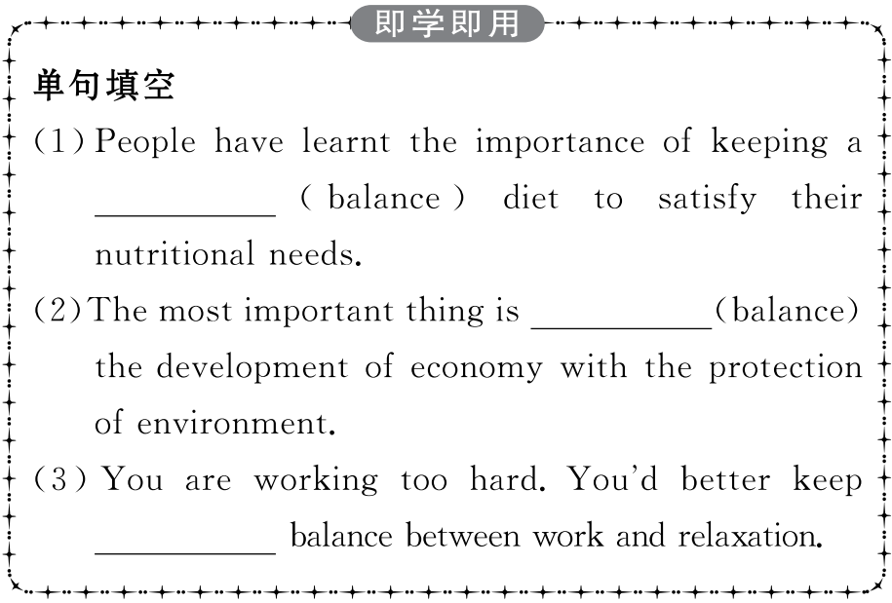
重点词汇
重点句式
重点语法
随堂练习

Slide 10
重点词汇
重点句式
重点语法
随堂练习

Slide 11
重点词汇
重点句式
重点语法
随堂练习
2.adjustable adj.可调节的,可调整的
【课文原句】It also has a voice control setting that enables you to stay hands-free,while its waterproof band is fully adjustable so that it is comfortable to wear.
它还有一个语音控制设置,使您无需用手来操作,而它的防水表带是完全可调的,因此戴着舒适。
【词汇精讲】句中的adjustable是形容词,意为“可调节的,可调整的”,可作表语或定语。
The height of the bicycle seat is adjustable.
这辆自行车车座的高度可以调节。
The bags have adjustable shoulder straps.
这些包的肩带可以调整。

Slide 12
重点词汇
重点句式
重点语法
随堂练习
【词汇拓展】
I believe that you can adjust yourself to the life in Beijing soon.
我相信你能很快适应在北京的生活。
This is the temperature control,you may adjust it as you like.
这是温度控制器,您可以根据自己的喜好进行调整。

Slide 13
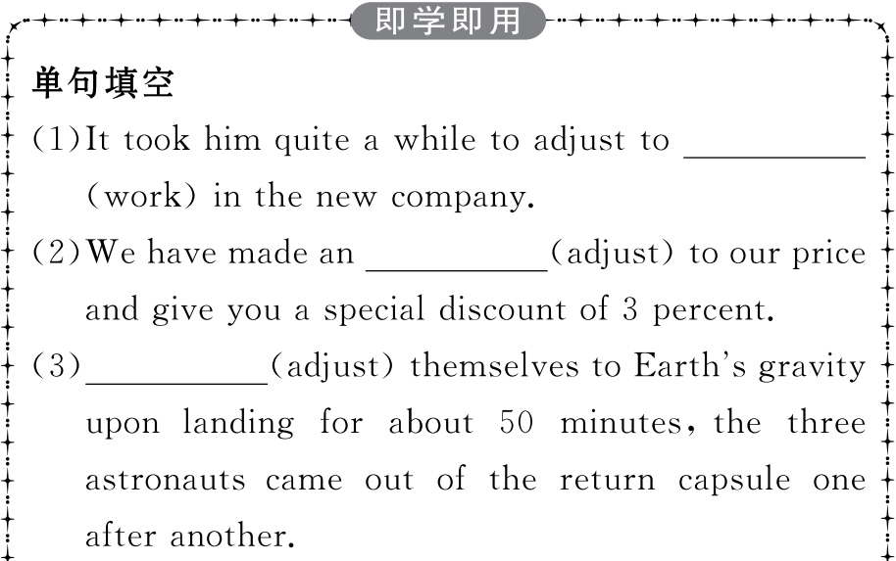
重点词汇
重点句式
重点语法
随堂练习

Slide 14
重点词汇
重点句式
重点语法
随堂练习

Slide 15
重点词汇
重点句式
重点语法
随堂练习
3.involve v.包含,需要
【课文原句】It involves doing very slow physical exercises to relax your mind and calm your body.
它需要做非常缓慢的体育锻炼,以放松身心。
【词汇精讲】句中involve是及物动词,意为“包含,需要”,后接动词时要用-ing形式。
At the centre,Danny was given the choice of three projects,one of which involved working with children.
在中心,丹尼得到了三项任务的选择,其中一项是与孩子们一起工作。

Slide 16
重点词汇
重点句式
重点语法
随堂练习
【词汇拓展】
He’s involved in the organization of a new club.
他参与了新俱乐部的组织工作。
Online voting becomes increasingly popular,and many competitions get people involved in it.
网络投票变得越来越流行,许多竞赛让人们参与其中。

Slide 17
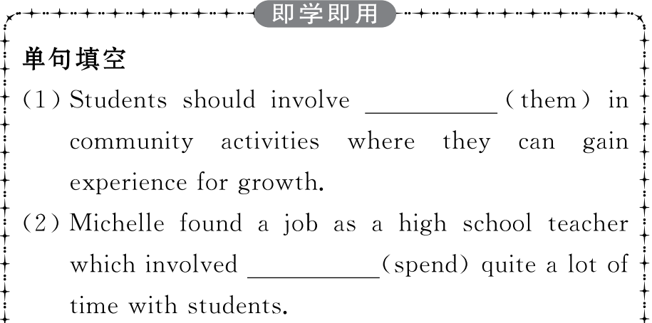
重点词汇
重点句式
重点语法
随堂练习

Slide 18
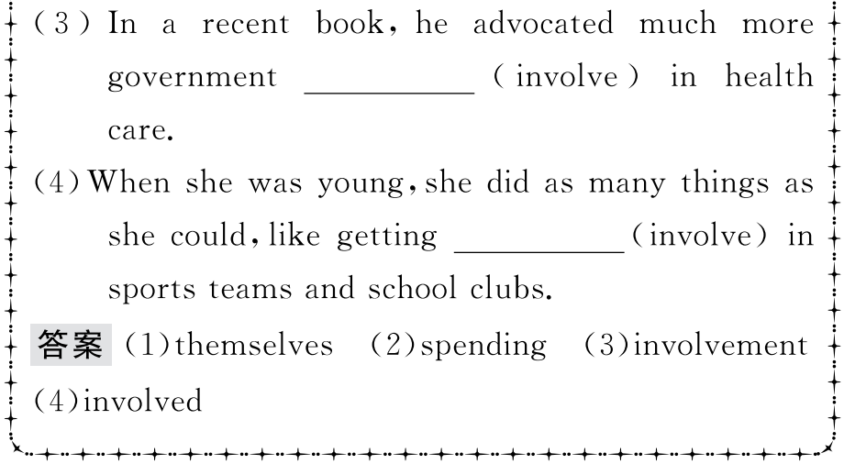
重点词汇
重点句式
重点语法
随堂练习

Slide 19
重点词汇
重点句式
重点语法
随堂练习
4.master n.大师,能手
【课文原句】A great master of yoga.一位瑜伽大师。
【词汇精讲】句中的master是名词,意为“大师,能手”。
As we all know,he is a master in literature.
我们都知道他是个文学大师。
She has studied English for 40 years and now she is a master of the English language.
她研究英语40年了,现在是一位英语大师。
【词汇拓展】
master vt.控制,掌握,精通
Duff soon mastered the skills of radio production.
达夫很快掌握了广播节目制作的技能。
Mr Brown tried hard to master the situation.布朗先生尽力控制这个局面。

Slide 20
重点词汇
重点句式
重点语法
随堂练习

Slide 21
重点词汇
重点句式
重点语法
随堂练习
5.response n.回答,回复
【课文原句】During the interview,listen carefully to each question and try to understand the main ideas within the interviewee’s responses.
在采访过程中,仔细听每一个问题,试着理解受访者回答中的主要观点。
【词汇精讲】句中的response是可数名词,意为“回答,回应”。
I received an encouraging response to my advertisement.
我的广告宣传有了令人鼓舞的回应。
I knocked on the door but there was no response.
我敲了门,可是没有回应。

Slide 22
重点词汇
重点句式
重点语法
随堂练习
【词汇拓展】
He always takes the lead in response to the government’s call.
他总是带头响应政府的号召。
When asked about the company’s future,the director responded that he remained optimistic.
当被问到公司的未来时,经理回答说他依然乐观。

Slide 23
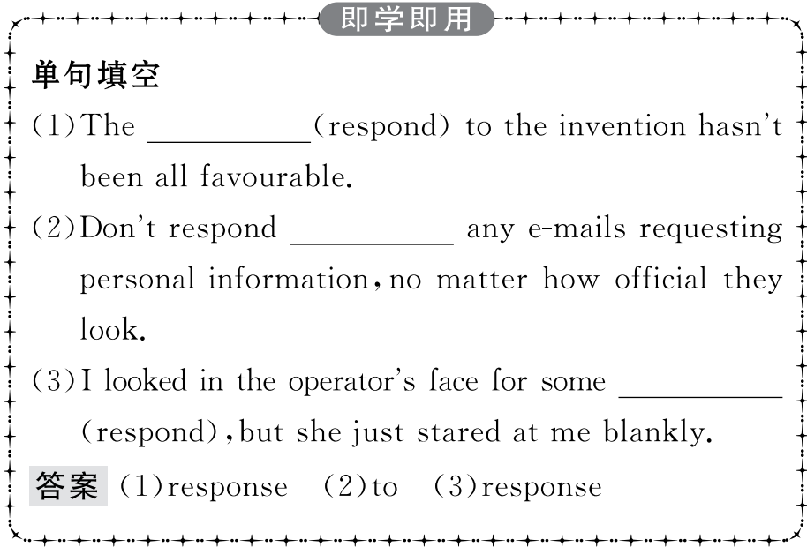
重点词汇
重点句式
重点语法
随堂练习

Slide 24
重点词汇
重点句式
重点语法
随堂练习
Whether you’re a professional athlete or keen sportsperson,DX Sports Watch is the ideal choice for you.
无论您是职业运动员还是热衷于体育的人,DX运动手表都是您理想的选择。
【句式剖析】
句中的whether...or...意为“无论……,还是……”,引导包含选择范围的让步状语从句。
I shall go,whether you come with me or stay at home.
不论你来还是留在家中,我都要去。
Whether she wins or loses,this is her last chance.
不管是赢是输,这都是她最后一次机会。

Slide 25
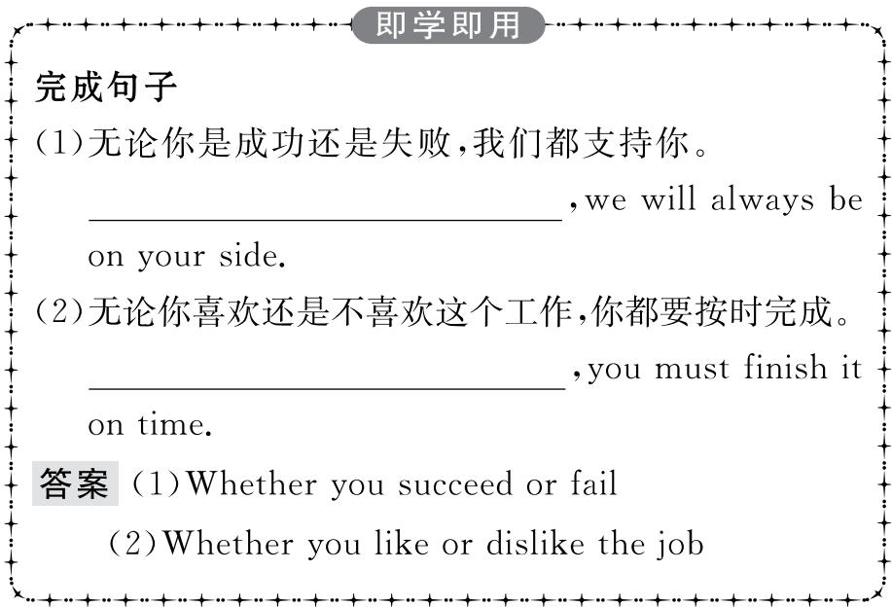
重点词汇
重点句式
重点语法
随堂练习

Slide 26
重点词汇
重点句式
重点语法
随堂练习
动词不定式作定语和结果状语
一、动词不定式作定语
1.不定式作定语多和被修饰的名词具有“动宾关系”,即被修饰的名词是不定式动作的承受者;如果不定式是不及物动词,就要在其后面加上相应的介词。
I am hungry.Please give me something to eat.
我饿了,请给我些东西吃。
Brown has something important to deal with at present.
目前布朗有重要的事情要处理。

Slide 27
重点词汇
重点句式
重点语法
随堂练习
2.当动词不定式与其所修饰的名称构成逻辑上的动宾关系,而该动词是不及物动词时,其后需要加上适当的介词构成动词短语。
There is nothing to worry about.
没有什么可担心的。
Please give me a piece of paper to write on.
请给我一张纸用来写字。
3.在last,first,second等表示顺序的词后一般要用动词不定式作定语。
Our manager was the last one to leave company yesterday.
我们经理昨天是最后一个离开公司的。
China is the third country in the world to send man into space.
中国是第三个把人送入太空的国家。

Slide 28
重点词汇
重点句式
重点语法
随堂练习
4.有些名词的同根词常跟动词不定式,因而它们也常跟不定式作定语。常见的有:
He made a promise to come tonight.
他答应今天晚上来。
I have no plans to go there for a holiday.
我没有到那里去度假的计划。
注意:当动词不定式所修饰的名词是不定式的承受者时,不定式既可以用主动形式,也可以用被动形式,但含义有所不同。
promise plan attempt offer decision refusal failure ability chance warning anxiety eagerness
willingness readiness

Slide 29
重点词汇
重点句式
重点语法
随堂练习
Do you have anything to send?
你有要寄的东西吗?(寄东西的执行者是“你”)
Do you have anything to be sent?
你有什么需要我(或别人)去寄的吗?(动作的执行者是问话者或他人)

Slide 30
重点词汇
重点句式
重点语法
随堂练习
二、动词不定式作结果状语
动词不定式作结果状语时,通常用其基本形式,且总是出现在句末,其逻辑主语就是句子的主语。结果状语常常只限于learn(得知),find(发现),see,hear,to be told,make等具有界限含义的动词。
He returned home to learn that his friend had just left.
他回到家后得知他的朋友刚离开。
There were so many people that I had to shout to be heard.
人太多了,我必须大声喊才能被听到。
Dinosaurs have completely died out on the earth,never to be seen again.
恐龙已从地球上完全消失,再也见不到了。

Slide 31
重点词汇
重点句式
重点语法
随堂练习
注意以下特殊结构:
(1)enough to do结构
The hall is large enough to hold 3,000 people.
大厅足够大,能容纳3 000人。
I didn’t run fast enough to catch up with him.
我跑得不够快,追不上他。
(2)only to do表示意外的结果
He hurried to the station,only to find the train had left.
他匆忙赶到车站,结果发现火车开走了。
He went to the booking office in a hurry,only to be told the tickets had been sold out.
他匆匆忙忙地去售票处,结果被告知票已售罄。

Slide 32
重点词汇
重点句式
重点语法
随堂练习
(3)too...to do...结构
The little girl is too tired to walk any farther.
小女孩太累了,走不动了。
I was too excited to say a word.
我太激动了,一句话也说不出来。
(4)so as to do结构
He shut the door so as not to be disturbed.
他把门关上,以免受到打扰。
Would you be so kind as to tell me the way to the station?
你如此好心,请告诉我去车站的路好吗?
(5)在某些情况下,动词不定式也可以直接在句中作结果状语。
He lived to be a hundred years old.他活到了100岁。
What have I done to excite you?我做了什么使你如此兴奋?

Slide 33
重点词汇
重点句式
重点语法
随堂练习
Ⅰ.用适当的介词填空
1.Tai chi is a Chinese martial art a long history.
答案:with
2.Many people other countries come to China to learn martial arts every year.
答案:from
3.He fell in love the place the first time he came here.
答案:with
4.Can you tell me the reason choosing Mount Tai as our destination?
答案:for
5.Do you know the difference these two words?
答案:between

Slide 34
重点词汇
重点句式
重点语法
随堂练习
Ⅱ.完成句子
1.请你把你的新自行车借给我,好吗?
Would you be so kind as me your new bike?
答案:to lend
2.冰很厚,可以在上面步行。
The ice is thick enough .
答案:to walk on
3.他回到家中,发现他父亲回来了。
He got home that his father was back.
答案:to learn

Slide 35
重点词汇
重点句式
重点语法
随堂练习
4.汤姆到达车站,却发现火车已经开走了。
Tom got to the station only the train had gone.
答案:to find
5.他不够高,够不到书架顶上的书。
He is not tall enough the books on the top of the shelf.
答案:to reach

