Slide 1
Unit 6 Topic 1
I have some exciting news to tell you.
Section C
WWW.PPT818.COM

Slide 2
Review: Word competition
郊游
恰当的
价格
付费
冰箱
宾馆
标准(的)
舒服的
field trip
proper
price
pay (for)
fridge =refrigerator
hotel
standard
comfortable

Slide 3
Review: Word competition
单个的
条件
总的，全部的
sleeper
suitable
air conditioning
partner
mount
single
condition
total
卧铺列车
合适的，适宜的
空调
伙伴，搭档
山峰

Slide 4
Review: Sentences competition
1. 一张电影票的费用是58元，我们花116元买了两张。(cost, pay)
A ticket to the movie costs ¥58, and we paid 116 for two.
2. 他们有98元的贵宾(VIP)票。
They have tickets at ¥98 for the VIP.
3. 我要预定一间双人的标准房间。(book)
I want to book a standard room with two single beds.
4. 房间里的空调让他觉得很舒服。
The air conditioning in the room made him feel comfortable.

Slide 5
A: Hello, Fuzhou Railway Station. ____________________
B: I’d like to ______ ______ ______ to Mount Huang.
A: OK. The train leaves at 10:00 p. m. and _______ _____ Mount Huang Railway Station at 11:00 a. m.
B: All right. What about the _______?
A: We have tickets _______ ¥ 360 for the soft sleeper and ¥240 for the hard sleeper. _______ _______ do you want?
B: I’d like 8 tickets _____ the hard sleeper.
A: Eight hard sleeper tickets. OK. Please ______ _____ the tickets before 18:00. And ______ ______ ______ your name, please?
B: Sure. My name is Cheng Tao.
A: And your ________ _________?
B: It’s 13563856358. Thanks.
A: It’s my pleasure.
What can I do for you?
book some tickets
arrives at
price
at
Which kind
for
pay for
may I have
phone number
Complete and act out the dialog.

Slide 6
Ask and answer:
What’s the price of the hard sleeper to Mount Tai?
What does a standard room with two single beds cost?
How long are they going to stay in the hotel?
How much does the trip to Mount Tai cost?
¥145
¥100
2 nights
train tickets: ¥145×2
+
tickets to Mount Tai: ¥60
+
room: ¥50×2
+
food, drink & photos: ¥ 100
= ¥550

Slide 7
Talk
Each of the students needs at least ¥550 for the trip. That’s a lot of money.
What should you do if you need so much money for your trip?
Ask parents for it?
Use your pocket money or lucky money?
Borrow it from somebody?
Make money by yourself? But how?
How will Kangkang and his friends deal with the problem?

Slide 8
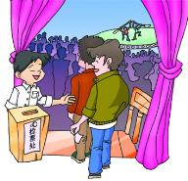
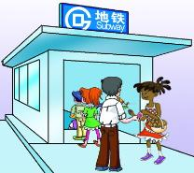
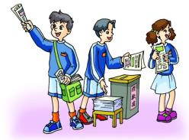
Match the following ideas about how to raise money with the pictures.
3a
The best way to raise money is to sell newspapers.
Why don’t we put on a show to raise money?
Let’s sell old books.
I think we can sell flowers to raise money at the weekend.
2
4
3
1

Slide 9
Work in groups and discuss which idea above is the best. And why? Write down the key points and your ideas.
3b
The best way to raise money is to ….
_________________________________________________________________________________
_________________________________________________________________________________
Key points:
Your ideas:

Slide 10
Read 1a and match the words with their meanings.
1b
You can guess the meaning of a new word by looking at the words around it.
common
raise
special
order
serve
to collect money
to ask for food or drinks in a restaurant or hotel
happening often
different from what is normal
to give somebody food or drinks during the meal

Slide 11
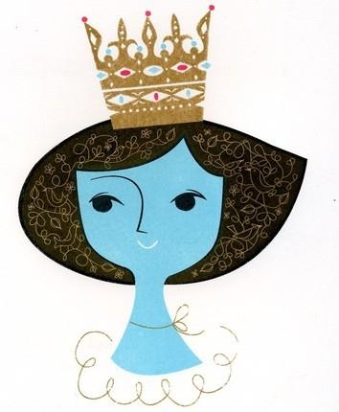
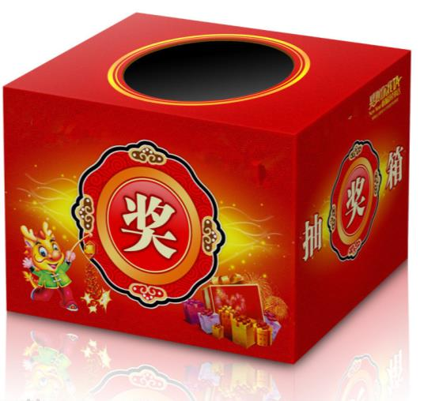
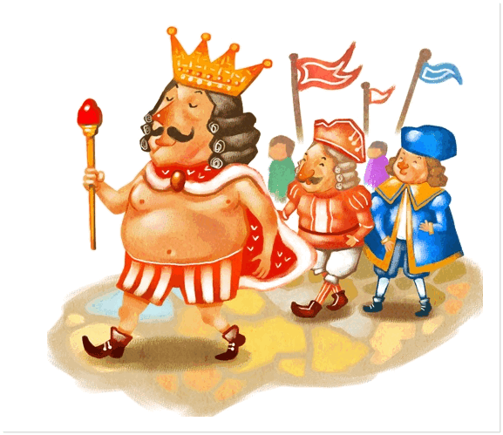
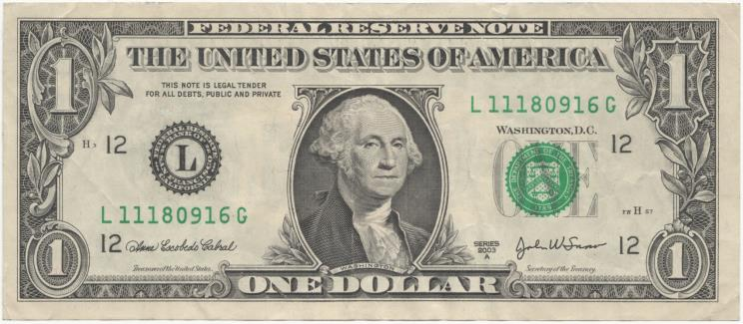
New words
queen
king
draw n. & v.
dollar
Canada n.
Canadian adj.

Slide 12
Read 1a again and put the sentences in the correct order.
1c
Each student spends one dollar buying a ticket.
The student has a special lunch.
The headmaster greets the student in the morning.
One student’s ticket is drawn and he or she will be the king or queen.
1
4
3
2

Slide 13
Answer the questions.
How much does each student pay for the draw?
One dollar.
What are the special rights for the “king” or “queen”?
“特权”
The headmaster greets him and carries his/her books.
Sit in the headmaster’s chair for the day and can use the headmaster’s mobile phone to call home.
Get a special lunch.

Slide 14
Retell 1a according to the key words.
common, think of, King or Queen, cost… one dollar, draw, winning ticket, arrive, greet, carry, sit, mobile phone, special lunch

Slide 15
Key & difficult points in 1a.
It is very common to raise money in Canadian and American schools.
It is very popular for students in Canada and the USA to raise money. (They often / usually do these kinds of things. )
It costs each student one dollar to buy a ticket for the draw.
Each student spends one dollar buying a ticket for the draw.
Each student pays one dollar for the draw.
After all the tickets are sold, one ticket is drawn.
After the students sell out all the tickets, they draw one ticket.

Slide 16
2
Read and complete the letter with the correct forms of the given words.
Dear Li Wei, Sunday, April 7th
How are you?
I have some great news _______ (tell) you. Next week, we’re going on a spring field trip. You know, spring is the best time _________ (climb) Mount Tai. There are many interesting places ________ (visit) there. Mount Tai is in Taian, Shandong. So we decided ________ (take) the train. Kangkang helped us __________ (book) the train tickets. I also called __________ (book) some rooms.
Many of us didn’t have enough money, so Michael advised us __________ (raise) money, such as putting on a show, and ________ (sell) flowers and old books. It’s so exciting!
I’m looking forward to hearing from you.
Yours,
Maria
to tell
to climb
to visit
to take
(to) book
to book
to raise
selling
Find out and learn the sentences with the infinitive.
I hope to get letters from you very much.

Slide 17
Exercise
1. 我有一些令人兴奋的事告诉你。
I have_____ _____ ____ ____ ___ you.
2. 你们的任务就是查明旅行费用。
Your task is ____ ____ ____the cost of the trip.
3.在卖完票后，他们开始抽奖。
After they sold out tickets, they____ ____ _____.
4. 我期待着去泰山的旅行。
I’m ______ ______ _____ the trip to Mount Tai.
some exciting news to tell
to find out
began to draw
looking forward to

Slide 18
Summary
We learn:
New words and phrases:
raise (money), king, queen, common, Canadian, dollar, forward, look forward to
The infinitive:
The best way to raise money is to sell newspapers.
Why don’t we put on a show to raise money?

Slide 19
Summary
We can:
Talk about money raising activities and choose the best one.
Use the infinitive:
登泰山的最好时间 the best time to climb Mount Tai
决定乘火车 decide to take the train
建议我们去筹钱 advise us to raise money

Slide 20
Project
Discuss with your classmates and think about more ways of raising money and write them down.

Slide 21
Homework
Review the key points in Section A - C.
Collect more verbs with the structure “v. + to do sth. ” and “v. + sb. + to do sth. ”
Preview Section D.

Slide 22
The end.
Thanks!

