Slide 1
Unit 3
Online tours
Task
WWW.PPT818.COM

Slide 2
Learning targets
To use charts to organize ideas.
To know how to write an introduction.

Slide 3
Introducing a country
Amy wants to introduce the UK to her friends. She collected some information on the Internet and made a chart.

Slide 4
An island country
England, Wales ...
About
the
country
London, the capital
Bid and modern
Long history
Kings and queens
were once its rulers
Palaces and castles
Buckingham Palace
The
UK
Places
to visit
Museums
the British Museum
Places of
natural beauty
the Lake District
Best time to visit
May to September
Others
Weather
Changes often
Money
Pounds

Slide 5
Free talk
How much do you
know about the UK?

Slide 6


national flag 国旗
national emblem
国徽

Slide 7
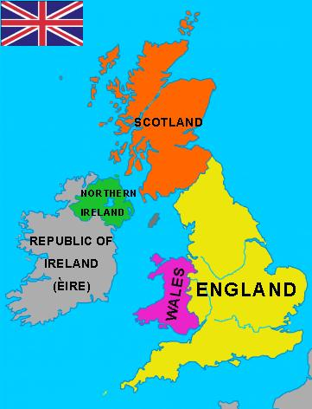
map

Slide 8
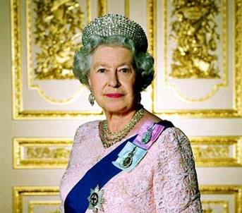
Queen Elizabeth II

Slide 9
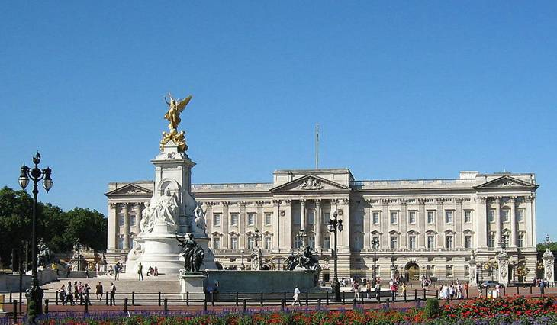
Buckingham Palace

Slide 10
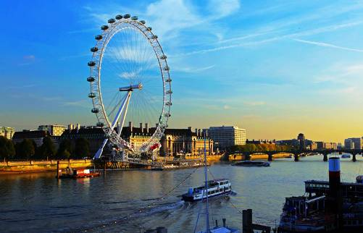
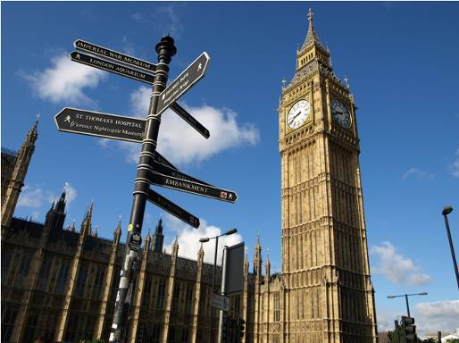
London

Slide 11
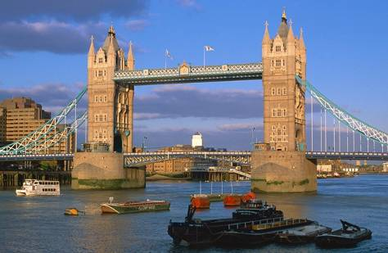
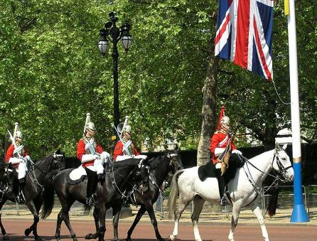
London

Slide 12
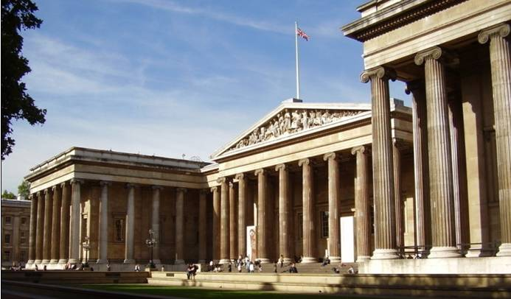
the British Museum

Slide 13
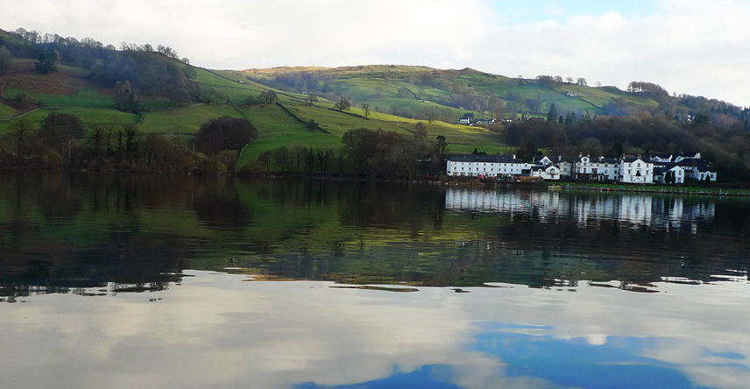
the Lake District

Slide 14
Amy has written an introduction to the UK. Listen to her article and answer the questions.
1. Which city is the capital of the UK?
London.
2. When is the best time to visit the UK?
From May to September.

Slide 15
Read again and answer more questions.
1. What is the full name of the UK?
2. Which countries is the UK made up of?
3. Where is one of the most famous place in the UK?
4. What has the UK always been famous for?
5. How is the weather in the UK?

Slide 16
1. What is the full name of the UK?
The United Kingdom of Great Britain and Northern Ireland.
2. Which countries is the UK made up of?
It is made up of England, Scotland, Wales and Northern Ireland.
3. Where is one of the most famous place in the UK?
Buckingham Palace.

Slide 17
4. What has the UK always been famous for?
It has always been famous for its museums.
5. How is the weather in the UK?
It changes often. It is sunny one minute, but rainy the next.

Slide 18

1. It is made up of England, Scotland, Wales and Northern Ireland.
be made up of 由……组成/构成
e.g. 生活是由琐事构成的。
Life is ___________ little things.
[拓展]
be made of 由……制成(看得出原材料)
be made from 由……制成(看不出原材料)
be made in 在某地制造
made up of

Slide 19
2. It has been the home of kings and queens for a long time.
be the home of ... 是/成为……的家
e.g. 自然保护区已经成为了很多罕见
的鸟的家。
Nature reserves
_________________ of many
rare birds.
have been the home

Slide 20
3. The UK has always been famous for its museums.
be famous for意为“因为……而出名”。当主语是人时，常表示以某种技能或特征而出名；当主语是地点名词时，常表示以某个名胜古迹或特产而出名。
e.g. 伦敦因大本钟而著名。
London is ___________ Big Ben.
famous for

Slide 21
[拓展]
be famous as 意为“作为……而出名”。当主语是人时，常表示以某个身份而出名；当主语是地点名词时，常表示作为某种东西的产地而出名。如：
His uncle is famous as an actor.
This area is famous as a green tea producing place.

Slide 22
【运用】根据句意选用for或as填空。
1) George is famous ________ a writer.
2) France is famous ________ its wine and food.
as
for

Slide 23
4. The best time to visit the UK is from May to September because its winter is wet and cold.
句中的to visit the UK是动词不定式短语作后置定语。
e.g. The best time to travel in the city is in
May.
the best time to do sth. 做......最好的时间
e.g. 春天是放风筝最好的时间。
Spring is the _____________ kites.
best time to fly

Slide 24
5. It is sunny one minute, but rainy the next, so prepare for it before you go there.
prepare 用作动词，意为“准备”，后面常跟名词、代词、不定式作宾语。prepare还常与for搭配构成短语prepare for, 表示“为……作准备”。
e.g. 期末考试要到了, 你最好做好准备。
The final exam is coming. You’d
better _____________it.
prepare for

Slide 25
Exercises
Translation.
1. 我们班有15个男生和12个女生。
Our class is made up of 15 boys and 12 girls.
2. 白金汉宫已经成为国王和女王的家很久 了。
Buckingham Palace has been the home of kings and queens for a long time.

Slide 26
3. 英国还有很多自然美景的地方。
The UK also has many places of natural beauty.
4. 这一分钟是晴朗的，下一分钟就会有雨。
It is sunny one minute, but rainy the next.
5. 春天和秋天是旅游的最好时间，因为既不
太热也不太冷。
The best time to go travelling is spring and autumn, because it is not too hot or too cold.

Slide 27
Writing
Find out the main idea of each paragraph.
Para. 1
Introduce the country simply
Introduce the views of the country
Para. 2
Para. 3
Introduce the climate of the country

Slide 28
Pick a country that interests you and make a chart to organize your ideas. Then write an introduction. You can add some pictures to make it more interesting.

Slide 29
Useful expressions
It is a/an ... country.
..., the capital, is big and modern / beautiful.
It has always been famous for ...
There are/is ... on / in ...
The best time to visit ... is ...
The weather often / seldom changes ...

Slide 30

Show us your
introduction!

Slide 31
1. Finish the exercises in the
workbook.
2. Revise the whole unit.

