Slide 1
Unit 4 Road Safety
WWW.PPT818.COM

Slide 2
Brain storm
开动脑筋，用以下单词说一说交通规则吧！
must
mustn't
Road safety
can
can't

Slide 3
Aims
1.I know the function of the stress in a sentence and try to practise it.（了解句子重音的作用并尝试运用）
2.I can understand and act the cartoon time.
（理解并表演本课卡通）
3. I know about the difference of road rules for drivers between China and western countries.（知道中西方不同的汽车行驶交通规则）
Class
Rules
Listen carefully.
Watch carefully.
Speak loudly.

Slide 4
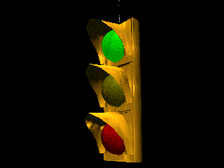
Traffic lights song
Twinkle, twinkle, traffic light.
Round the corner shining bright.
Red man, stop!
Green man, go!
Yellow man, very very slow!
Twinkle, twinkle, traffic light.
Round the corner shining bright.

Slide 5
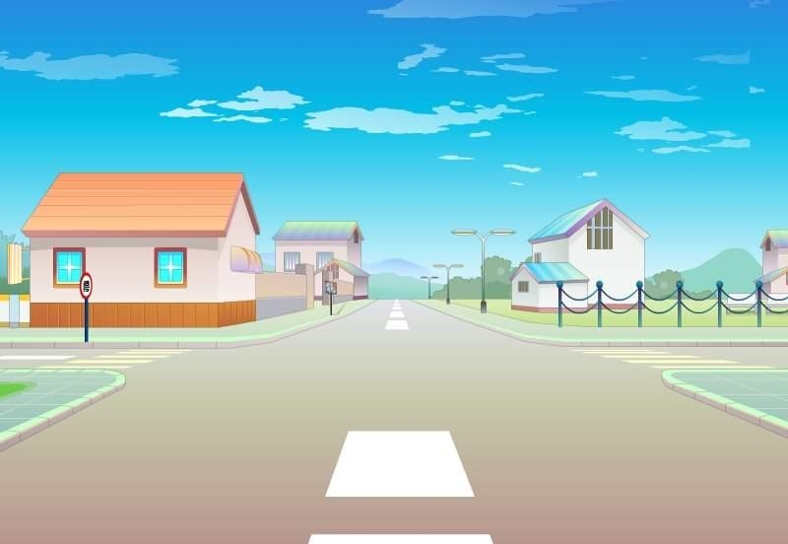
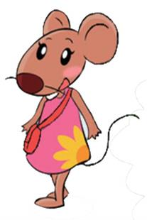
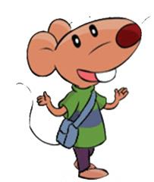
Watch and judge
一般情况下，句子中名词、动词、形容词和副词等。重读单词的发音听起来相对响亮而且清晰。
Are they right?
We must/mustn’t…
Stop! There’s a red man.
We mustn’t walk now.
We must wait for the green man.
Stop! There’s a red man.
We mustn’t walk now.
We must wait for the green man.

Slide 6
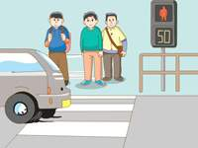
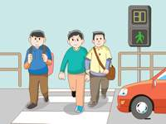
Let's read
‘Stop! There’s a ’red man.
We mustn’t walk now.
We must wait for the green man.
There he is! Now we can walk.
But don’t run!

Slide 7
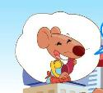
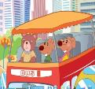
Listen and choose
1.Who are they calling?
A.Billy B.Willy C.Aunt Alice
2.How do they get to the house?
A.By bus. B.By car. C.by metro.
=
take a bus

Slide 8
Watch and answer
Q1: What can they see on the road？
There are so many cars on the road.
so much
Learning tip: so many 修饰可数名词复数
so much 修饰不可数名词。

Slide 9
Think and choose
so many
sweets
so much
rice
people
so much
so many
bread
so many
so much

Slide 10
Read and answer
Q2: How many times does the bus stop?
Two.
Why does it stop?
“ ”划出

Slide 11
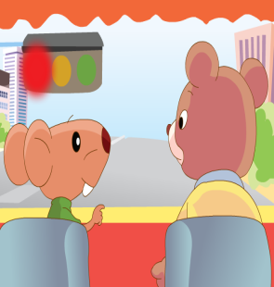
the first time
There is a red light. The bus stops.
Bobby: Why does the bus stop here?
Bear: Look at the red light.
It means we must stop.
Bobby: Oh, I see.
Follow the rules on the road.

Slide 12
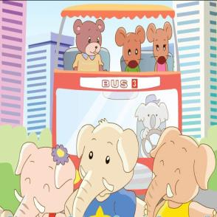
the second time
The bus goes on, but soon it stops again.
Bobby: There aren’t any traffic lights here.
Why is the bus stopping again?
Bear: Look! Some elephants are crossing the road. We must stop and wait.
Give way to pedestrians.
礼让行人。

Slide 13
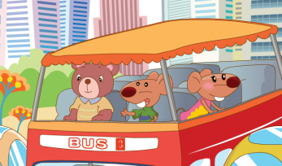
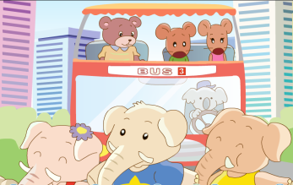
Give an ending
The bus stops again. What happened?
(展开大胆的想象，续编故事。)

Slide 14
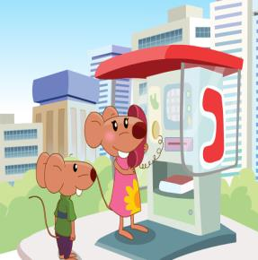
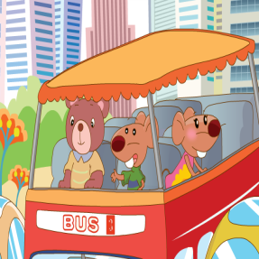
Listen and repeat
Bobby and Tina go to see their aunt.
Tina: Hello, Aunt Alice. This is Tina.
How do we get to your house?
Alice: You can take the bus, Tina.
Tina: OK.
get off
下车
They get on the bus.
Bobby: Look! There are so many cars on the road.
Tina: Yes. They’re going fast.

Slide 15
Listen and repeat
stop：
There is a red light. The bus stops.
Bobby: Why does the bus stop here?
Bear: Look at the red light.
It means we must stop.
Bobby: Oh, I see.
+
Ving
1、停止
我看见了。
停止尖叫
stop shouting
我明白了。
2、车站
一个公交车站
a bus stop
The bus goes on, but soon it stops again.
Bobby: There aren’t any traffic lights here. Why is the bus stopping again?
Bear: Look! Some elephants are crossing the road. We must stop and wait.

Slide 16
Happy reading
四人一组，选择一种你们喜欢的方式朗读课文吧！
Read in
paragraphs
分段读
Read together
一起读
Read in roles
分角色读

Slide 17
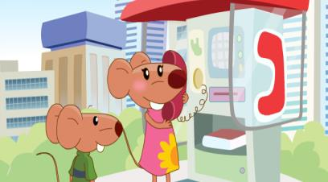
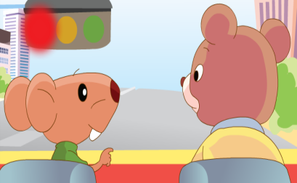
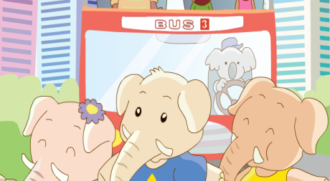
Dub in roles
小组合作，选择其中一幅图，分角色配音。
1
2
3
4

Slide 18
Complete and retell
Bobby and Tina wanted______(see) their aunt. They ____(get)there by bus. When they got on the bus, they ___(see) so____(much) cars. The cars are going ____(fast). But the bus _______(stop) because there___(be) a red light. They must ____(stop).Then the bus stopped again. There ______(be not) any traffic lights, but some elephants were ________(cross) the road.
to see
got
saw
many
fast
stopped
was
stop
weren’t
crossing

Slide 19
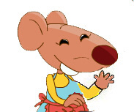
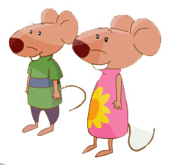

Slide 20
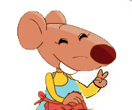
I have been to many places. She found different countries has different traffic rules .
culture time

Slide 21
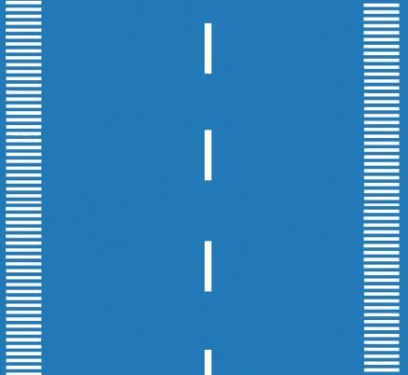
Look and find
1
2
Find the difference between them.
(找出不同之处)

Slide 22
Look and say
1
on the left side
People drive ______________ of the road .
People walk _____________ of the road.

Slide 23
Look and say
2
People walk _______________ of the road.
on the right side
People drive ______________ of the road .
on the right side

Slide 24
Listen and say
In the UK, people drive on the left side of the road.
/e/
/ə/
/aʊ/
In China, except（除了） Hong Kong and Macau（澳门） ,
people drive on the right side of the road.

Slide 25
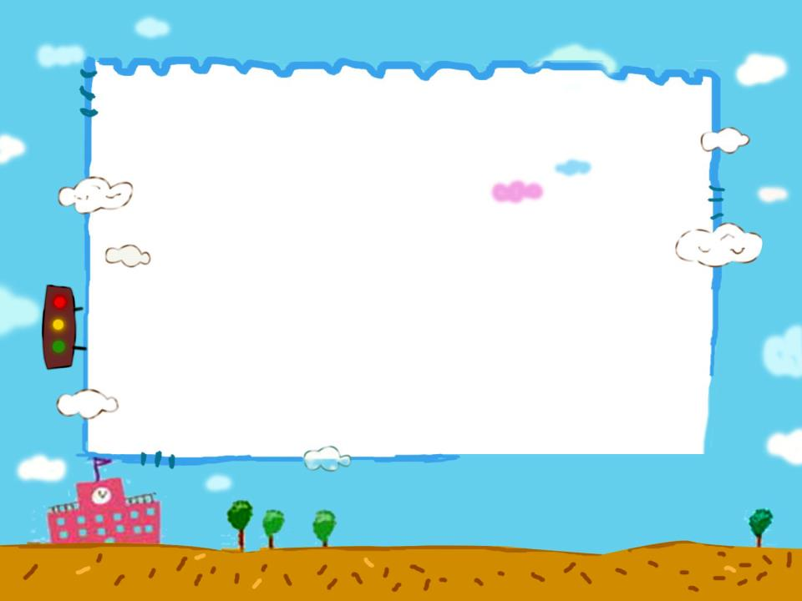
Do you know?
世界上大部分的国家实行的是右行制，而实行左行制的国家以英联邦国家居多，如：Australia , New Zealand等。

Slide 26
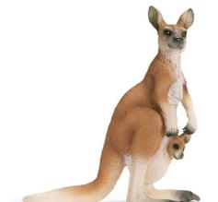
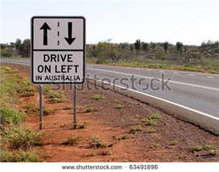
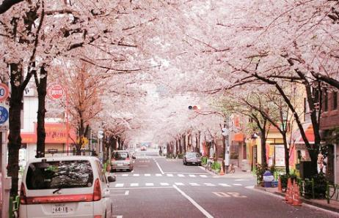
Where is it and how do people drive? 看看下面是哪个国家,说说人们是如何开车的？
Look and say
In Australia and Japan, people also drive
on the left side of the road.

Slide 27
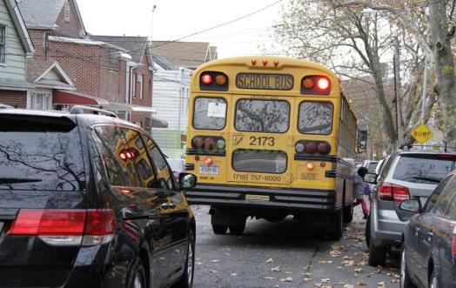
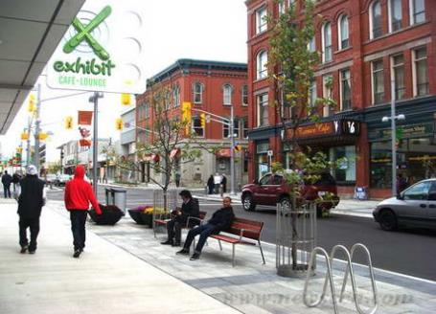
Where is it and how do people drive? 看看下面是哪个国家,说说人们是如何开车的？
Look and say
In the USA and Canada, people also drive
on the right side of the road.

Slide 28
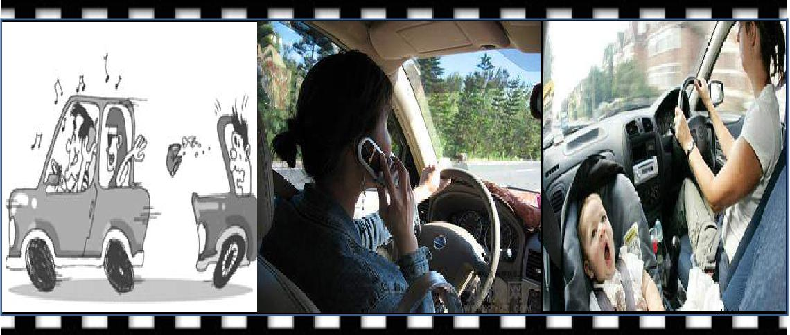
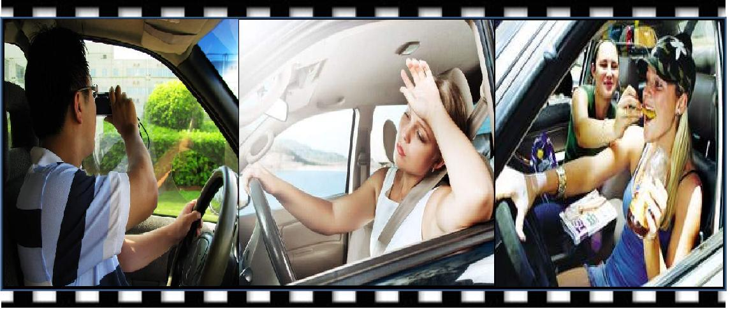
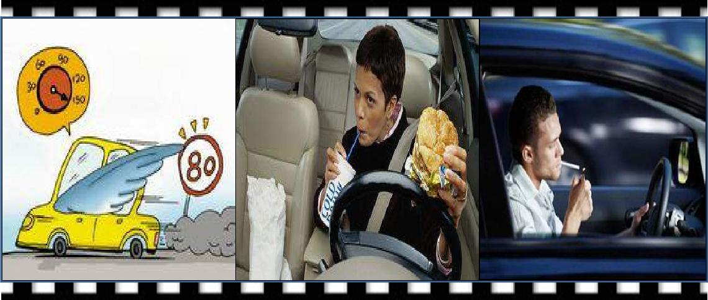
Look and think
Are they good drivers?

Slide 29
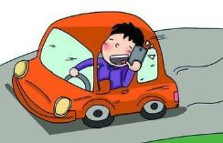
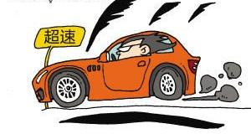
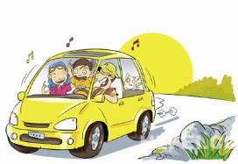
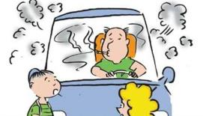
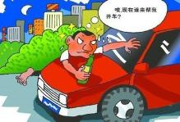
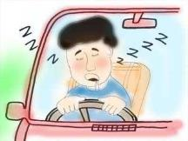
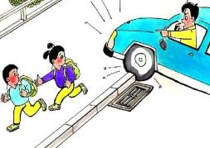
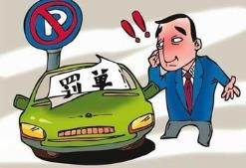
Look and say
1
5
2
6
3
7
4
8

Slide 30
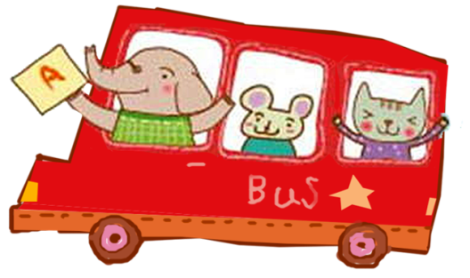
Think and say
What do you want to say to a driver?

Slide 31
Follow the rules,
Cherish every day!

Slide 32
Ticking time!
 | ★ ★★ | ★★ | ★
1.I know the function of the stress in a sentence and try to practise it. （了解句子重音的作用并能尝试运用）
2. I can understand and act the cartoon time. （理解并表演本课卡通）
3 I know about the difference of road rules for drivers between China and western countries. （知道中西方不同的汽车行驶交通规则）

Slide 33
Homework
1.Listen, read and act the cartoon.
（听读演本课卡通。）
2.Read Cartoon time, and mark the stress.
（标出cartoon time中的重读单词试着朗读。 ）
3.Find more countries who drive on the right side or left side of the road.
(找出其他靠右行驶或靠左行驶的国家。)

