Slide 1
Unit3 It’s a pineapple.
人教精通版四年级上册
WWW.PPT818.COM

Slide 2
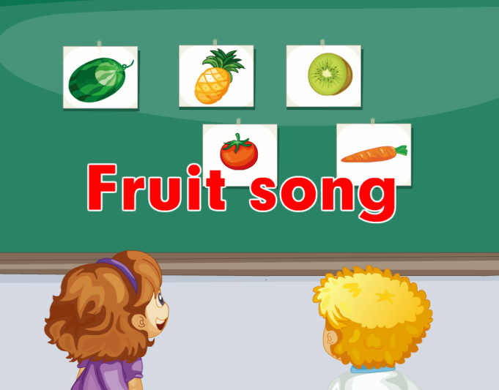
Let’s sing
Review

Slide 3
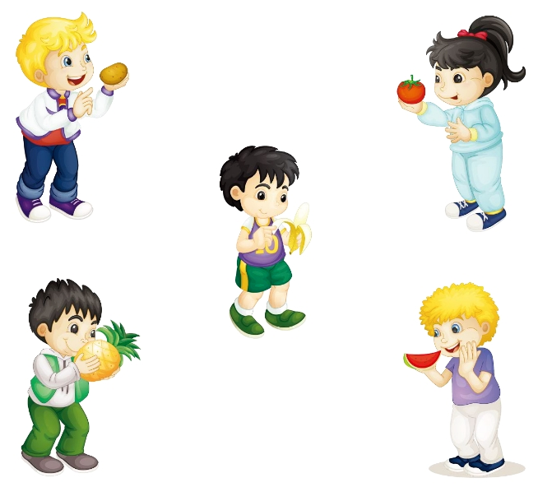
Let’s do
Review
Show me the potato.
Pass me the tomato.
Peel the banana.
Smell the pineapple.
Eat the watermelon.

Slide 4
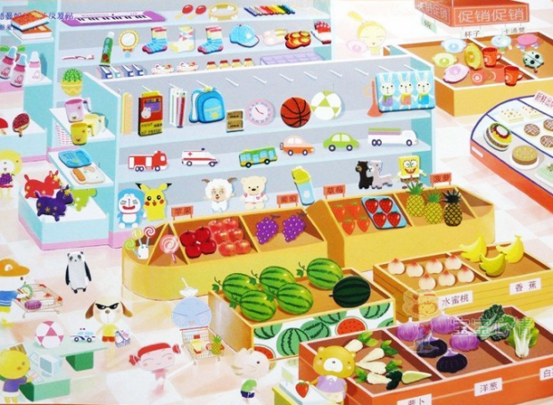
Free talk
Lead-in
Now, let’s go to the supermarket. What do
you want to buy?

Slide 5
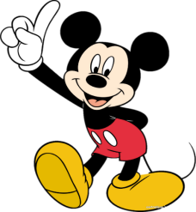
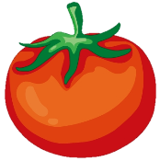
Think and say
Presentation
I want to buy a kind of vegetable.
It’s round and red. It’s juicy (多汁的).
What’s that in English?
tomato

Slide 6
Think and say
Presentation
I want to buy a kind of vegetable.
It’s long and green. And there’s a
yellow flower on it. What’s
that in Chinese?

Slide 7
Let’s learn
Presentation
What’s that in English?
It’s a cucumber.

Slide 8
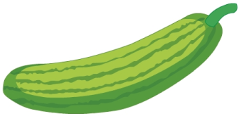
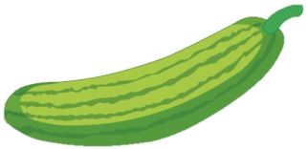
Let’s learn
Presentation
cucumber
cucumbers
Do you like cucumbers?

Slide 9
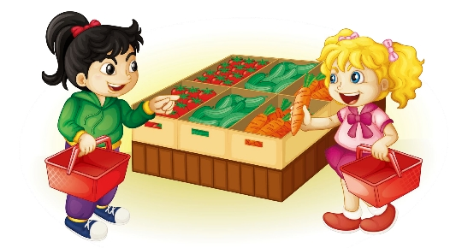
Presentation
Listen and answer
What’s that in English?
It’s a carrot.

Slide 10
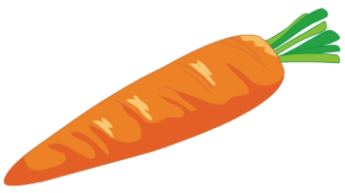
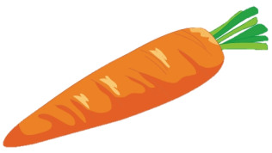
Let’s learn
Presentation
carrot
carrots

Slide 11
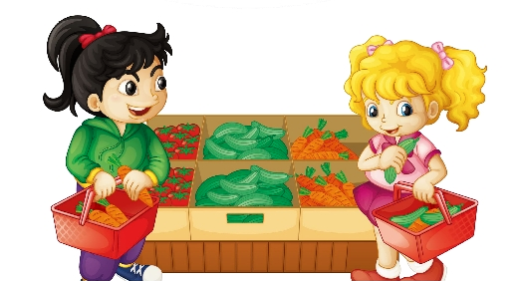
Presentation
Listen and answer
Does Kate like carrots?
Yes, she does.
She likes cucumbers, too.

Slide 12
Just read and write
Presentation

Slide 13
Presentation
Listen and imitate
1
2
Hi, Kate. What’s that in English?
It’s a carrot.
3
Do you like carrots?
4
Yes, I do. And I like cucumbers, too.

Slide 14
Show time
两人一组，练习对话并表演，其他同学评价。
 | 模仿录音中的语音语调，有感情地朗读。
 | 可以脱离课本，适当改动其中部分，语音地道。
 | 适当添加内容，意思完整，有创新，表演生动。
Good
Great
Excellent

Slide 15
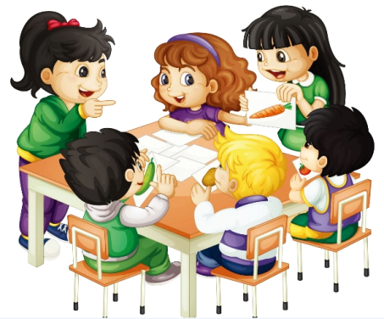
Let’s play
Practice
1
2
What’s that in English?
It’s a carrot.
4
Yes, I do.
3
Do you like carrots?

Slide 16
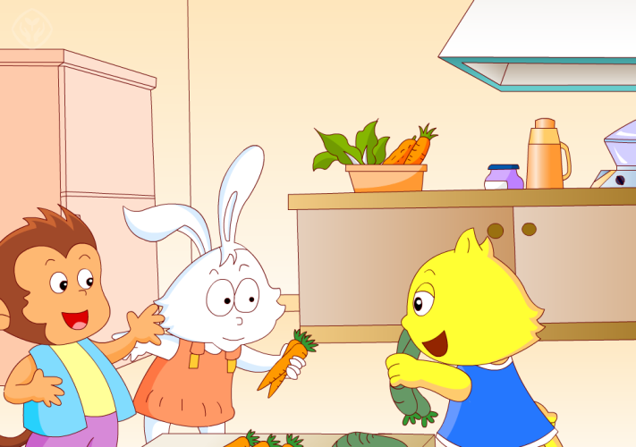
Let’s chant

Slide 17
Summary
本课学习的蔬菜类单词有:
carrot
cucumber

Slide 18
Summary
本课的重点句型是什么？
—What’s that in English?
—It’s a/an ...

Slide 19
Homework
1. 跟读Just talk部分的课文录音，并注意语音、语调。
2.制作一些你喜欢的果蔬图片，并在上面标注上它们的英文名字。
3. 预习Lesson17。
Close

