Slide 1
Unit 8
Is there a post office near here?
R 七年级下册
第1课时
WWW.PPT818.COM

Slide 2
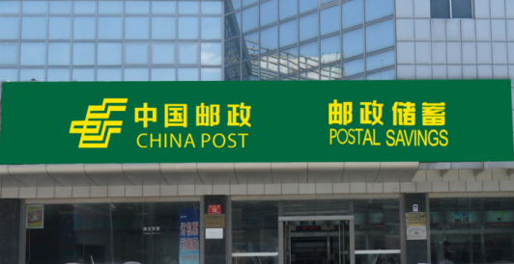
Do you know these places?
Lead-in
post office

Slide 3
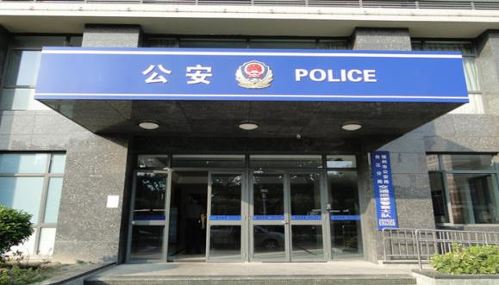
police station

Slide 4
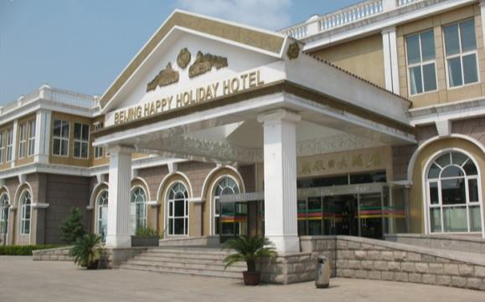
hotel

Slide 5
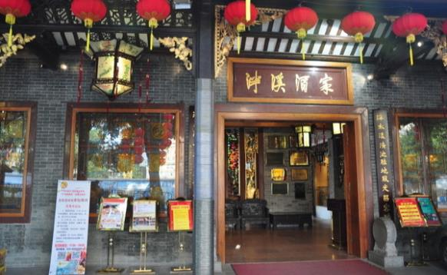
restaurant

Slide 6
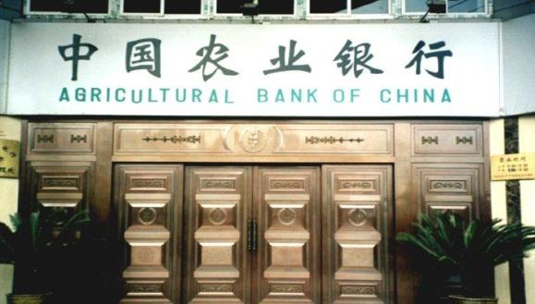
bank

Slide 7
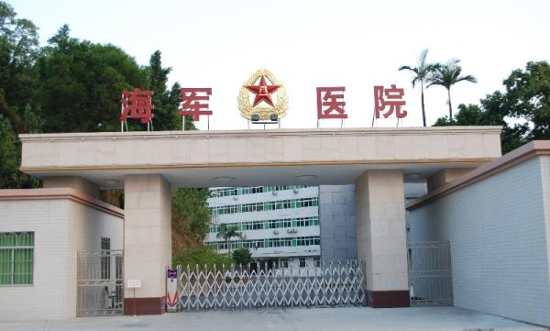
hospital

Slide 8
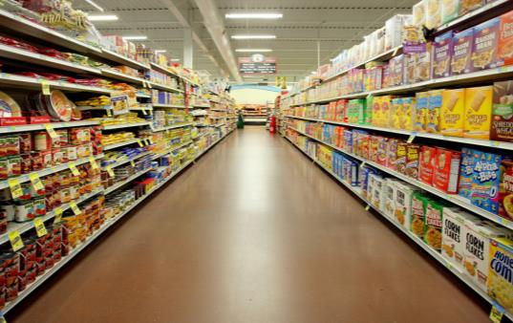
supermarket

Slide 9
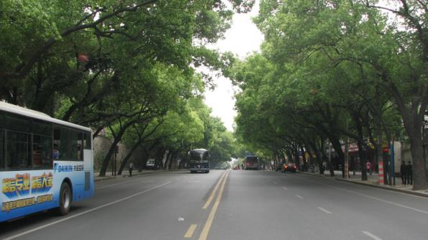
street

Slide 10
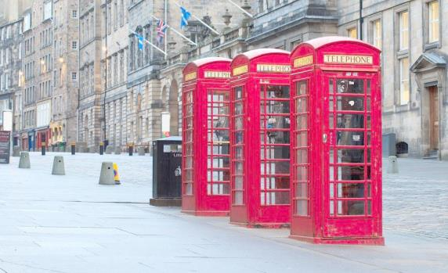
pay phone

Slide 11
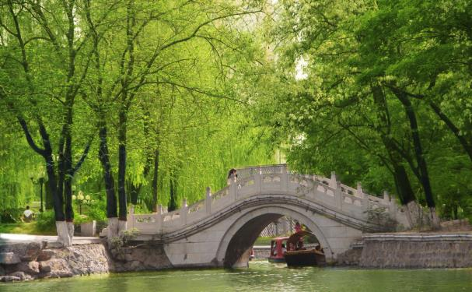
park

Slide 13
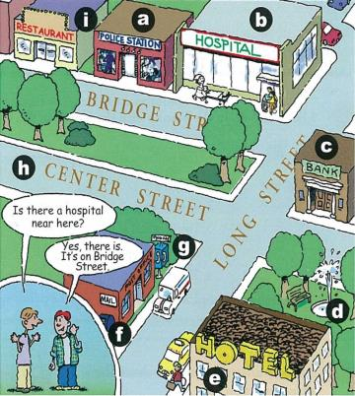
1a
Match the words with the places in the picture.
f
1. post office __
2. police station __
3. hotel __
4. restaurant __
5. bank __
6. hospital __
7. street __
8. pay phone __
9. park ___
a
e
i
c
b
h
g
d

Slide 14
1b
Listen and circle the places you hear in 1a.
1. post office __ 2. police station __
3. hotel __ 4. restaurant __
5. bank __ 6. hospital __
7. street __ 8. pay phone __
9. park ___

Slide 15
1c
Practice the conversation with your partner. Then ask and answer questions about the other places in 1a.
Is there a hospital
near here?
Yes, there is. It’s
on Bridge Street.

Slide 16
Is there a post
office near here?
Yes, there is.
It’s on Long Street.

Slide 17
Is there a restaurant
on Bridge Street?
Yes, there is.

Slide 18
Match the sentences with the pictures. Write each number in the box.
2a
4
6
2
3
5
1
1. The pay phone is across from the library.
2. The pay phone is next to the library.
3. The pay phone is between the post office and the library.
4. The pay phone is on Green Street.
5. The pay phone is in front of the library.
6. The pay phone is behind the library.

Slide 19
Listen and fill in the blanks with the words in the box.
2b
next to in front of between
behind across from on
1.The police station is between the restaurant and the hospital.
2.The park is ___________ the bank.
across from

Slide 20
next to in front of between
behind across from on
3.The hospital is ___ Bridge Street.
4.The pay phone is _______ the post office.
5.The restaurant is _________ the post office.
6.The hotel is _______ the police station.
on
next to
in front of
behind

Slide 21
Ask and answer questions about the places in 1a on page 43.
2c
Where’s the hospital?
It’s next to the police station.

Slide 22
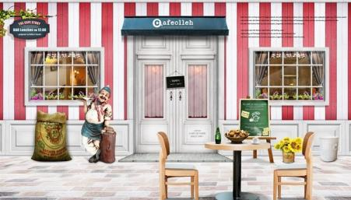
It’s next to the police station?
Where’s the restaurant?

Slide 23
It’s next to the post office.
Where’s the pay phone?

Slide 24
2d
Role-play the conversation.
对不起”“劳驾”或“请原谅”,是打扰他人前的客套话,以示礼貌或歉意
Tony: Hi, excuse me.
Linda: Yes. How can I help you?
Tony: Well, I’m new in town. Is there a bank around here?
Linda: Yes, there is. It’s on Center Street. It’s across from
the park.
Tony: Oh…where’s Center Street?
Linda: It’s not too far from here. I can walk with you.
Tony: Oh, that’s great! Thanks so much.
Linda: No problem.
离……远(= far away from)
反义词组:be close to 离……很近

Slide 25
2d
Answer the questions.
1. Is there a bank near here?
_______________________
2. Where’s the bank?
_____________________________________
3. Is Center Street far from here?
_________________________________
Yes, there is.
It’s on Center Street, across from the park.
No, it isn’t.

Slide 26
Language points
1. —Is there a hospital near here? 这附近有医院吗？
—Yes, there is. It’s on Bridge Street.
是的，有。它在桥街上。
Is there … 有……吗？
这是there be句型的一般疑问句形式
肯定回答：Yes, there is. 否定回答：No, there isn’t.

Slide 27
辨析：there be 与 have/has
there be 某处有某物/某人
句型：There be+某物/某人+某地
（客观存在）
have/ has 某人/某物有某人/某物
句型：某人/某物+have/has+某物/某人
（从属关系）
（取决于句子的主语）

Slide 28
翻译下列句子。
1.在我的包里有两把尺和一支钢笔。
____________________________________________
2.我有一个妹妹和两个弟弟。
____________________________________________
3.她有一辆汽车。
____________________________________________
There are two rulers and a pen in my bag.
I have a sister and two brothers.
She has a car.

Slide 29
2. The pay phone is next to the library.
付费电话在图书馆的旁边。
next to(介词短语) 在……的旁边；邻近
有时可与beside互换
例：银行在医院旁边。
The bank is beside/next to the hospital.

Slide 30
辨析：next to与near
next to
near
物体之间距离较近。后常接表示场所、顺序、价值等方面的词。
紧挨着；紧靠着
有时可与next to互换使用， 但其所表示的“近”是相对于far来说的。
在……附近

Slide 31
3. The pay phone is in front of the library.
付费电话在图书馆前面。
in front of 在……的前面
反义词: behind 在……的后面
强调一个物体在另一个物体外部的前面
易混淆短语：in the front of
强调一个物体在另一个物体内部的前面

Slide 32
4.Where’s the hospital? 医院在哪里？
Where’s ……？ 询问某人或某物在哪里的常用句型
基本结构: Where + be动词+人/物/地点名词？
取决于所询问物体的单复数。
例: 你的英语老师在哪里？
Where is your English teacher?

Slide 33
5. How can I help you? 需要我帮忙吗？
此句广泛用于商店、饭店、旅馆、邮局、办事处等场所,作为对顾客的招呼语。
同义句型：
Can/May I help you?
What can I do for you?

Slide 34
Exercise
一、单项选择.
( )1. ________ there a bank near here?
A. Am B. Is C. Are D. Be
( )2. Our school is ______ a bank.
A. next B. next to C. between D. between and
B
B

Slide 35
( )3. — _____ is the park?
— It’s on Center Street.
A. What B. When C. Where D.How
( )4. The supermarket is ____Fifth Avenue.
A.on B. through C. between D. /
C
A

Slide 36
二、句型转换
1.There is a post office near here. (变否定句)
________ _______ a post office near here.
2.The bank is across from the park. (对划线部分提问)
_________ is across from the park?
3.饭馆离学校不远。（将句子补充完整）
The restaurant ______ ______ ______ the school.
There isn’t
Where
isn’t far from

Slide 37
3. There are some people in the park.
(一般疑问句并作肯定回答)
_______ there ______ people in the park?
Yes, ______ _______ .
4. What can I do for you? (改为同义句）
_______ _______ I _______ you?
Are
any
there are
How can help

