Slide 1
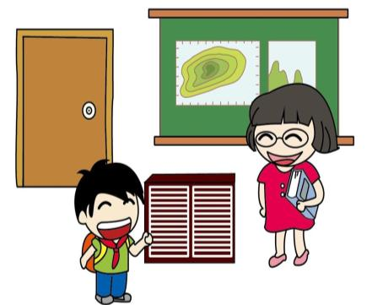
Unit 2
A new student
第一课时
WWW.PPT818.COM

Slide 2
Introduce
How many classrooms are there in our school?
Are there any computer rooms?
Is there a music room?
They’re on the third floor.
It’s on the first floor.
“How many···are there···?”
“Is/are there···?”
“It’s/They’re on the···floor”

Slide 3
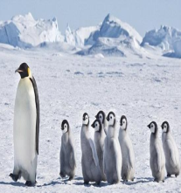
Words
show around带领…参观
常用短语： show sb around 带领某人参观
show something around 显示周围的东西
show one around 四处逛逛
eg: I’ll show you around.
小练习：For the first time you come here, let me you .
A. show around B. show off
A

Slide 4
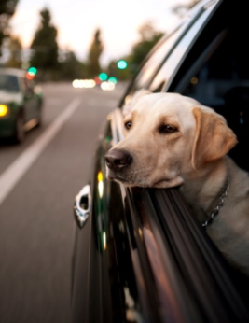
Words
have a look 看一看
常用短语：have a new look 呈现新面貌
have a rough look 走马观花的看
eg：Please have a look. 请您过目。
小练习：Get onto my shoulders and over the fence.
A. look after B. have a look
B

Slide 5
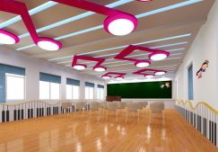
Expressions
Is there a music room? 有音乐教室吗？
There be 的疑问句：
（1）There be 句型的一般疑问句是将be 放在there 之前。
回答时用yes或no，后面接简单答语。
eg：--Is there a cake on the table? . --Yes，there is. / No，there isn’t.
--Will there be a party tonight？--Yes，there will./ No, there won’t

Slide 6
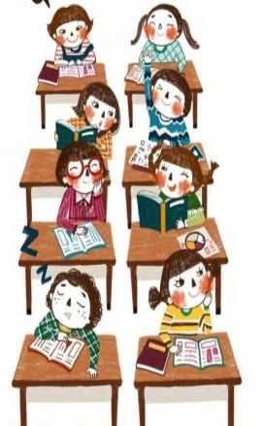
Expressions
（2）There be 句型的特殊疑问句，主要有how many和how much做引导词有两种情况：
eg: How many students are there in your school?
How much money is there in your pocket?

Slide 7
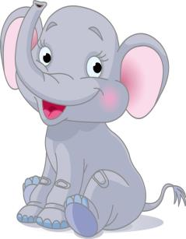
Expressions
（3）There be 句型的反意疑问句：
eg: There is a cup on the table, isn’t there?
There is some orange in the glass, isn’t there?
There are a lot of letters in the mailbox, aren’t there?
There will be a new hospital nearby, won’t there?

Slide 8
Dialogue
Talk about your school using“Is/Are there…?”.

Slide 9
Summary
show around
have a look
Is/Are there···?

Slide 10
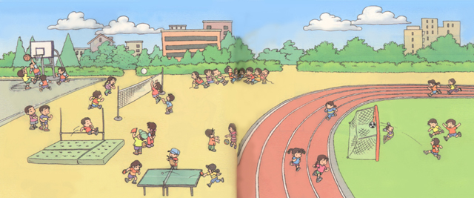
Exercise
i a r
play
l_ b r __ __ y
______ ground

Slide 11
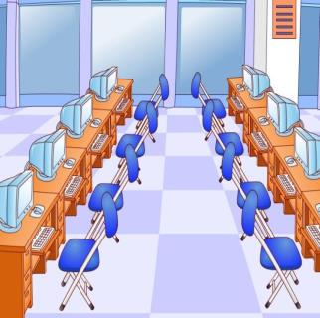
Exercise
class
computer
_______room
_______room

Slide 12
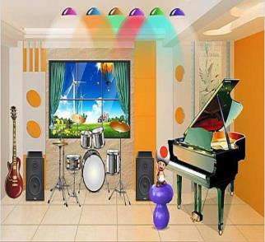
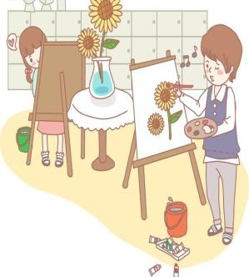
Exercise
music
art
_______room
_______room

Slide 13
Exercise
（）1、____there two dogs?
A. Is B. Are C. Am
（）2、____ there a people?
A. Is B. Are C. Am
（）3、How many music rooms _______ in your school?.
A. is there B. are there C. there
B
A
B

Slide 14
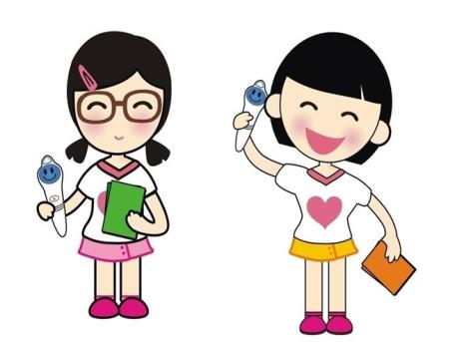
Homework
Text dialogue performance: a group of three students.

