Slide 1
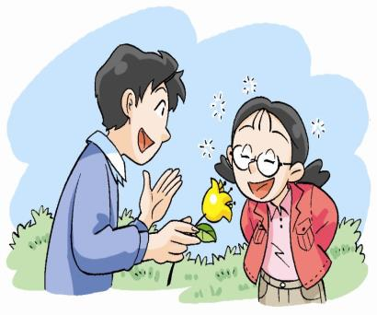
Smell and taste
第一课时
WWW.PPT818.COM

Slide 2
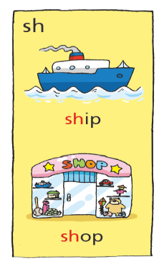
Look and read
sh-
shape
-sh
fish, dish, wash …

Slide 3


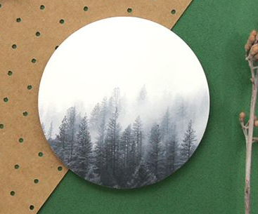


rectangle
Let's learn
triangle
square
circle
star

Slide 4
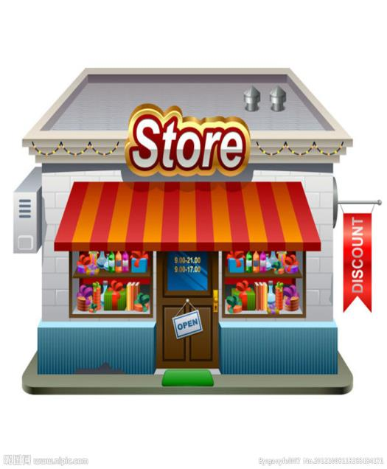
Let's learn
colour
shape

Slide 5

请你当一回小侦探，帮老师找到缺失的三种水果！
To be a detetive

Slide 6
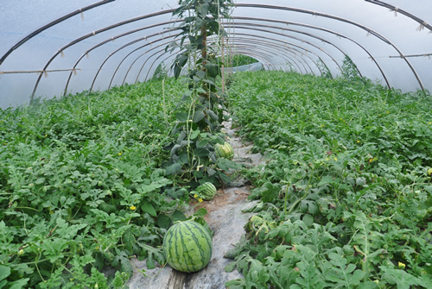
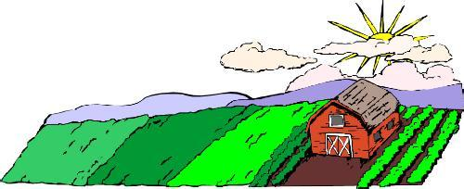
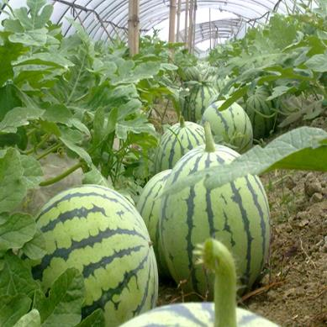

Slide 7
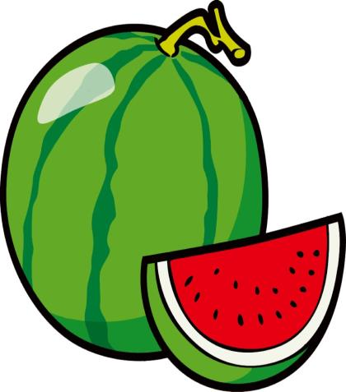

Is it _____?
Yes,it is.
No,it isn’t. It’s _____.
Smell it.
Is it _____?
watermelon

Slide 8
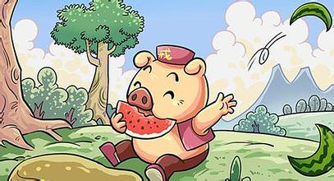
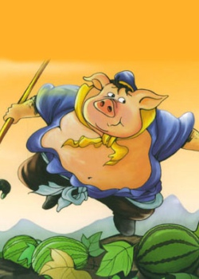
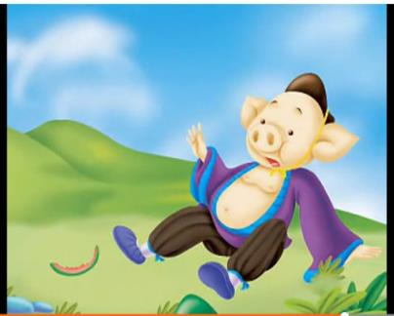



Piggy eats a watermelon.
He throws the peels away.
Piggy slips on the peels.
He is unhappy.
Throw the rubbish into the bin

Slide 9
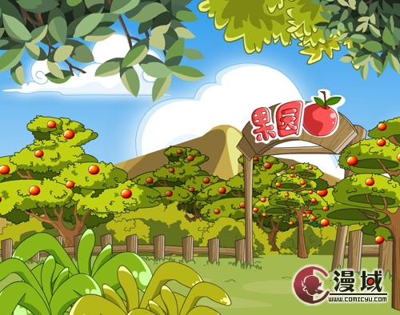
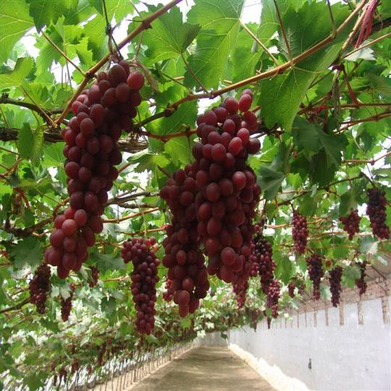
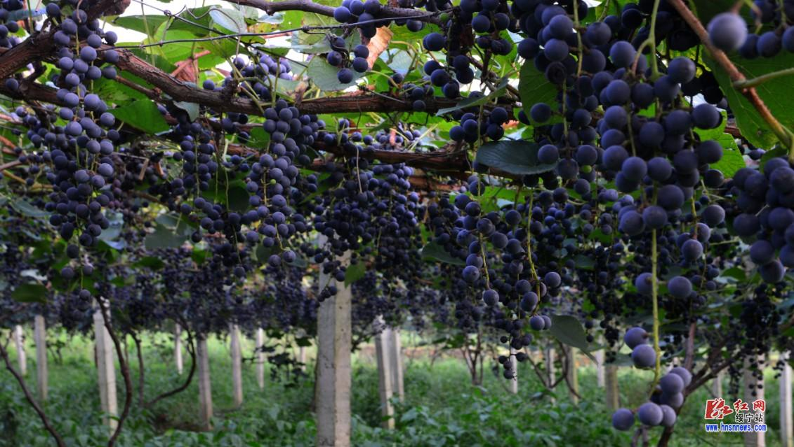
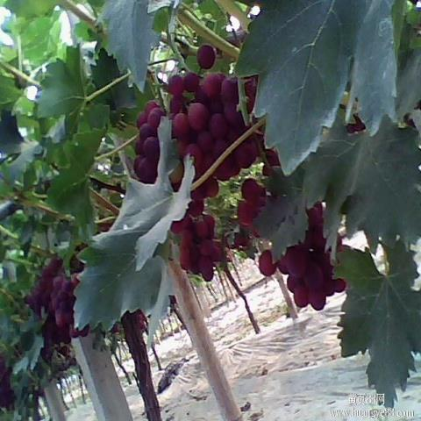
orchard

Slide 10
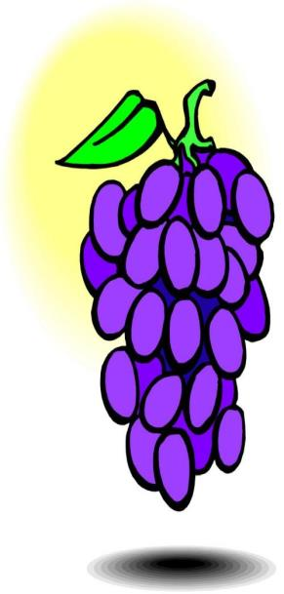
Is it ___?
Yes,it is.
No,it isn’t. It is ____.
Taste it.
Is it ___ or ____?
It’s _____.
grape

Slide 11
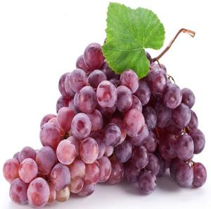
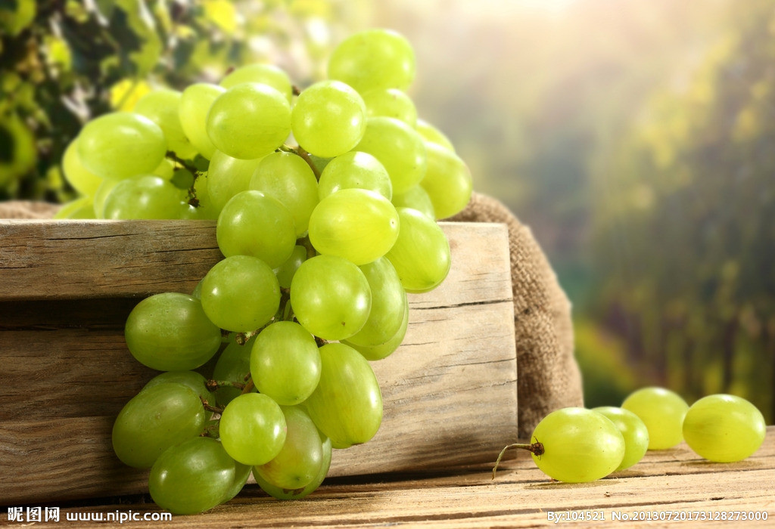
green
purple
They are (round) and (small).
They are (sweet) and (sour).
size
taste

Slide 12
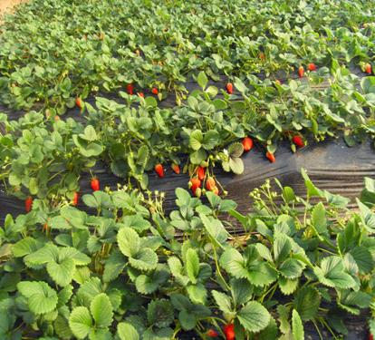
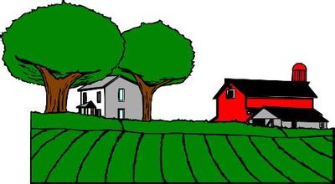
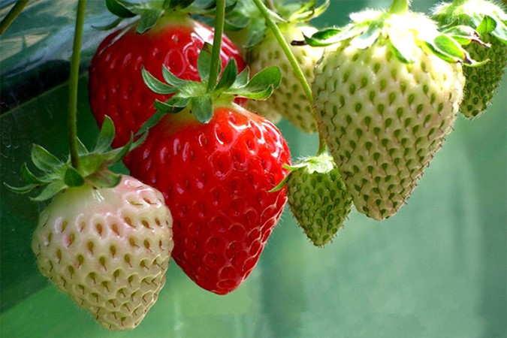
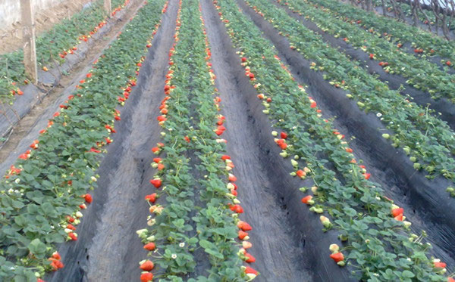

Slide 13
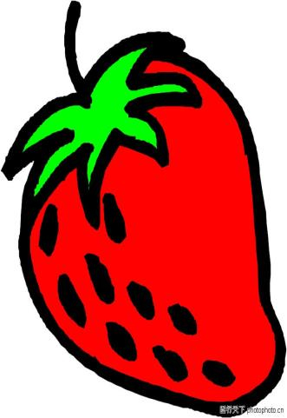
Is it ___?
Yes,it is.
No,it isn’t. It is ____.
Touch it.
Is it ___ or ____?
It’s _____.
strawberry

Slide 14
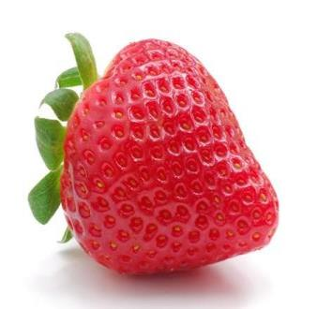
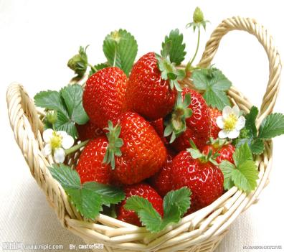
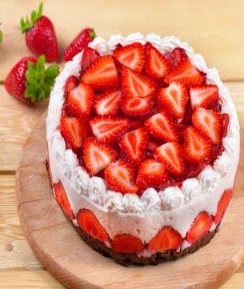
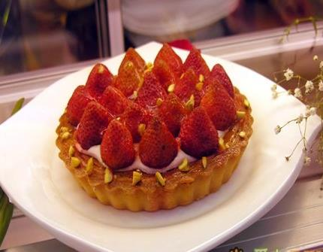
a strawberry
ies
strawberr___

Slide 15
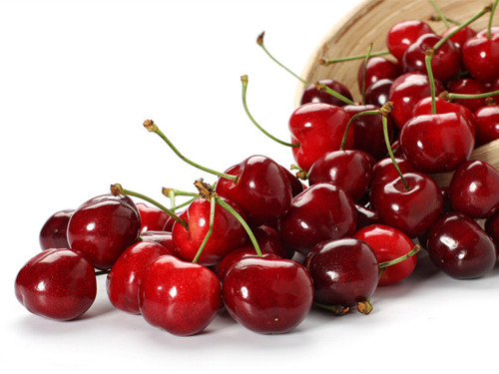
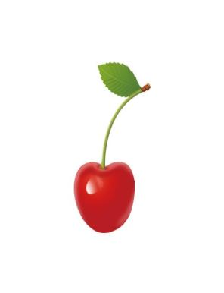
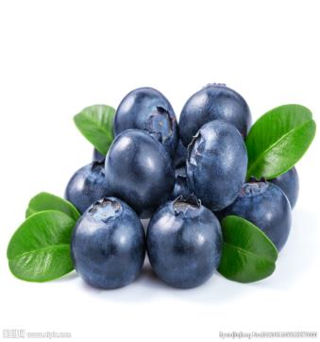
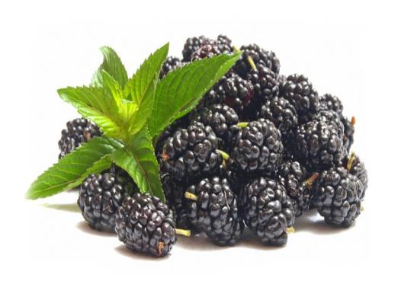
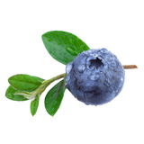
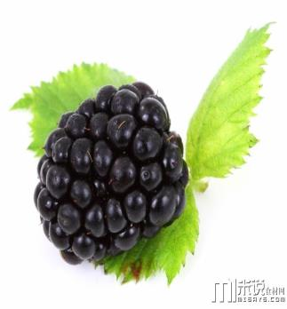
ies
blueberry
blueberr
ies
blackberry
blackberr
ies
cherry
cherr

Slide 16
Let's chant
I like watermelon,I like watermelon,
round and big,round and big.
I like watermelon,I like watermelon,
green and sweet,green and sweet.
I like grape,I like grape,round and small, round and small.
I like grape,I like grape,sour and sweet, sour and sweet.
I like strawberry,I like strawberry,
red and small, ,red and small.
I like strawberry,I like strawberry,
sour and sweet,sour and sweet.

Slide 17
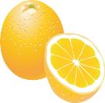


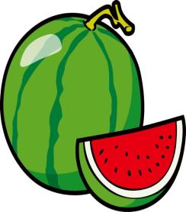
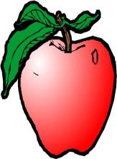


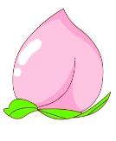

Group work
A:Is it ... or ... ?(colour/size)
B:It's ... .
A:Is it ... or ... ?(sweet/sour/bitter)
B:It's ...

Slide 18
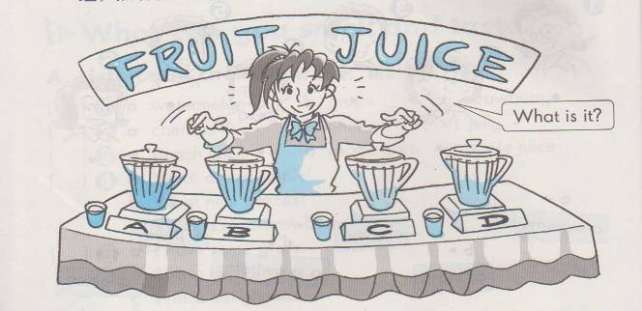
Make some juice

Slide 19
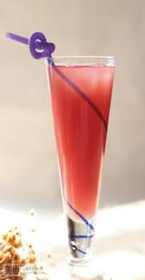
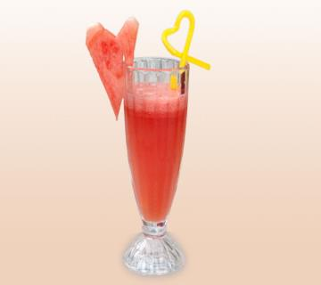
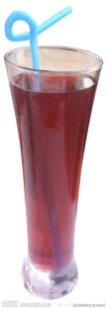
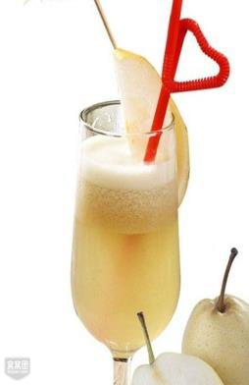
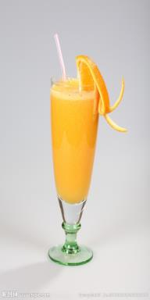
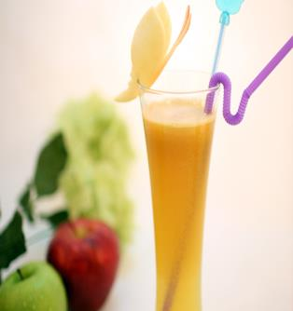
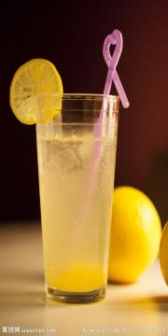
A: Smell this. Is it … juice or … juice?
B: Is it … juice?
A: Taste it. Is it … juice?
B: It’s (sweet/sour). It’s … juice.
A: You’re right./Sorry, it’s …
Taste and guess

Slide 20
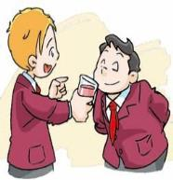
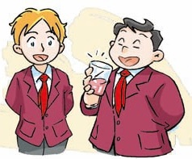
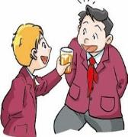
Retell
____ this. Is it strawberry juice _____ watermelon juice?
Smell
3
or
Look, Joe. I have
some _____ here.
juice
strawberry
juice
Is it ________ _____?
It’s _____ and _____.
It’s ________ juice.
1
sweet
Taste
sour
____ it.
What’s this, Joe?
strawberry
Is it _____ juice?
orange
2
4
Yes,_____ .
it is
You’re _____.
right

Slide 21
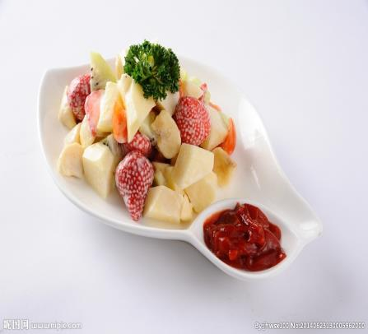
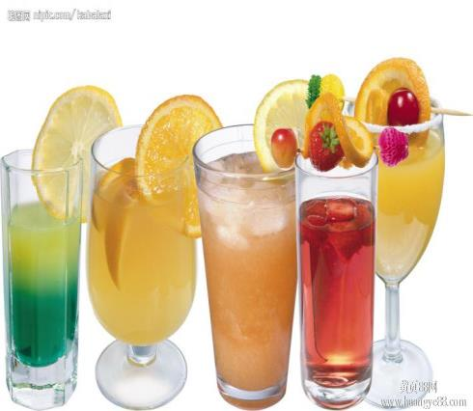

Taste and guess
A:I have some salad.Smell it.Is it ... or ... ?（水果名称）
B:Is it ... ?（水果名称）
A:Taste it.Is it sweet or sour?
B:It's ...(sweet/sour) .It's ...（水果名称）.
A:Yes,you're right./Sorry,it's ... .
fruit salad
fruit juice

Slide 22
Tips
The fruit juice is sweet and nice.
And the fruit is good for our health.
So we should eat fruit or drink juice everyday.

Slide 23


Homework
Listen and read pages 6 and 7. Preview page 8.
Copy and recite the new word and sentences:
grape
Is it watermelon juice or strawberry juice?
It’s strawberry juice.
You’re right.
3. Complete Workbook 4B pages 8 and 11.

