Slide 1
Unit 7 Shopping Reading (II)
WWW.PPT818.COM

Slide 2
Help Sandy
Sandy wants to buy something for her family, but she doesn’t have enough money. Let’s help her finish some tasks to earn money.

Slide 3
Task 1 Translate
Just a minute.
two yuan each
different kinds
last year’s cards
take a look
I’ll take them.
1. 稍等。
2. 每个两元
3. 不同种类
4. 去年的卡片
5. 看一看
6. 我要买它们。
7. 它们与她的粉色外套很相配。
They match her pink coat.

Slide 4
Task 2 Fill in the blanks
In the first shop, Amy wants to buy some __________ for Simon. They are _____ yuan each. Amy doesn’t think they are _____. The shopkeeper says the ________ cards are only one yuan each. But Amy wants to buy the new cards.
In the second shop, Amy wants to buy __________ for Sandy. She knows Sandy likes hair clips and they are very_________. She thinks they ________ her _______ coat. The hair clips are _______ yuan. She has fifteen yuan. So she has_______ money to buy them.
football cards
2
cheap
last year’s
hair clips
pretty
match
pink
nine
enough

Slide 5
Task 3 Role-play
S1: ... Can I help you?
Amy: I want ....
S1: Here are ... Take a look.
Amy: How much ...?
S1: They’re ... each.
Amy: ... not cheap.
S1: ... last year’s ...?
They’re ....
Amy: No, ....
S2: ...What can I do for you?
Amy: I’d like ....
S2: There are ....
Amy: Oh, ... match ....
S2: Yes, ... pretty.
Amy: How much ...? I only
have ....
S2: ... enough.
They’re … yuan.
Amy: Fine, I’ll take them.
S2: OK. Here’s ....
Notes:
5

Slide 6
What do shopkeepers say?
Can I help you?
What can I do for you?

Slide 7
What to buy?
Sandy wants to buy a wallet for her mother.
= Sandy wants to buy her mother a wallet.
Sandy wants to buy sth for sb.
= Sandy wants to buy sb sth.
¥ 150
¥ 280
buy sth for sb = buy sb sth

Slide 8
Guess: What’s in the box?
Is there a/an ... in the box?
Are there any ... in the box?

Slide 9
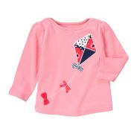
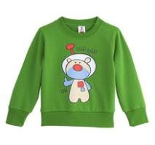
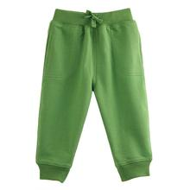
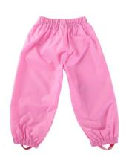
Do they match each other?
The pink T-shirt _________ the pink trousers.
The green T-shirt _________ the green trousers.
matches
matches

Slide 10
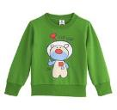
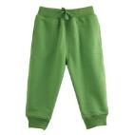
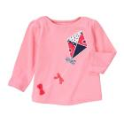
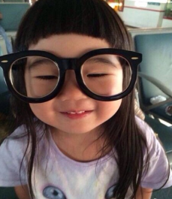
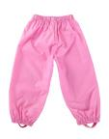
Do they fit them?
Do they fit Joe?
Yes, they fit him very well.
The pink T-shirt and trousers _______ Grace very well.
fit
match sth
fit sb

Slide 11
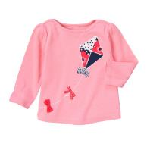
How much?
A: How much does ... cost?
B: It costs ...
A: How much do ... cost?
B: They cost ...
¥40
¥20
A: How much is ...?
B: It is ...
A: How much are ...?
B: They are ...
¥10
¥25

Slide 12
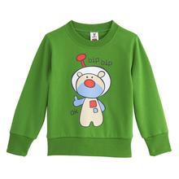
Does Sandy have enough money for them?
Sandy has enough money for them.
= Sandy has enough money ____ _____ them.
to buy

Slide 13
Does she have enough money for them?
Sandy has enough money.
Sandy is ____ ______ .
enough money
rich (富有的) enough
rich enough
enough + n. (复数名词或不可数名词）
adj. + enough

Slide 14
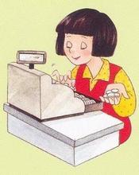
The change is ...
Just a minute. Here is your change.
The change is 5 yuan.

Slide 15
Make a conversation
Sandy wants to buy some stationery for herself with the change. What can she buy in the stationery shop? Please make a conversation.
ballpen: 2 yuan
glue: 1 yuan
rubber: 1 yuan
pencilcase: 3 yuan
exercise book: 2 yuan

Slide 16
Exercises
一、句型转换
1. Can I help you? (同义句转化)
______ ______ _____ _____ _____ _____?
2. There is some rice in the bag. (改为一般疑问句)
______ ______ _____ rice in the bag?
3. How much is the book? (同义句转化)
How much _______ the book ______?
What
can
I
do
for
you
Is
there
any
does
cost

Slide 17
Exercises
二、选择
1. The interesting book ______ me 15 yuan.
A. spends B. pays C. costs D. takes
2. I _____ 15 yuan buying the book.
A. spend B. pay C. cost D. take
3. I _____ 15 yuan for the book.
A. spend B. pay C. cost D. take

Slide 18
Exercises
4. We don’t have _____ to read. Let’s buy some.
A. enough book B. book enough
C. enough books D. books enough
5. The boy is not _____ to dress himself.
A. enough old B. old enough
C. enough young D. young enough
enough + n.
adj. + enough

Slide 19
Exercises
三、动词填空
1. There ______ (be) 20 girls in our class.
2. There ______ (be) some money in my pocket.
3. How much _____ the jacket ______ (cost)?
4. Tony spends one hour ______ (do) his
homework every day.
5. We don’t have enough time _________ (finish)
the task. Let’s hurry.
are
is
does cost
doing
to finish

Slide 20
Homework
Remember the useful words and phrases in the conversation.
2. Do some exercises.

