Slide 1
Unit 3 Robots Study skills
WWW.PPT818.COM

Slide 2
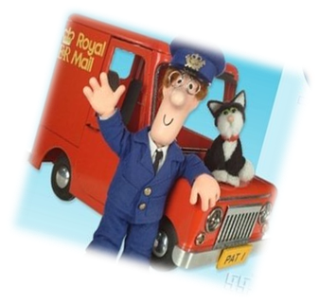
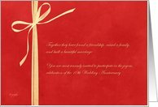
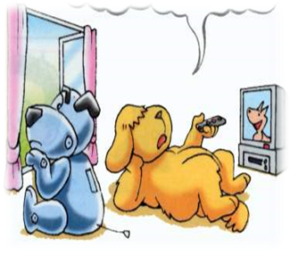
An invitation

Slide 3
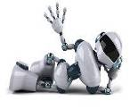
Dear Hobo and Eddie:
We sincerely invite you to our robot show.
By then, there will be many robots from different countries. Some are specially designed to make delicious food, and other robots are designed to help students with their homework.
We expect you to come. Place: Times Square, New York, the USA Date: 15-16 May 2015
Robot Show Centre

Slide 4
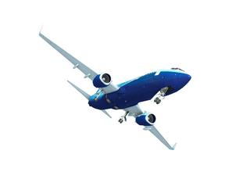
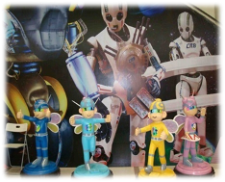
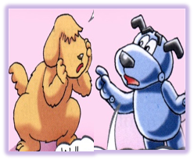
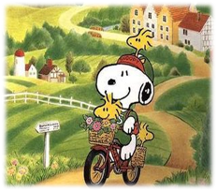
Some problems！

Slide 5
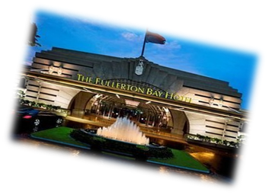
On the 1st day
the 2nd floor
the 3rd floor
the 1st floor
the 2nd floor
the ground floor
the 1st floor
the dinning room
Hobo and Eddie: Excuse me, where is _______________?
An American: It’s on the _______ floor.
first
Hobo and Eddie: Where is the restaurant?
There’s ______________ on the first floor.
a health centre

Slide 6
Chinese | BrE | AmE
秋天 | autumn
饼干 | biscuit
卡车 | lorry
电梯 | lift
书店 | bookshop
花园 | garden
电影 | film
足球 | soccer
橡皮 | rubber
假期 | holiday
fall
cookie
truck
elevator
bookstore
yard
movie
football
eraser
cookie

Slide 7
British English or American English?
underground
pants
can
apartment
mail
subway
trousers
tin
flat
post

Slide 8
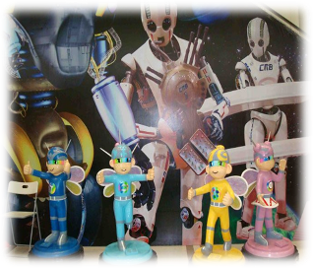
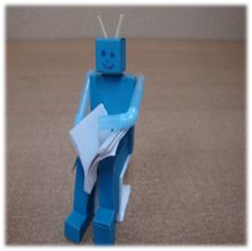
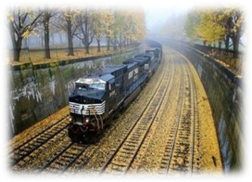
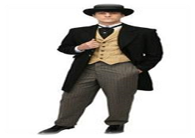
On the 2nd day
clerk [klɑːk] [klɝk]
clock [klɒk] [klɑk]
An American: What’s your job?
An Englishman: I’m a clerk.
An American: Clock? Your job is
to tick tick all day long?
Notes:
8

Slide 9
Vowel—A
Vowel—O
Consonant—R

Slide 10
Vowel—A
[dɑ:ns]
● [dæns]
dance
[ɑ:sk]
[æsk]
ask
[hæf ]
[hɑ:f ]
half
[klɑːs]
[klæs]
class
● [lɑːst]
last
[læst]

Slide 11
Vowel—O
British English [ɒ]
American English [ɑ]
box
hot
clock
possible
[hɑt]
[klɑk]
[bɑks]
[hɒt]
[klɒk]
[bɒks]
['pɑsəbl]
['pɒsɪb(ə)l]

Slide 12
Consonant—R
[kɑ:]
car
[kar]
hair
card
party
door

Slide 13
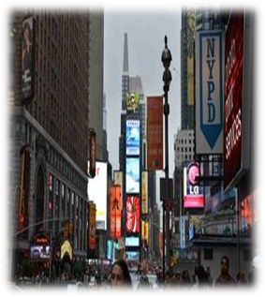
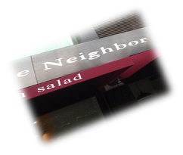
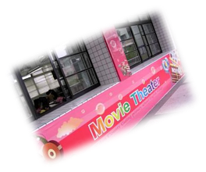
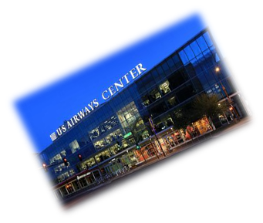
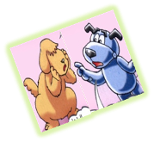
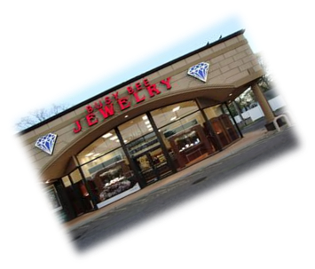
On the 3rd day
spelling mistakes
Notes:
13

Slide 14
theatre
theater
centre
center
metre
meter
colour
color
humour
humor
favourite
favorite
jeweller (珠宝商)
jeweler
traveller
traveler
kilogramme
kilogram
programme
program
dialogue
dialog

Slide 15
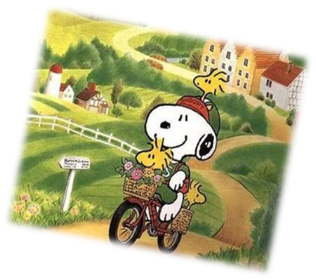
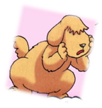
On the 4th day
Snoopy: What do you think of the
robot show?
Hobo: Wonderful!
Snoopy: Did you buy a robot yet?
Eddie: Did you? Snoopy English?
Snoopy: No. It’s American English!
Eddie: Oh! I see.
Each of us has already
bought a robot.

Slide 16
Have you got …?
My friend has just arrived.
in the team
at the weekend
I’ll see you on Monday.
Write to me soon.
Do you have …?
My friend just arrived.
on the team
on the weekend
I’ll see you Monday.
Write me soon.

Slide 17
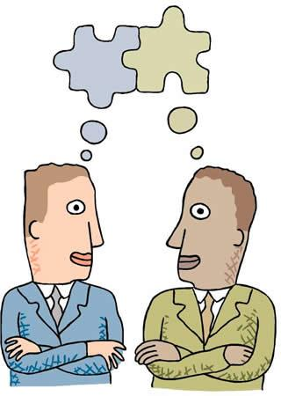
After the trip
Use American English to complete the article
Several days ago, Eddie and I went to the USA for a robot show. We saw robots from different countries. Eddie already_______ (买) a robot. This new robot comes in his _____________ (最喜欢的颜色) —red, blue and white. The robot can help a lot in the _______ (花园). When he goes _______ (旅行), the robot can help look after me. It’s a pity that the robot never goes to see a ________ (电影) with him.
bought
favorite colors
yard
traveling
movie

Slide 18
After the trip
Complete it according to what you’ve learned
During this trip to the USA, Eddie and I also achieved a lot about the differences between British and American English. They are mainly different in ____________, _____________, ____________ and ____________.
We think the world is so wonderful that we should go out as often as possible. We should always remember that we are never too old to learn.
vocabulary
pronunciation
spelling
grammar

Slide 19
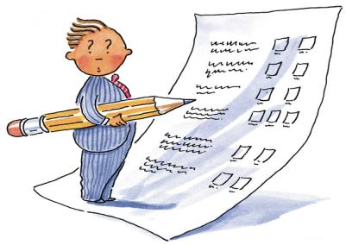
Homework
Revise the differences between British
English and American English.
2. Find more differences between British
English and American English on the Internet.

