Slide 1
Unit 8 Birthdays
五年级
第3课时
WWW.PPT818.COM

Slide 2
Let’s play
填入所缺数词，大声说出句子,
注意基数词和序数词的正确使用哦！
Su Hai’s birthday is on the ___ of May.
December is the ___ month of a year.
The ___ day of a week is Sunday.
There are ____ months in a year.
Today is the _______ of April.
There are ____ days in April.
This classroom is on the _____ floor.
There are ___ students in our class.
August is the _____ month of a year.
There are____ people in the girl’s family.

Slide 3
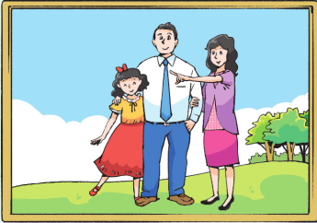
Let’s listen
ð
th
This is my father.
He works in the city.
That’s my mother.
She’s tall and pretty.
Th
th
th
Th
th

Slide 4
Let’s read
This is my father.
He works in the city.
That’s my mother.
She’s tall and pretty.

Slide 5
Do you know more words with “th” ?
Let’s think
ð
brother they them together
their there these those
then with clothes other…

Slide 6
Read and match
你会区分th的不同读音吗？
they
thank
three
think
their
the
them
these
birthday
mouth
/ð/
/θ/

Slide 7
想象一下，女孩收到礼物会说什么？
Happy birthday, dear!
Here’s a present for you.
Thank you so much./…
What a nice present!
I love it very much.
It’s very nice of you.
You’re so kind.
…

Slide 8
收到
If you receive some presents, when do you open them?
A. After all the people leave，I open them.
B. Maybe I open them tomorrow.
. . .
C.

Slide 9
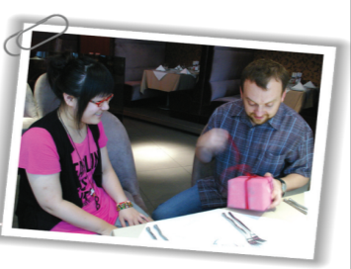
Culture time
People in the West usually open their presents as soon as they receive them.
一……就……

Slide 10
Let’s guess
Youth Theatre
Child Play: ***
Date: the 6th of April, 2017
Time: 8:00-9:30 pm
Area: the 1st floor
Seat: Row 7, Number 17
Tel: 025-83372492 Add: No. 146 North Zhongshan Road
Price: ￥180
Youth Theatre
Child Play: ***
Date: : the 6th of April, 2017
Time: 8:00-9:30 pm
Area: the 1st floor
Seat: Row 7, Number 19
Tel: 025-83372492 Add: No. 146 North Zhongshan Road
Price: ￥180
Youth Theatre
Child Play: ***
Date: the 6th of April, 2017
Time: 8:00-9:30 pm
Area: the 1st floor
Seat: Row 7, Number 15
Tel: 025-83372492 Add: No. 146 North Zhongshan Road
Price: ￥180
see a play
(看戏剧)

Slide 11
Let’s watch
1. Who is in the play?
2. What roles（角色)do
they play（表演）?

Slide 12
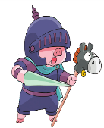
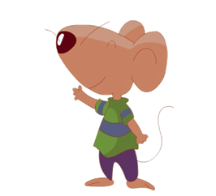
2. What roles(角色)do
they play(表演)?
1. Who is in the play?
guard守卫
hero英雄
princess公主

Slide 13
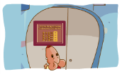
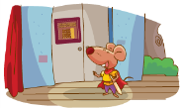
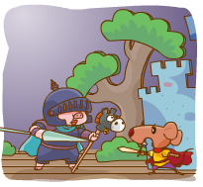
Read and order
5
2
b
a
The pig runs away. Then, a cat comes out from a room.
Bobby sees some numbers on the door.
3
数字
c
答案
4
Bobby has the answers.
1
d
e
The door opens...There is a pig in the house. They start fighting.
开始战斗
Bobby is a hero in a play.

Slide 14
Read and answer
1.自读课文，划出问题答案。
2.四人一组讨论后反馈。
1.How can Bobby open the door？
密码
2.What is the password?
3.How does Bobby feel at last(最后)？
Notes:
HAPPY BIRTHDAY

Slide 15
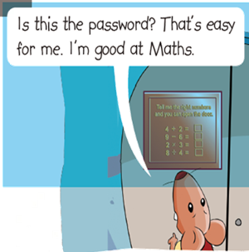
Read and answer
1.How can Bobby open the door？
Tell the right numbers and he can open the door.
Tell me the right numbers and you can open the door.
4＋2＝
9－6＝
2×3＝
8÷4＝
Notes:
HAPPY BIRTHDAY

Slide 16
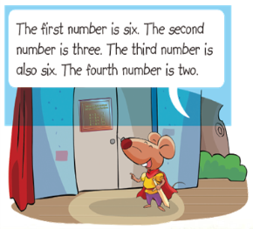
Read and answer
2.What is the password?
It's 6362.
Tell me the right numbers and you can open the door.
4＋2＝
9－6＝
2×3＝
8÷4＝
Notes:
HAPPY BIRTHDAY

Slide 17
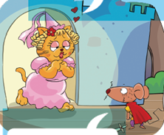
Read and answer
3.How does Bobby feel at last(最后)？
Thank you so much!
surprised
scared
Oh, what a play!
哦，怎样的一场戏剧啊！
Notes:
HAPPY BIRTHDAY

Slide 18
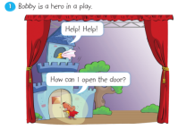
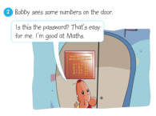
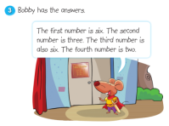
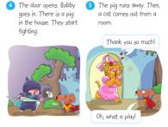
Let’s read
Tips:四人一组选择一种喜欢的方式朗读课文,
读出不同角色的不同语气哦！
Read in roles.(分角色读)
Read together.(齐读)
Read after one.(跟一个学生读)
…

Slide 19
Tips:注意不同角色，不同音色，不同表情动作哦!
Let’s act
Tips：
能完整地表演故事。
能有感情，有动作，生动地表演故事。
能发挥想象，增加语句，创编故事。

Slide 20
Read and fill
hero
Bobby is a ____ in a play. He wants to open the door and save (救) the princess. He sees some _______ on the door. He is ______ at Maths and he knows the ________ . The _____ number is six . The _______ number is three . The _____ number is six. The _____ number is two.
Bobby goes into the door and sees a pig. They ____ _______ . The pig runs away and a cat _____ _____ ____ a room. Bobby is surprised.
numbers
good
password
first
second
third
fourth
start
fighting
comes
out
from
Notes:
HAPPY BIRTHDAY

Slide 21
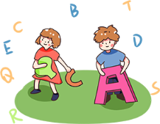
Homework
1、Listen, read and recite cartoon time.
Try retelling the story.
听、读、背Cartoon time,尝试复述故事。
2、Preview checkout time.
预习Checkout time。

Slide 22
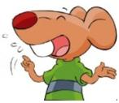
Let’s discuss
What do you think of Bobby in the play?
(你认为剧中的Bobby怎么样？)
clever
聪明的
funny
滑稽的
brave
勇敢的
kind
善良的
. . .

