Slide 1
Module
6
Hobbies
Unit 2
Hobbies can make you grow as a person.
WWW.PPT818.COM

Slide 2
Read and find:
1.占据
2.有点乱
3.在书架上
4.看一看
5.如此多扇子
6.大部分
7.和…一样
8. 收集硬币和纸币
9.集邮
10.重要的东西
11.在某人的一生中
12.火车票
take up
a bit of a mess
on the shelf
have a look
so many fans
most of
as … as
collect coins and notes
collect stamps
something important
in one’s life
train tickets

Slide 3
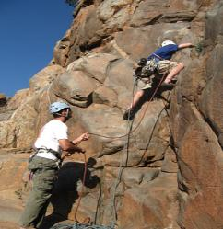
Guessing game
Let’s guess what hobbies they are.
climbing
I don’t like climbing because
I am not a professional climber.
dancing
People like dancing because it’s relaxing.

Slide 4
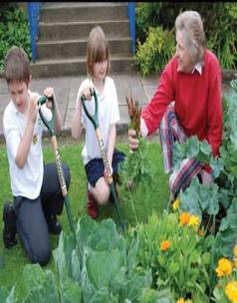
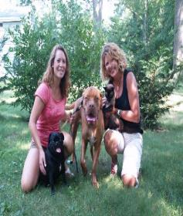
growing vegetables
Children like growing vegetables, it can bring them enjoyment and success.
looking after animals
Many people look after animals because they are useful.

Slide 5
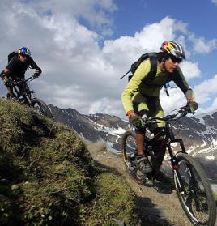
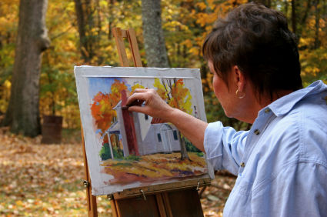
mountain biking
Young people like mountain biking because it’s exciting.
painting
I like painting. It’s creative. You can draw everything you imagine in your mind.

Slide 6
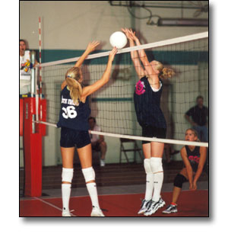
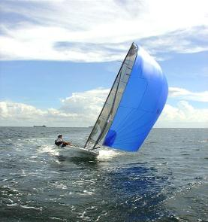
playing volleyball
Many people like playing volleyball. They think this activity can develop their skills.
sailing
I don’t like sailing. I’m not a good swimmer and I don’t have good swimming skills.

Slide 7
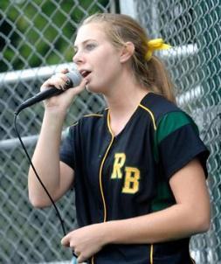
singing
I love singing, because it
can make me happy.
writing
He enjoys writing. He often writes stories. He thinks it’s creative. He is not lazy!

Slide 8
Think about it!
What do you think of the hobby?
Hobbies are good for people.
Hobbies can make us relax / happy.
Hobbies can make our life interesting.
Hobbies can develop our interests.
Hobbies can help us learn new skills.
…

Slide 9
Reading
1. Scanning and skimming.
1) What hobbies does David have?
2) What is David’s special hobby?
Writing, playing volleyball and many other things.
Writing.

Slide 10
2. Read and tell true or false.
1. David Smith likes writing.
2. He learned writing during a summer
camp of 2000.
3. There was a professional writer on the camp.
4. David wrote a story about his life
in senior high school.
5. David’s first book came out in 2012.
6. His book was very popular.
7. Writing was his only hobby in his free time.
T
2010
F
T
a life of a sixteen-year-old boy
F
T
T
wasn’t
F

Slide 11
3. Read again and answer the questions.
1. What advantages can hobbies bring to
young people?
2. What hobbies does David have?
Hobbies can make you grow as a person, develop your interests and help you learn new skills.
David likes writing, playing volleyball and many other things.

Slide 12
3. When did David become a successful writer?
4. Will David’s new books be successful?
After his story about the life of a sixteen-year-old boy came out as a book in 2012.
Maybe yes. The passage doesn't say it.

Slide 13
Language points
1. Many students have hobbies, such as
reading…and looking after animals.
such as 表示“比如, 例如”
The shop is selling many things, such as
school things, food and toys.
look after (+ sb / sth)
= take care of 照顾; 照看
His parents was out, so he has to look after
his little sister at home.

Slide 14
2. Hobbies can make you grow as a person,
develop your interests and help you learn
new skills. 爱好可以促使你成长，培养你
的兴趣，并帮助你学习新的技能。
make sb do sth
make sb + adj.
make sb + n.
His jokes made us all laugh.
他的笑话把我们都逗笑了。
Listening to music can make me happy.
听音乐可以使我快乐。
We make him our monitor. 我们选他当班长。

Slide 15
make you grow as a person: 使你健全成长
as prep. 介词 这里表示“作为”。
He began to teach in that school as a math
teacher in 2000.
develop your interests 培养你的兴趣
develop 表示“发展，形成，成长，提高”。 This course can help you develop your speaking skills.
Tom has developed into a strong leader.

Slide 16
help sb (to) do sth 帮助某人做某事
help sb with sth 在某方面帮助某人
I help him cook the meal.
我帮他做饭。
I help him with his English.
我帮他补习英语。

Slide 17
3. During the summer of 2010, he spent
four weeks at a summer camp.
I spend some of my free time playing
volleyball for my school team.
during 在……时间内, 在……期间
Some shops open at night during the
Christmas.
on sth
spend money / time
(in) doing sth
在某物
某人花时间 / 金钱
做某事

Slide 18
I spent 10 years on the book.
I spent 10 years writing the book.
我花了10 年时间在(写)这本书上。
spend; take; pay; cost 都表示“花费”,
区别是：
sb spend + some time / money + on / (in)
doing sth
It takes / took sb + some time + to do sth.
sb pay + some money + for sth
sth cost (sb) + some money

Slide 19
4. As well as the usual activities, …
as well as 表示“也, 还, 除……以外还有;
不仅…而且”, 是并列连词, 用来连接并列成分。
连接并列主语时, 谓语动词与前一主语
保持一致。
The girl is lively as well as healthy.
We all want to visit Beijing as well as
Shanghai.
He as well as his friends likes playing
football.

Slide 20
as well as 与 not only …, but also…的区别
A as well as B
强调A, “不但B, 而且A”
not only A but also B
强调B, “不但A, 而且B”
e.g.
The teacher as well as the students is
coming to see you.
Not only the teacher but also the students
are coming to see you.

Slide 21
5. David wrote a story about the life of a
sixteen-year-old boy, and it came out…
come out 本句中表示“出书”, 还可以表
示“出现; (秘密等)传出; 结果是”等。
When will your new book come out?
你的新书什么时候出版？
At last the truth came out.
真相终于大白了。
The answer to the question came out wrong.
这道题的答案结果是错的。

Slide 22
6. Many young people love his book, and as a
result, David has become a successful
young writer.
as a result 意为“结果”, 表示后面的句子
所表达的前面的句子所表达的构成因果
关系, 前面是因，后面是果 。如：
He works hard, as a result, he got a good
mark in the exam.

Slide 23
7. He is also interested in many other things.
他对许多其他东西也很感兴趣。
be interested in + n. /v.-ing 对……感兴趣
Women are always interested in fashions.
女人总对时装很感兴趣
I was interested in dancing.
我对跳舞很感兴趣。

Slide 24
8. “I like playing volleyball too,” ….
“我也喜欢打排球”……
当 play后接表示球类的名词时, 该名词前不能
有任何冠词;当 play后接表示乐器的名词时, 需
要在该名词前加上定冠词the.
如: play the piano 弹钢琴
play the flute 吹笛子
play baseball 打棒球
play football 踢足球

Slide 25
4. Complete the sentences with the correct form of the words in the box.
activity pleasure result skill success
1. What _________ do you enjoy doing?
2. What new ______ have you learnt through
your hobbies?
3. Has any of your hobbies brought you _______
and _______?
4. Have you made new friends as a(n) ______
of your hobby?
activities
skills
pleasure
success
result

Slide 26
Some hobbies, for example, reading and painting, are very relaxing.
2. David likes writing. He also likes playing volleyball.
3. Many young people love David’s book, and so his hobby has brought him success.
Some hobbies, such as reading and painting, are very relaxing.
David likes writing as well as playing volleyball.
Many young people love David’s book, and as a result, his hobby has brought him success.

Slide 27
Possible answer
My classmate's hobby
My friend Paul plays chess. His father taught him to play when he was only five years old, and as a result, he is good at it now. He has played in the school team as well as in many competitions. Paul is not just a chess player. He also enjoys outdoor activities, such as walking in the countryside and climbing.

Slide 28
Exercise
一、单项选择题。
1 .Which hobby do you think _____ the least
time?
A. takes up B. clears up
C. stands up D. grows up
2. —Do you collect ______ , Kate?
—Yes. I collect stamps.
A. the car B. anything
C. everything D. nothing
A
B

Slide 29
3. There is _______ in today’s newspaper.
You should read it.
important something
B. important nothing
C. nothing important
D. something important
4. Mr Green wrote a book. It ____last month.
A. took out B. turned out
C. came out D. went out
D
C

Slide 30
5. Since then, the young man ______ another
bad habit.
A. has developed B. developed
C. will develop D. develops
6. — _____ do you fly kites with your brother?
— Once a month if it is fine.
How long B. How many
C. How often D. How far
A
C

Slide 31
7. —How did you become interested in
growing flowers?
—Well my mother first made me _____
about it seriously.
A. think B. thinking
C. thinks D. to think
8. Uncle Bill enjoyed _____ the violin when
he was young.
A. to play B. playing
C. play D. plays
A
B

Slide 32
9. There _____ a bag and some books on the
desk.
A. be B. is
C. are D. am
10. My grandma often _____interesting stories.
A. says B. talks
C. speaks D. tells
B
D

Slide 33
二、根据句意和汉语或首字母提示写单词。
1.Which ________ (活动) do you like better,
camping or swimming?
2.Watching sports gave him great _________
(愉悦).
3. He is a very nice p______ to work with.
4. Workers are learning a new s______.
5. It takes hard work to achieve s_______.
activity
pleasure
erson
kill
uccess

Slide 34
Homework
Work in pairs. Talk about what hobbies are good for people and develop your interest.

