Slide 1
Unit 5 I like those shoes
WWW.PPT818.COM

Slide 2
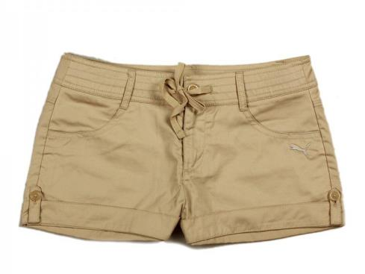
shorts

Slide 3
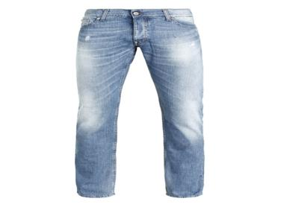
jeans

Slide 4
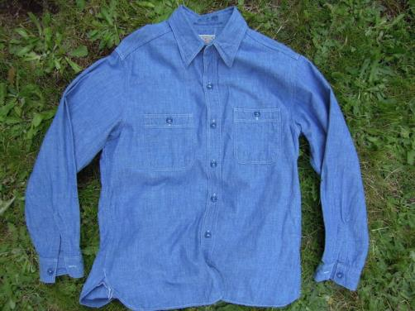
shirt

Slide 5
Dad, look at the blue shirt, they are so cool.
爸爸，看这件蓝色衬衣，它们好酷啊！

Slide 6
Can I look at the blue shirt?
我能看看这件蓝色衬衣吗？

Slide 7
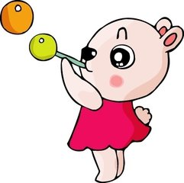
新学单词
short 短裤
shirt 衬衣
jeans 牛仔裤

Slide 8
新学单词
blue 蓝色的
orange 橙色的
red 红色的
green 绿色的

Slide 9
连词成句。
1．those，Can，trousers，we，at，have，a，look(？)
________________________________________________________________________
2．are，really，They，cool(！)
________________________________________________________________________

Slide 10
3．you，Here，are(.)
________________________________________________________________________
4．Find，skirt，red，the(.)
________________________________________________________________________

Slide 11
选择题
( )1.Where ________ my jeans?
A．is B．are
( )2.Find the red jeans ________ green shorts.
A．at B．and
( )3.Can I ________ at these jeans?
A．have a look B．put on
( )4.Pass me those ________．
A．trouser B．trousers

