Slide 1
Module 11 Photos
Unit 1 He's the boy who won the photo competition last year!
WWW.PPT818.COM

Slide 2



新课导入
Warming up
What is your hobby?
Do you like taking photos?
What about singing, dancing or playing the guitar?

Slide 3
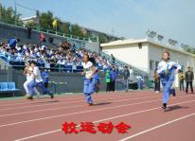
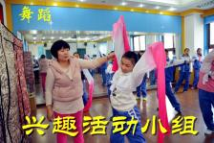
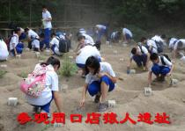
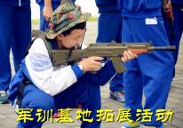
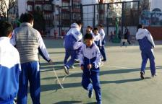
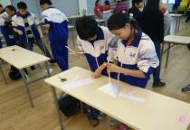
新课导入
Warming up
Photo display

Slide 4
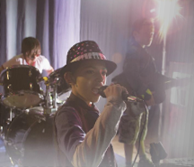
新课讲解
1
Work in pairs.
Look at the picture and say what is happening.
What do you know about a band?

Slide 5

新课讲解
2
Listen and complete the sentences.
1．The boy _______________is the guitar player.
2．The boy _______________is the singer.
3．The boy _______________is the drummer.
on the right
in the centre
at the back

Slide 6
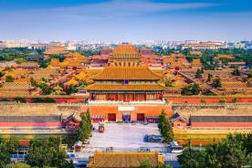
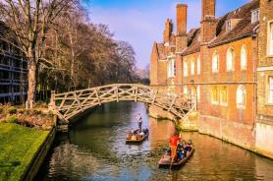
新课讲解
3
Listen and read.
Beijing
北京
Cambridge
剑桥

Slide 7
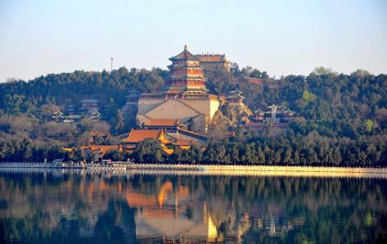
新课讲解
the Summer Palace
北京颐和园

Slide 8
新课讲解
Daming: Are you going to enter the photo competition,Tony?
Tony: You bet！I want to beat He Zhong this year.
He's not going to win it twice!
Daming: Who's He Zhong?
Tony: He's the boy who won the photo competition last year!
Daming: The one who took photos at the school dance?
Tony: That's right. The thing is, he's really good. And the
general standard of the competition is
much higher this year.

Slide 9
新课讲解
Daming: I have a feeling that we can solve these little
difficulties. What are the subjects that they've
chosen for this year's competition?
Tony: Nature, Home and Away, City and People, and Music.
Daming: I think He Zhong will choose Music. Why don't you
choose the subject Home and Away，and take photos
of Beijing?
Tony: But Beijing isn't my home town. It's Cambridge.

Slide 10
新课讲解
Daming: It doesn't matter. Take some photos of Beijing
and addsome photos of Cambridge that you
took recently.
Tony：That's a good idea.What about that photo of my
cousin flying kites with Chinese kids in the
Summer Palace? And the one of him reading a
Chinese menu for the first time in Cambridge?
Daming: Nice photos! I'm sure you're
in with a chance！
Everyday English
You bet!
The thing is, ...
It doesn't matter.
You're in with a chance!

Slide 11
新课讲解
Now answer the questions.
1．What did He Zhong do last year?
2．Which subject does Daming suggest Tony should choose?
3．Where is Tony's real home town?
4．What does Daming suggest Tony should do?
5．What does Tony think of Daming's suggestion?
He won the photo competition last year.
Home and Away.
Cambridge.
Tony should take some photos of Beijing and add some photos of Cambridge.
It's a good idea.

Slide 12

新课讲解
4
Find the words in the box in Activity 3.
add difficulty general standard
Now choose the correct answer.
  1.“The general standard of the competition...” means _____.
    a) the skills of some people in the competition
    b) the level of most people in the competition
  2．“...solve these little difficulties.”This means to ______．
      a) deal with the problems
      b)correct the mistakes
  3．“...add some photos of Cambridge...” This means to ______．
      a) put some photos in
      b)take some photos away

Slide 13
新课讲解
Pronunciation and speaking
5
Listen and mark the words which the speaker links.
1.Take some photos of Beijing and add some photos of
Cambridge that you took recently.
2.What about that photo of my cousin flying kites with
Chinese kids in the Summer Palace?
3. And the one of him reading a Chinese menu for the first
time in Cambridge?
Now listen again and repeat.

Slide 14
新课讲解
6
Work in pairs. Describe photos and guess.
Student A: Choose a photo in this book and describe
it to Student B.
Student B: Listen to Student A’s description of the
photo. Guess which photo he/she is
describing.

Slide 15
新课讲解
Language points 1
Point
You bet！当然啦！
eg：—Will you tell her? 你会告诉她吗？
—You bet！当然会呀！
1.相当于Yes, of course.
2.bet可作名词，意为“打赌”，如：win a bet 赢一场赌。
3.(句型)I bet (that)．..意为“我确信……” 相当于I'm sure(that)．..。

Slide 16
新课讲解
Language points 2
Point
feeling/'fiːlɪŋ/ n.感觉；直觉看法
eg：A feeling of panic was rising inside her.
她内心升起了恐慌感。
feeling作为感觉是可数名词，
作为知觉是不可数名词。

Slide 17
新课讲解
Language points 3
Point
difficulty/'dɪfɪklti/ n.困难；困境
eg：He finally solved the difficulty of transportation.
他终于解决了运输的困难。
它是difficult的名词形式，常用短语：
have difficulty (in) doing sth.表示“做某事有困难”。

Slide 18
新课讲解
Language points 4
Point
add/æd/ vt. 添加
eg：I'll add a few words when you finish.
你说完后，我接着说几句。
它多作及物动词，宾语可以是数字，也可以是有形的东西，如糖、水等，还可以是无形的东西，如麻烦等。
常用短语：add to增加、增添；其宾语多为困难、欢乐等抽象名词。add up把……加起来；add up to总计为；总共是，后面多跟合计起来的数目。

Slide 19
当堂小练
一、根据句意及首字母或汉语提示完成单词
1．【热点题】The price of food is a matter of ___________（普遍的）anxiety （担心）.
2．He set a high （标准） for his study.
3．It is my （直觉看法）that things are not easy.
4．The t is，we don't believe what he said.
5． Have you seen your neighbour （最近）？
general
standard
feeling
hing
recently

Slide 20
当堂小练
二、单项选择
C
6. —Did you have any difficulty your way to
the hotel？
—Yes， it's my first time to come to Hefei.
A. find B. to find C. finding D. found
7. general， Japanese cars are very reliable（可靠的）.
A. On B. In C. For D. At
8.They asked the waiter to the bills.
A.add up B.put on C.live on D.hurry up
9.（中考·广州）Do you know the man is talking
to Miss Wu？
A.he B.whom C.who D.which
B
A
C

