Slide 1
Unit1 We have new friends.
人教精通版五年级上册
Lesson 5
WWW.PPT818.COM

Slide 2
>>Review
Let’s chant

Slide 3
>>Review
Look and say
Where do you come from?
I come from France.

Slide 4
>>Review
Look and say
Where do you come from?
I come from Germany.

Slide 5
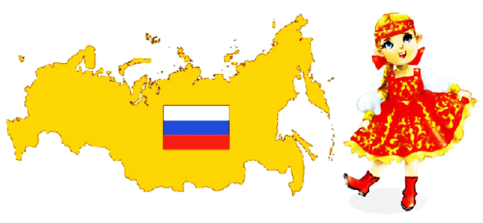
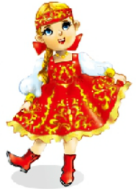
>>Review
Look and say
Where do you come from?
I come from Russia.

Slide 6
>>Lead-in
Free talk
What’s your name?
Where do you come from?
Where do you live?

Slide 7
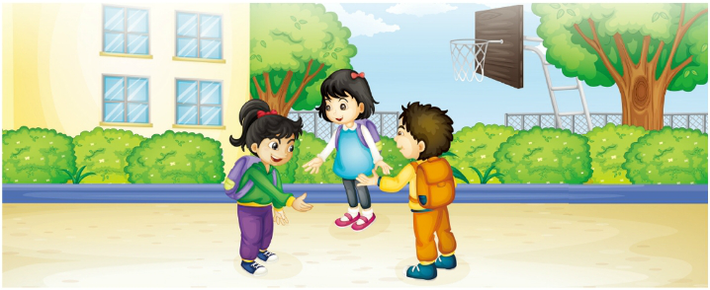
>>Presentation
Look, listen and say
Who are they? Where are they? What are they doing?
Cathy
Li Yan
Carl

Slide 8
>>Presentation
Listen and circle
Where do they live?

Slide 9
>>Presentation
Read and judge
1. Li Yan lives in the Happy City.
Cathy
in
on
2. Cathy lives on the Nangjing Road.
Li Yan
3. Carl lives on the Shanghai Street.
on

Slide 10
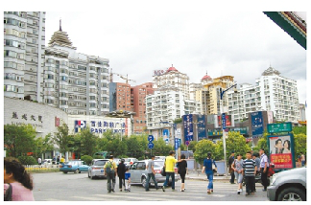
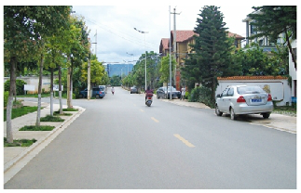
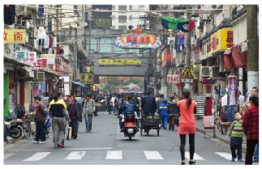
>>Presentation
Look and say
city
road
street

Slide 11
>>Presentation
Just talk
Listen and imitate
Hello! My name is Li Yan. What’s your name?
My name is Cathy.
My name is Carl.
Pleased to meet you.
Pleased to meet you, too.
Pleased to meet you, too.

Slide 12
>>Presentation
Just talk
Listen and imitate
Where do you live, Cathy?
I live on Nanjing Road.
I live in the Happy City. How about you, Li Yan and Carl?
Great! Let’s be friends.
I live on Shanghai Street.

Slide 13
>>Practice
Read it by groups for one minute .
小组读对话一分钟。
一分钟倒计时
60
Learning tip :
10
10
50
四人一组，比赛读句子，看谁能在一分钟内读完，并且读得准确、流利！
20
20
40
30
30
开始

Slide 14
>>Practice
Show time
小组合作，练习对话并表演，其他同学评价。
Pronunciation (语音) |  | Fluency (流利) | Cooperation (合作)
OK!
Great!
Super!

Slide 15
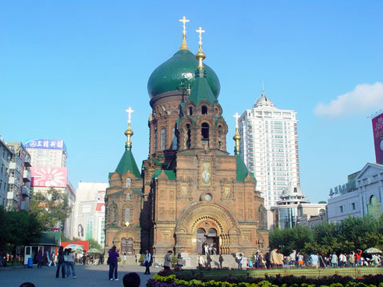
>>Practice
Look and say
Where do you live?
I live in Harbin City.

Slide 16
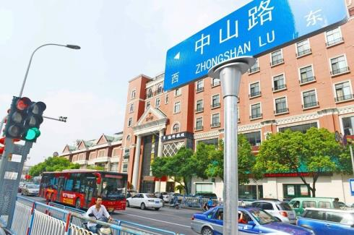
>>Practice
Look and say
Where do you live?
I live on Zhongshan Road.

Slide 17
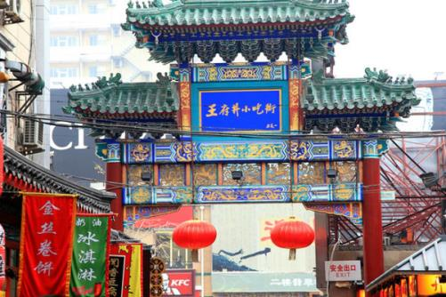
>>Practice
Look and say
Where do you live?
I live on Wangfujing Street.

Slide 18
>>Summary
如何询问和回答某人的家庭住址？
—Where do you live?
—I live in / on …
例句
—Where do you live?
—I live in the Happy City.
—I live on Nangjing Road.

Slide 19
>>Homework
1.观看课文动画，按照正确的语音、语调朗读课文对话。 2.运用本课所学句型“Where do you live? I live in/on …”询问你的同学或朋友的家庭住址，并把你们的对话记录下来。
3.预习Lesson 6。

