Slide 1
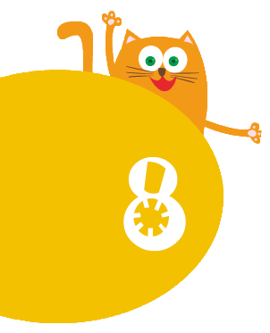
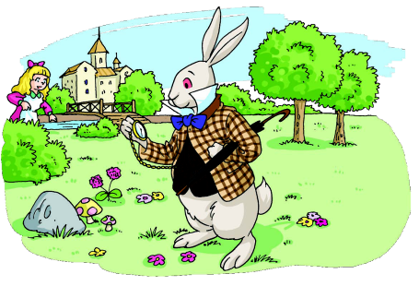
An outing
WWW.PPT818.COM

Slide 2

1. Where can we go for an outing?
2. What do we need for an outing?
3. Do you like outings? Why?

Slide 3
1. Who are they?
2. What are they doing?

Slide 4

Look and read
Alice: What are you doing, Peter?
Peter: I’m reading the map.
We are at Green Hill.
The Big Stone is on the hill.

Slide 5
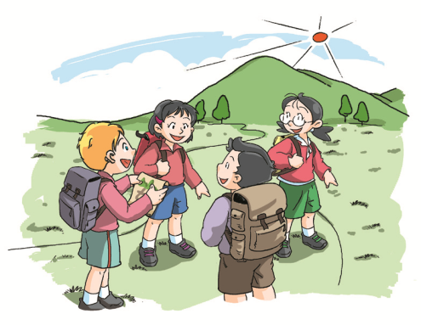
What’s in Peter’s hand?
Notes:
5

Slide 6
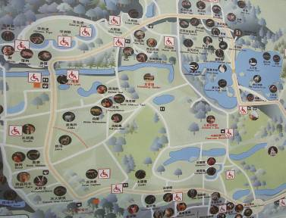

a map of …
a map of China
a map of Shanghai
map
a map of Green Hill

Slide 7

What’s in Peter’s hand?
Where are they?
Notes:
7

Slide 8
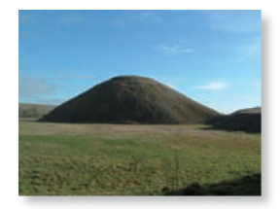
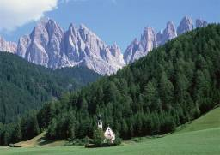
hill
mountain
a small hill
a big mountain
the top of the hill
the bottom of the hill

Slide 9
Green Hill
What’s in Peter’s hand?
Where are they?
What are they looking for?
Notes:
9

Slide 10
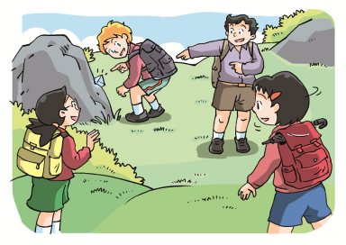
the Big Stone
Where is the big stone?
It’s on the hill.
Notes:
10

Slide 11

Today is a fine day. Peter is at ___________ with his friends. He is reading ______________. He wants to find _____________.

Slide 12

1. Where are they now?
2. Where is the letter?
3. What is Peter doing?

Slide 13
The Big Stone is on the hill. Peter finds ___________ behind it. The letter says, “ You can find a diamond _____________________.”

Slide 14
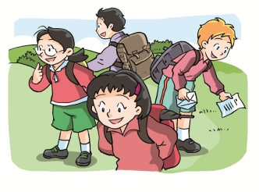
Look and read
1. What do they find at the top of Green Hill?
2. What does the letter say?
Notes:
14

Slide 15
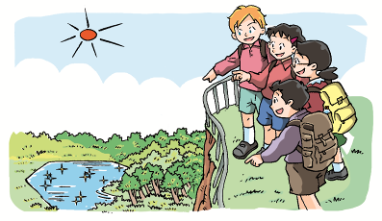
Look and read

Slide 16

Look and learn
lake
diamond
The lake is like a diamond.
… is like ...

Slide 17


Alice, Kitty, Peter and Joe are at the top of __________. They find another _________. It says,“Look down and you can see _____________.”
Oh, that’s it! _________ is like a big diamond. How amazing!

Slide 18

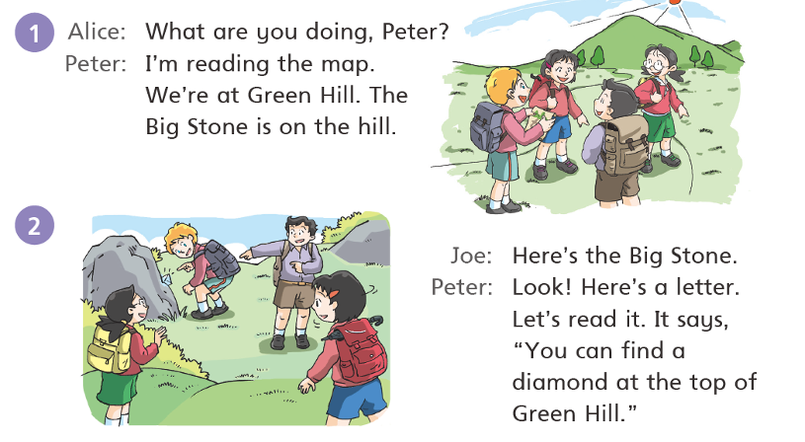
Look and read

Slide 19
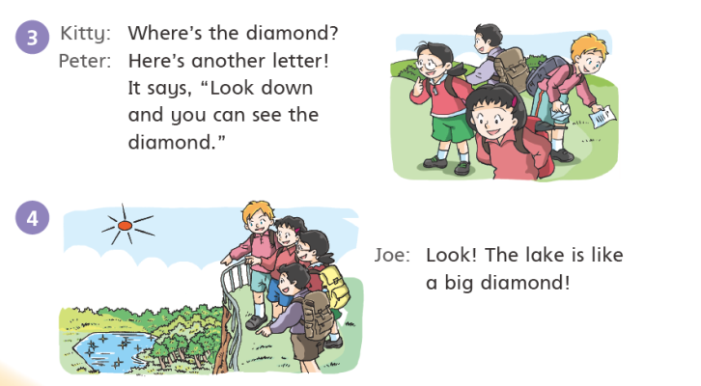
Look and read

Slide 20
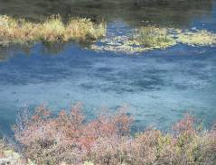
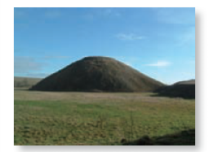

map
lake
hill

Slide 21
(find another letter)
at the top of Green Hill
(find a letter)
on the hill
at Green Hill
at the bottom of Green Hill
(read a map)
(find a lake)

Slide 22
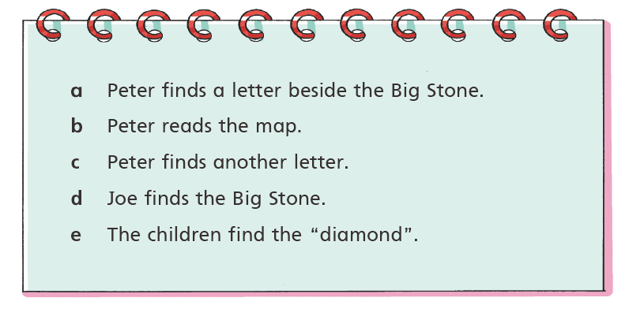
Think and order

Slide 23
Think and order
a
d
e
c

Slide 24

Peter is watching a lake. The lake is like a diamond.
Peter is at Green Hill. He is reading the map.
Peter is looking at a letter. The letter is behind the Big Stone.
Peter is looking down from the top of Green Hill.

Slide 25
Look and read
A diamond
Today is a fine day. Peter is at Green Hill with his friends. He is reading the map of Green Hill. He wants to find the Big Stone.
The Big Stone is on the hill. Peter finds a letter behind it. The letter says, “You can find a diamond at the top of Green Hill.”
Now Peter and his friends are at the top of Green Hill. Peter is reading another letter. It says, “Look down and you can see the diamond.”
Peter and his friends see a lake. The lake is like a diamond. How amazing!

Slide 26
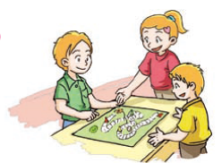
S1: What is Peter doing?
S2: He’s …(doing)
1
2
3
4
5

Slide 27
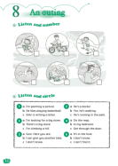
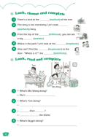
Homework
Read the dialogue on page 52.
2. Act out the story on pages 54
and 55 in your group.
3. Play the game on page 56 with
your friend.
4. Finish Workbook pages 44 and 46.

