Slide 1
Module 9 Great inventions
Unit 1 Will computers be used more
than books in the future?
WWW.PPT818.COM

Slide 2
新课导入
Warming up
思 考
Do you often surf the Internet?

Slide 3
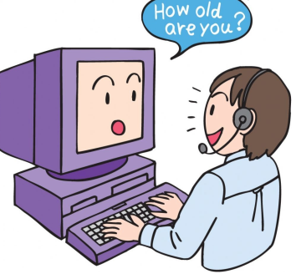
新课导入
Do you chat on the Internet?

Slide 4
新课导入
The Four Great Inventions
Papermaking
Printing
Gunpowder
Compass

Slide 5
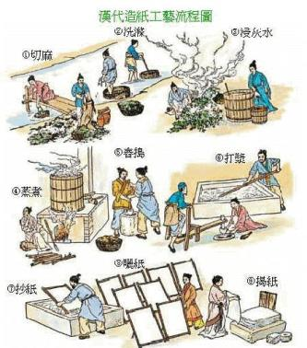
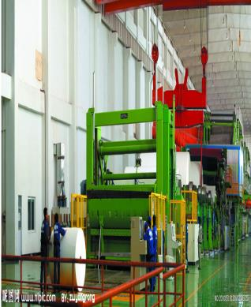
新课导入
Traditional papermaking
Modern papermaking

Slide 6
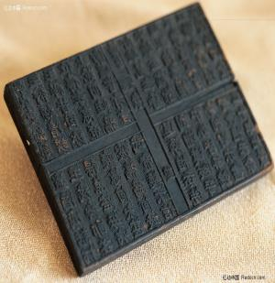
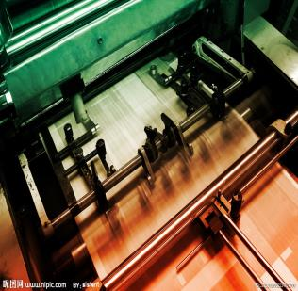
新课导入
Traditional printing
Modern printing

Slide 7
新课导入
Words review
borrow
put up
website
mail
textbook
mainly
thousands of
page
electronic
technology
powerful
v. 借人；借来
张贴；公布
n. 网站
n. 邮件；信件
n. 教科书；课本
adv. 大部分地；主要地
好几千；成千上万
n. 页；一页(纸)
adj. 电子的
n. 科技；技术
adj. 有影响力的；能控制他人的

Slide 8
新课导入
Words review
memory
full
fix
instructions
lend
properly
n. 存储器；存储量
adj. 满的；充满的
v. 修补；挽救
n. [复数]说明书
v.（把某物）接触；
借给（某人）
adj. 合适地；正确地

Slide 9
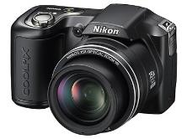
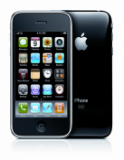
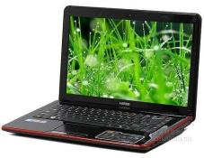
新课讲解
1
Work in pairs. Look at the pictures and answer the questions.
1．How have these inventions changed people's lives?
2．Which one do you think is the most important?
3．What other important inventions can you think of?
They have changed people's lives a lot.
I think the most important invention is the computer.
Lights, TV sets, cars...

Slide 10
新课讲解
2
Listen and complete the sentences.
1. Lingling loves her mobile phone because she can_____________.
2. All of Daming’s friends’ numbers are __________ in his phone.
3. Today’s cameras are better than old cameras because they do not _________ and the photos can ______________.
4. Lingling thinks everything ___________ by computers to some degree, so the computer is _________________ invention.
use it anywhere
kept
need film
be sent by email
was changed
the most important

Slide 11
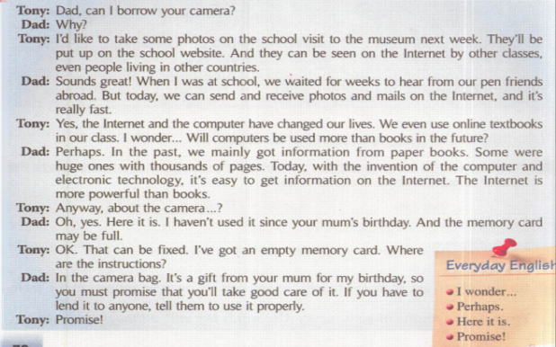
新课讲解
3
Listen and read.

Slide 12
新课讲解
Listen to Part 3 and answer the following questions.
1. What will Tony do on the school visit to the museum?
A. Take some photos. B. borrow some textbook
C. Take a trip
2. Where did we get mainly information in the past?
A. From the internet B. From the computer
C.From paper books.
3. Who is the gift for?
A. Tony’s mother B. Tony C.Tony’s dad
✓
✓
✓

Slide 13
新课讲解
Now read the summary of the conversation. Underline the wrong information and correct it.
on the school visit to the museum
Tony wants to borrow his father’s camera and take some photos of the school dance and the basketball match. The photos will be shown in the school magazine. Tony’s dad lends the camera. He promises Tony to look after it.
website
Tony
his dad

Slide 14
新课讲解
4
Find the sentences in the conversation which mean:
Changing the subject, can I get the camera?
2. It is not a problem. I will use another memory card.
3. I will do what you tell me to do.
Anyway, about the camera?
OK. That can be fixed. I’ve got an empty memory card.
Promise!

Slide 15
新课讲解
5
Answer the questions.
electronic fix instruction invention Lend mail page website
1.How do you fix a camera if the memory card is full?
If my memory card is full, I will copy some pictures to my computer.
2.When do you need to read the instructions?
I need to read the instructions before I use a new machine or I meet some problems.
3.How often do you send messages by mail?
I send messages by mail every day.

Slide 16
新课讲解
4. How many pages does this book have?
This book has 162 pages.
5. Which website do you often go to when you get online?
I often go to www.yahoo.com when I get online.
6. What is an example of electronic technology?
Camera is an example of electronic technology.
7. When you lend something to someone, what do they have to do later?
They should take good care of it before they give it back to me.
8. What do you think is the most important invention in human history?
I think fire is the most important invention in human history.

Slide 17
新课讲解
6
Listen and mark the pauses.
1. They’ll be put up on the school website. And they can be seen on the Internet by other classes, even people living in other countries.
2. You must promise that you’ll take good care of it.
/
/
/
Now listen again and repeat.

Slide 18
新课讲解
7
Work in pairs. Talk about the advantages of these inventions.
email mobile phone TV washing machine
— We can use email to send messages.
—Yes, we can use email to send messages quickly and cheaply.
Now describe how these inventions have influenced your life.
Email has great influenced my life …

Slide 19
新课讲解
Language points 1
Point
put up 张贴
关于put的短语
put out 熄灭 put on 穿上 put away 将……收起
put down 写下，记下 put off 延期
put...into 把……放进

Slide 20
新课讲解
Language points 2
Point
hear from 收到……的来信
hear from sb.＝ get/receive a letter from sb.
收到某人的来信。
eg：I heard from an old friend yesterday.
我昨天收到一封老朋友的信。

Slide 21
新课讲解
Language points 3
Point
thousands of 数以千计的
thousands of用来表示一个不具体的数目，前面不能用具体的数字修饰，后接可数名词复数。
拓展
约数和确数的表达：
约数 | hundreds/thousands/millions/...＋of＋ 可数名词复数
确数 | 基数词＋hundred/thousand/million/...＋ 可数名词复数

Slide 22
新课讲解
Language points 4
Point
full /fʊl/ adj. 满的；充满的
1.full 作形容词，意为“满的；充满的”，表示状态，可以放在be后作表语，也可以放在名词前作定语，其动词形式为fill，其反义词为empty。
2.常用短语：be full of...意为“充满；装满”，相当于be filled with...。
eg：He drove the car at full speed through the town.
他开车全速穿过这个镇。

Slide 23
新课讲解
Language points 5
Point
fix /fɪks/ vt. 使固定；修理
eg：Can you fix this machine? It can't work now.
你会修理这台机器吗？它现在不运转了。
1.常用于短语fix up，意为“修理”。
2.fix可用来表示修理任何东西，其同义词为mend和repair。

Slide 24
新课讲解
Language points 6
Point
lend /lend/ vt. 借出，借给
lend与borrow的区别
lend | 意为“借出”，表示主语把东西借给别人，是非延续性动词，常用于lend sb. sth.或lend sth. to sb.结构。
borrow | 意为“借入”，表示主语向别人借东西，是非延续性动词，常用于borrow sth. from sb.结构。

Slide 25
当堂小练
一、根据句意及首字母或汉语提示完成句子
1.If you want to know more information about the trip，please visit our
w .The address is www.trip.com.
2.（安徽）Could you please （借） me your dictionary？
3.—Have you finished reading the storybook？
—Not yet. It has got four hundred p ，but I've just read half of
them.
4.—My computer doesn't work. Can you help me f it？
—Sure. Let me have a look.
5.If you don't know how to use the new camera，please read the
i .
ebsite
lend
ages
ix
nstructions

Slide 26
当堂小练
二、同义句转换
6.（中考·重庆B）They get a letter from their son twice a month.
They their son twice a month.
7.Be careful. The bottle is filled with hot water.
Be careful. The bottle____ ______ ______hot water.
8.I've lost my mobile phone. Can I borrow yours to call home？
I've lost my mobile phone. Can you _______yours _______me
to call home？
hear from
is full of
lend
to

Slide 27
当堂小练
9.My mother doesn't go to work. She looks after my sister at
home all day.
My mother doesn't go to work. She _______ _______ _______
my sister at home all day.
10.Uncle Wang lent his camera to me three days ago.
I Uncle Wang‘s camera for three days.
takes care of
have kept

