Slide 1
Module 2 Public holidays
Unit 2 We have celebrated the festival since the first pioneers arrived in America.
WWW.PPT818.COM

Slide 2
新课导入
New words
思 考
among
speech
pioneer
grow
corn
prep. 在……之中
n. 演说；讲演
n. 开拓者；先驱者
v. 种植；栽培（植物）
n. 谷物；玉米
思 考

Slide 3
新课导入
New words
思 考
following
lay
over
dish
parade
ourselves
adj. 接着的；接下来的
v. 摆放（餐桌）
adj. 完了的；结束的
n. 盘；碟
n.（庆祝） 游行
pron. 我们自己
思 考

Slide 4
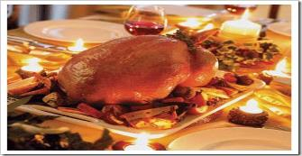
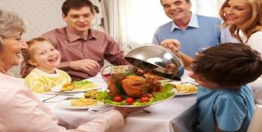
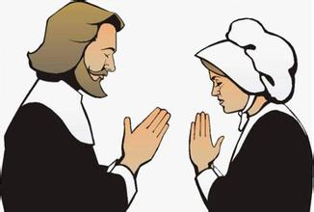
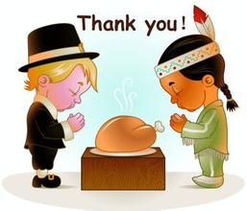
新课导入
思 考
思 考
Thanksgiving

Slide 5
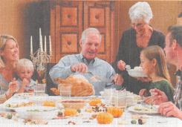
新课讲解
1
Work in pairs. Talk about the picture.
思 考
What can you see?
What are they doing?

Slide 6
新课讲解
2
Read the passage and match the headings with the paragraphs.
思 考
思 考
a) A special dinner
b) An American festival
c) The history of the festival
d) Things to do during the festival
3
1
2
4

Slide 7
新课讲解
Thanksgiving
Thanksgiving is an American festival. It is celebrated on the fourth Thursday in November. It is a time for a special dinner among family and friends. ❶ People make short speeches and give thanks for their food. ❷
We have celebrated the festival since the first pioneers from England arrived in America by ship in the seventeenth century. While they were crossing
思 考
思 考

Slide 8
新课讲解
the Atlantic，many people died，and after they landed，their first winter was worse than any English winter. The local people，the Native Americans，taught the pioneers how to grow corn. ❸ The following year they celebrated together by eating a dinner of the new food. ❹
We still celebrate Thanksgiving today with a traditional dinner. The kitchen is always the most crowded room in our house because we all help
思 考

Slide 9
新课讲解
prepare the food. We lay the table, and then before we begin dinner, my father gives thanks for the food, so we remember why we celebrate the festival. ❺ We usually eat too much, but it is only once a year! We often talk a lot and tell stories after dinner as well. ❻ When it is all over, everyone helps wash the dishes. ❼
The festival is a very busy time for travel when friends and families come together to celebrate. During the festival, there are plenty of other things to see and do. ❽
思 考

Slide 10
新课讲解
We live in New York City，and we go to watch the Macy's Thanksgiving Day Parade. The parade goes along several streets and finishes at the famous Macy's store. Thanksgiving is the start of the Christmas season，and we start shopping for presents. Football is also important at Thanksgiving, with many teams playing games. Like many Americans, we usually watch the games on television and enjoy ourselves very much. ❾
思 考

Slide 11
新课讲解
3
Read and complete the table
Facts about Thanksgiving
Date | ___________________________
Meaning | ______________for their food
History | Have celebrated it since _______________ from England arrived in America Learnt from the Native Americans how to __________ and celebrated together by ___________
Celebration | Celebrated with ____________________ _____________________________ before dinner Celebrated by watching ____________in New York City and _____________on television
思 考
The fourth Thursday in November
give thanks
the first pioneers
grow corn
eating a dinner
a traditional dinner
my father gives thanks for the food
the parade
the games

Slide 12
新课讲解
Read para.1 and answer:
1、What is Thanksgiving?
2、What do people often do on Thanksgiving?
思 考
It is an American festival.
It is a time for a special dinner among family and friends.
People make short speeches and give thanks for their food.

Slide 13
新课讲解
Read para.3 and choose
思 考
C

Slide 14
新课讲解
Read para4 and finish the table
The ways to celebrate
Things to see | Things to do
the parade
(goes along…and
finishes at …)
the games
go shopping
play football

Slide 15
新课讲解
4
Complete the passage with the correct form of thr words in the box.
思 考
among corn dish lay pioneer plenty
The first (1) ________ crossed the Atlantic and arrived in America in the seventeenth century. At the beginning, they did not have enough food. The Native Americans taught them how to (2) ______ . They soon had (3) ________ to eat. Today, people living in the US remember the Native Americans and the pioneers at Thanksgiving. This festival is celebrated with a meal (4) _______ family and friends. Everyone helps (5) _______ the table. After the meal, they help wash the (6) _______.
pioneers
corn
enough
among
lay
dishes

Slide 16
新课讲解
Language points
思 考
1. People make short speeches and give thanks for their food.
give thanks (to sb.) for (doing) sth.
对（某事/某人）做了某事而表示感谢
这里thanks 用作名词，give也可以换成其他动词。
例如：She expressed her thanks to her friends for coming to the party.

Slide 17
新课讲解
2. We have celebrated the festival since the first pioneers from England arrived in America by ship in the seventeenth century.
Since表示“自从……”，常用于现在完成时。
例如：We have been friends since childhood.
3. The following year they celebrated together by eating a dinner of the new food.
by eating a dinner of the new food 在句中作状语，表示以聚餐品尝新食物的方式（来庆祝）。
by doing sth. 以某种行为方式……

Slide 18
新课讲解
5
Think about an unforgettable festival you have enjoyed. Answer the questions.
1.What was it?
2.When was it?
3. Who did you spend it with?
4. How did you spend it?
5. Will you remember it for long? Why?

Slide 19
新课讲解
6
Write a passage about the festival. Use your answers in Activity 5 to help you.
An unforgettable festival for me was National Day last year...

Slide 20
新课讲解
Possible answer:
I had a great time on National Day last year. I’ll remember it for a long time because it was Golden Week. I went with my mother and father to visit my grandparents in Shanghai. My grandmother made delicious dumplings and many other dishes, so I ate lots of really nice food!

Slide 21
当堂小练
Exercises
一、根据句意及汉语提示完成单词
1.【易错题】They walked （在……之中）
the crowds in the street.
2. Our headmaster made a long （演讲)at the
meeting last week.
3. In many ways she became a （先驱者）.
4. When we arrived， the meeting was （结束的）.
among
speech
pioneer
over

Slide 22
当堂小练
Exercises
二、单项选择
6. Will you finish the task tomorrow？
A. in B. by C. at
7. It usually rains at this time of the year.
A. a lot B. lots of C. a lot of D.lot of
8. 【易错题】 You know，computers bring
troubles .
A. also B. neither C. either D. as well
B
A
D

