Slide 1
Section B Using language
外研版高中英语必修二
Unit 1 Food for thought
WWW.PPT818.COM

Slide 2
Ⅰ
Ⅱ
Ⅲ
Ⅰ.知识体系图解
function
download
related
diet
addict
tip
custom
manners
trick
plate
handle

Slide 3
Ⅰ
Ⅱ
Ⅲ
differ
steak
slightly
incredibly
bitter
bakery
creamy
recommend
acid
attack
yoghurt
within

Slide 4
Ⅰ
Ⅱ
Ⅲ
保持健康
在……方面不同
以……开始
有做……的能力
如果有必要
说服某人做……
提建议

Slide 5
Ⅰ
Ⅱ
Ⅲ
Ⅱ.释义匹配
1.function A.to move information or programs from a computer network to a small computer
2.download B.something that is done by people in a particular society because it is traditional
3.custom C.an act of violence that is intended to hurt a person or damage a place
4.differ D.to work in the correct or intended way
5.attack E.to be different from something in some way
答案:1.D 2.A 3.B 4.E 5.C

Slide 6
Ⅰ
Ⅱ
Ⅲ
Ⅲ.选词填空
1.It is raining hard and I stay at home.
2.He is taller than you and he reach the apple on the tree.
3.My friend tells me that he not try spicy food.
4.As students,we work hard at our lessons.
5.The railway station is very near.You not take a taxi.
can,dare,must,need,have to
have to
can
dare
must
need

Slide 7
重点词汇
重点句式
重点语法
随堂练习
1.related adj.有关系的,相关的
【词汇精讲】related是形容词,意为“有关系的,相关的”。
Mathematics and physics are related.
数学和物理是相关学科。
They found that small talk is related to happiness.
他们发现闲聊与幸福有关。

Slide 8
重点词汇
重点句式
重点语法
随堂练习
【词汇拓展】
I don’t understand how the two ideas relate to each other.
我不明白这两种想法之间有什么关系。
She relates her childhood experiences in the first chapters.
她在第一章讲述了童年的经历。

Slide 9
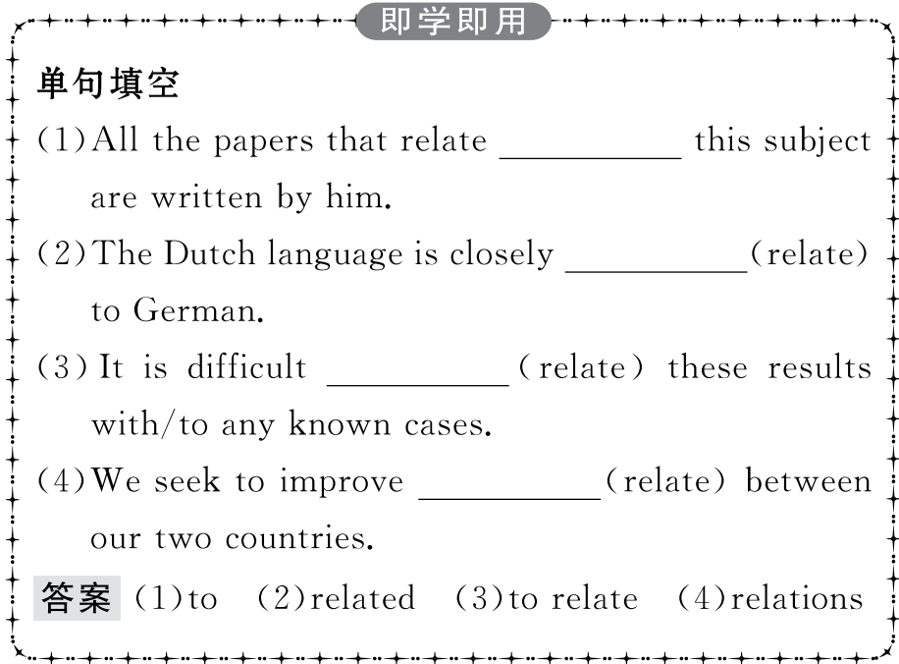
重点词汇
重点句式
重点语法
随堂练习

Slide 10
重点词汇
重点句式
重点语法
随堂练习
2.addict n.对……着迷的人
【课文原句】So,if you’re a sugar addict and aren’t able to say no to chocolate or cola,you had better download it now!
所以,如果你是一个糖瘾者,不能拒绝巧克力或可乐,你最好现在下载它!
【词汇精讲】句中的addict是名词,意为“对……着迷的人”。
She is a TV addict and watches as much as she can.
她是个电视迷,看起电视来没完没了。
My brother is a computer game addict and he always plays computer games.
我哥哥是个电脑游戏迷,他总是玩电脑游戏。

Slide 11
重点词汇
重点句式
重点语法
随堂练习
【词汇拓展】

Slide 12
重点词汇
重点句式
重点语法
随堂练习
Some students even become addicted to the Internet and cannot concentrate on school and family life.
一些学生甚至沉溺于网络并且不能集中精力于学校和家庭生活。
Li Ming is a game addict,and his father has been trying to prevent him from being addicted to computer games which are very addictive.
李明是一个游戏迷,他爸爸一直在设法让他不要沉迷于让人上瘾的电脑游戏。

Slide 13
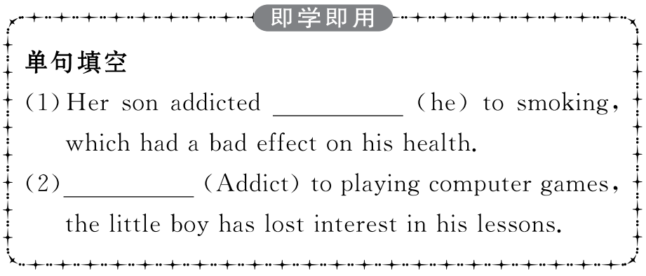
重点词汇
重点句式
重点语法
随堂练习

Slide 14
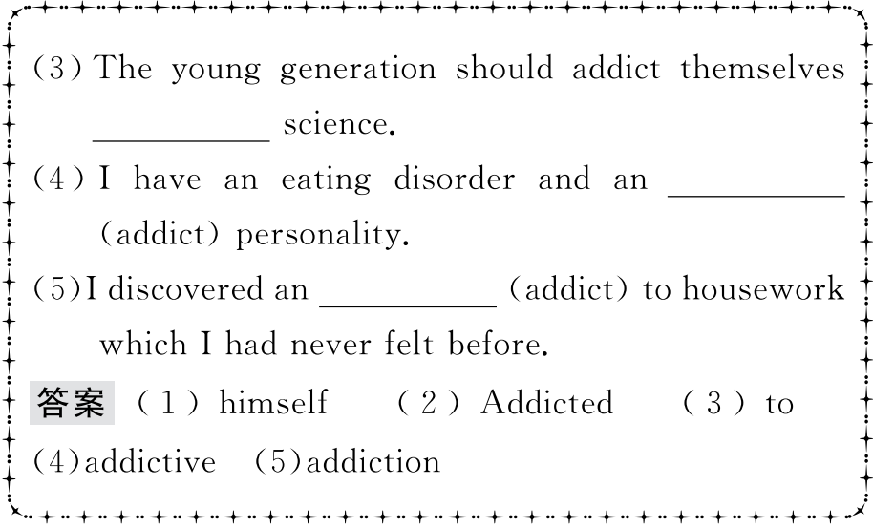
重点词汇
重点句式
重点语法
随堂练习

Slide 15
重点词汇
重点句式
重点语法
随堂练习
3.differ v. 不同,不一样,有区别
【课文原句】Table manners,however,can differ in different situations.
然而,餐桌礼仪在不同的情况下可能有所不同。
【词汇精讲】句中的differ是不及物动词,意为“不同,不一样,有区别”。
French differs from English in this respect.
在这方面法语不同于英语。
Ideas on childcare may differ considerably between the parents.
在抚育儿童方面,父母的观点可能迥然不同。

Slide 16
重点词汇
重点句式
重点语法
随堂练习
【词汇拓展】
These two regions differ greatly in climate.
这两个地区气候差异很大。
Things in the world differ from each other in a thousand ways.
世界上的事物是千差万别的。

Slide 17
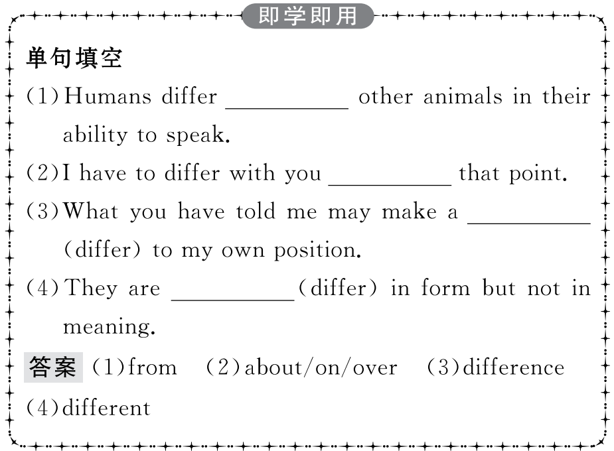
重点词汇
重点句式
重点语法
随堂练习

Slide 18
重点词汇
重点句式
重点语法
随堂练习
4.recommend v.推荐
【课文原句】Highly recommended! 强烈推荐!
【词汇精讲】recommend是及物动词,意为“推荐,建议”。
It was really annoying;I couldn’t get access to the data bank you had recommended.
这真的很烦人;我无法访问您推荐的数据库。
I recommend the book to all my students.
我向我所有的学生推荐了这本书。

Slide 19
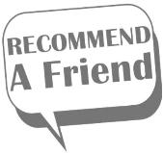
重点词汇
重点句式
重点语法
随堂练习
【词汇拓展】

Slide 20
重点词汇
重点句式
重点语法
随堂练习
I recommend that you talk to your friend about his behaviour.
我建议你和朋友谈谈他的行为。
There is a recommendation that a child’s first eye exam (should) be at the age of six months.
建议孩子的第一次眼科检查应该在六个月大时进行。
【温馨提示】recommend和recommendation后接从句时,从句谓语动词常用虚拟语气,即“should+动词原形”,should可以省略。

Slide 21
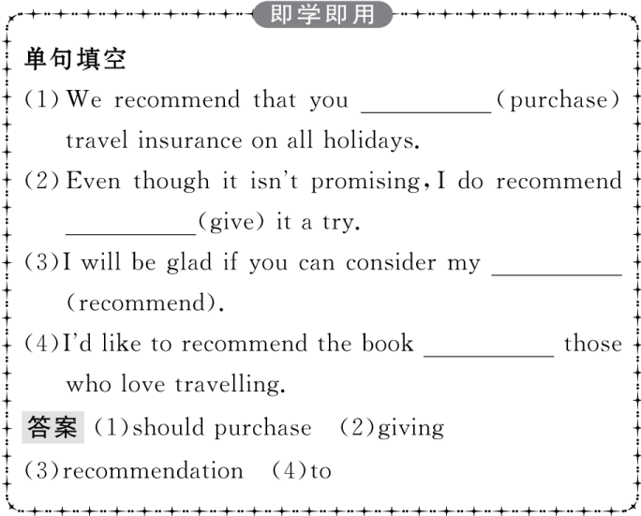
重点词汇
重点句式
重点语法
随堂练习

Slide 22
重点词汇
重点句式
重点语法
随堂练习
5.attack v.侵袭,侵蚀
【课文原句】The sugar in soft drinks forms acid and attacks our teeth for about 20 minutes each time we drink them.
软饮料中的糖会形成酸,每次饮用时都会侵蚀我们的牙齿约20分钟。
【词汇精讲】句中的attack是及物动词,意为“侵袭,侵蚀”,作名词可以表示“攻击,抨击,(病情)发作”。
The man insisted that he was just defending himself when attacked.
那个人坚持说当受到攻击时他只是在进行自卫。
According to a recent research,heavy coffee drinking and heart attack are not necessarily cause and effect.
根据最近一项研究,饮过量的咖啡与心脏病并没有必然的因果关系。
Zhaxi and other volunteers watched over the antelopes day and night to keep them safe from being attacked.
扎西和其他志愿者日夜守护着这些羚羊,以保护它们免受攻击。

Slide 23
重点词汇
重点句式
重点语法
随堂练习
【词汇拓展】
If you go there alone after dark you might get attacked.
如果你天黑后独自一人去那里,你可能会受到袭击。
When an animal is under attack,it can run away or fight back.
动物遭到攻击时,要么逃走要么反击。

Slide 24
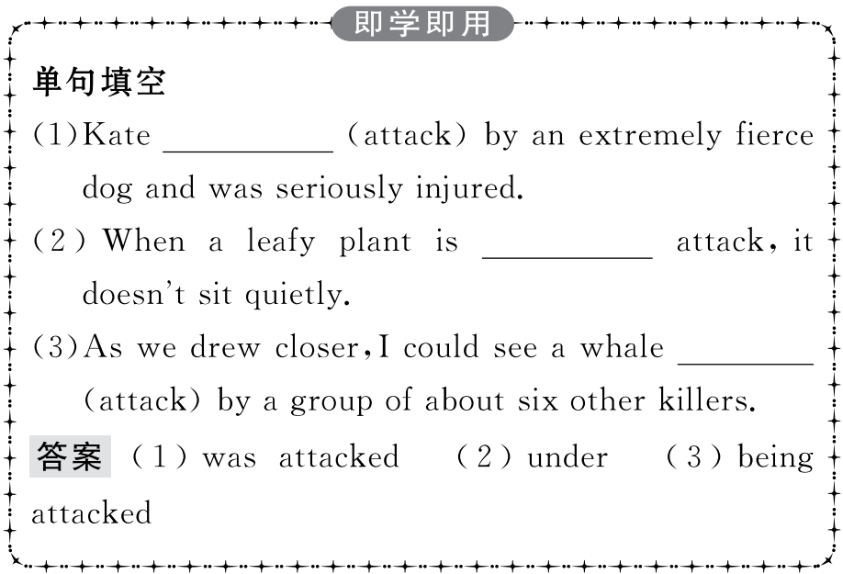
重点词汇
重点句式
重点语法
随堂练习

Slide 25
重点词汇
重点句式
重点语法
随堂练习
1.While going on your first trip to the UK is exciting,new and different customs can also be confusing.
虽然你初次去英国的旅行很令人兴奋,但新的和不同的习俗也可能令人困惑。
【句式剖析】
本句是一个省略句,句子补全应为:While you are going on your first trip to...。while是连词,意为“虽然,尽管”,引导让步状语从句。当while引导时间状语从句时,从句中的谓语动词必须是连系动词或延续性动词。
The mother didn’t know who to blame for the broken glass as it happened while she was out.
妈妈不知道该责备谁打碎了玻璃,因为这发生在她外出的时候。
While they were building a tunnel through the mountain,the workers discovered an underground lake.
当工人们在修建一个穿山隧道时,他们发现了一个地下湖。

Slide 26
重点词汇
重点句式
重点语法
随堂练习
【句式拓展】
While I enjoy the book with some nice pictures,I don’t have enough money to buy it.
虽然我喜欢这本图片精美的书,但是我没有足够的钱买它。
Generally,sweet apples are eaten fresh while tart apples are used to make applesauce.
一般说来,甜苹果生吃,而酸苹果则用来制作苹果酱。

Slide 27
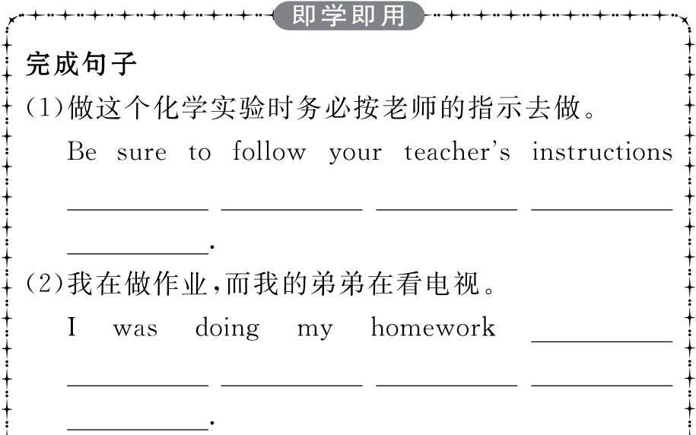
重点词汇
重点句式
重点语法
随堂练习

Slide 28
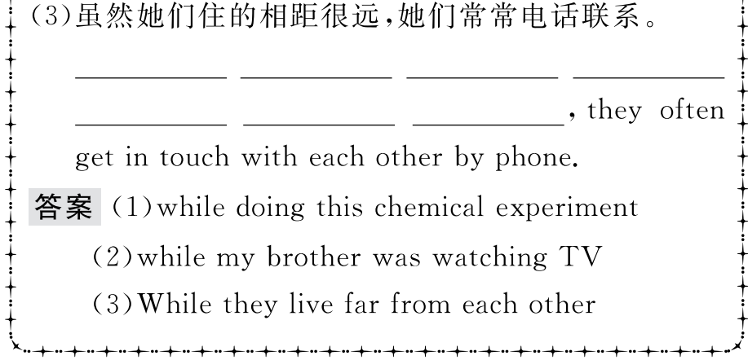
重点词汇
重点句式
重点语法
随堂练习

Slide 29
重点词汇
重点句式
重点语法
随堂练习
2.The sugar in soft drinks forms acid and attacks our teeth for about 20 minutes each time we drink them.
软饮料中的糖会形成酸,每次饮用时都会侵蚀我们的牙齿约20分钟。
【句式剖析】
句中的each time是名词短语,在此作从属连词用,引导时间状语从句,意为“每次……”。
Each time he smiled at me,a thread of warmth and friendship flowed into my heart.
每次他向我投以微笑时,他同时也将一丝丝温暖和友情送入我的心房。
Each time he comes to Baoding,he comes to see me.
每一次他来保定都来看我。

Slide 30
重点词汇
重点句式
重点语法
随堂练习
【词汇拓展】
与each time有类似用法的词语还有:

Slide 31
重点词汇
重点句式
重点语法
随堂练习
注意:the first time表示“第一次”,在句中可作宾语、表语,还可以用作连词,引导时间状语从句。for the first time 表示“第一次”,独立作状语,不引导从句。
Immediately the film was over,they went out of the cinema.
电影一结束,他们就出了电影院。
Every time he goes to Beijing,he visits the Great Wall.
每一次他去北京都会游览长城。

Slide 32
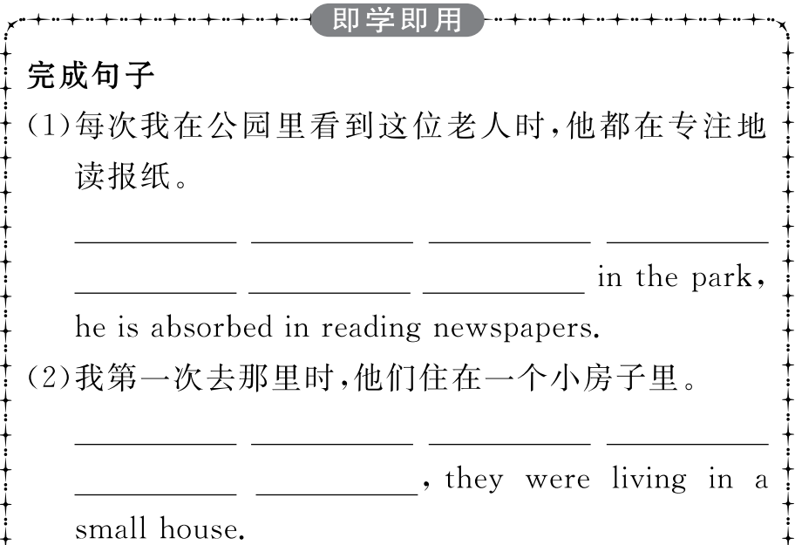
重点词汇
重点句式
重点语法
随堂练习

Slide 33
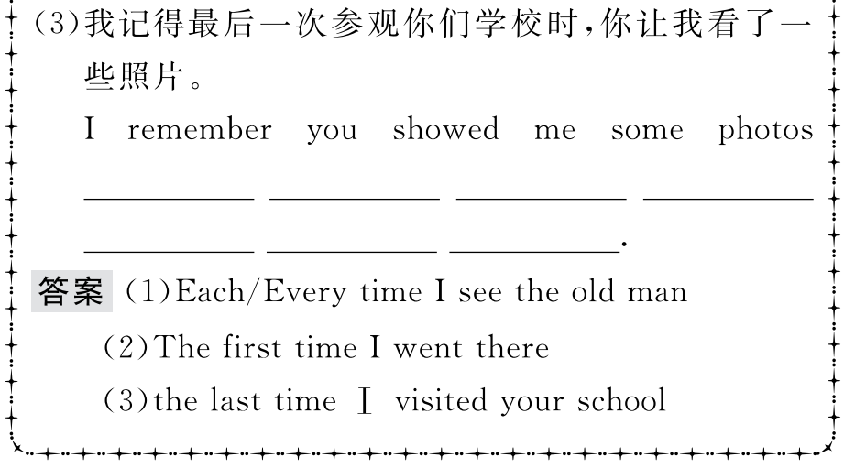
重点词汇
重点句式
重点语法
随堂练习

Slide 34
重点词汇
重点句式
重点语法
随堂练习
情态动词(Ⅰ)
1.can,could

Slide 35
重点词汇
重点句式
重点语法
随堂练习

Slide 36
重点词汇
重点句式
重点语法
随堂练习
2.may,might

Slide 37
重点词汇
重点句式
重点语法
随堂练习
3.must,have to

Slide 38
重点词汇
重点句式
重点语法
随堂练习

Slide 39
重点词汇
重点句式
重点语法
随堂练习
4.should,ought to

Slide 40
重点词汇
重点句式
重点语法
随堂练习
5.will,would

Slide 41
重点词汇
重点句式
重点语法
随堂练习
6.need,dare

Slide 42
重点词汇
重点句式
重点语法
随堂练习
Ⅰ.介(副)词填空
1.The tickets are free of charge and you needn’t pay them.
答案:for
2.My brother picked some Spanish when he was traveling in Spain.
答案:up
3.To work out a plan,one has to start investigation.
答案:with
4.The authors of the plan believe they can reach this point about two years.
答案:within/in
5.They decided to go a trip to Xi’an during the summer holiday.
答案:on

Slide 43
重点词汇
重点句式
重点语法
随堂练习
Ⅱ.翻译句子
1.那个小女孩晚上不敢出去。
答案:The little girl dare not go out at night.
2.你最好每天早晨锻炼半小时。
答案:You had better work out for half an hour every morning.
3.把字典带给她。她或许会用得着。
答案:Take the dictionary to her.She may use it.
4.你没有必要去了,会议快要结束了。
答案:You needn’t go because the meeting is about to end.
5.火车票售完了,我不得不乘飞机。
答案:The train tickets have been sold out,so I have to go by air.

