Slide 1
Unit 2 Good Behaviour
Don’t shout, please.
WWW.PPT818.COM

Slide 2
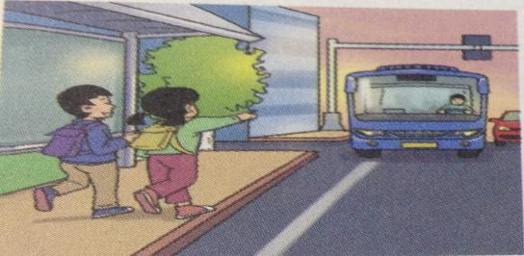
T: Here comes the bus.
Ss: Let’s get on the bus.

Slide 3
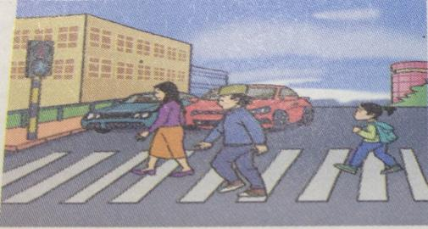
T: The light is green.
Ss: Let’s cross the street.

Slide 4
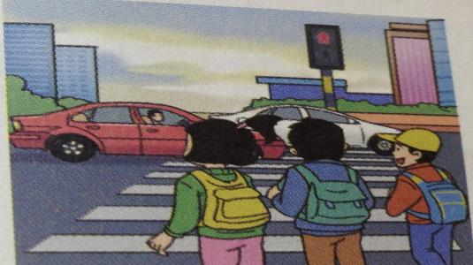
T: The light is red now.
Ss: Let’s stop and wait.

Slide 5
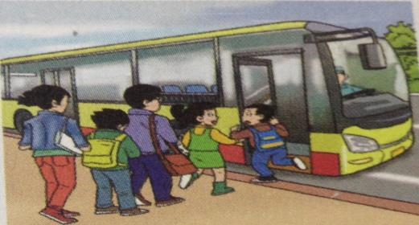
T: Don’t push, please.
Ss: Let’s wait in line.

Slide 6
draw. （^_^ orˇˍˇ ）
shout ( ) Don’t shout ( )
run ( ) Don’t run ( )
Put the bag on the seat. ( )
Don’t put the bag on the seat.( )
大声说，喊叫，呼喊
ˇˍˇ
^_^
ˇˍˇ
^_^
ˇˍˇ
放，放置
^_^
座，座位

Slide 7
choose.
Li Mei：Is the zoo ______, auntie？
Li Ming’s mum：No. It’s_______.
We’ll get off at the next stop.
far B. near

Slide 8
Let’s choose.
far
Li Mei: Is the zoo ______, auntie?
Li Ming’s mum: No. It’s_______.
We’ll get off at the next stop.
near
下（车）
下一个的
far B. near
车站

Slide 9
Listen, repeat and imitate.
Read freely
Role play

Slide 10
Let’s read.
Put your bag on the seat.
Put the book back before you leave.
Don’t push.
Don’t shout.
Don’t run.
Take my seat.
Get off the bus at the next stop.

Slide 11
Rules in classroom.
Don’t speak in class.
Don’t run in the classroom.
Don’t eat in class.
…

Slide 12
Homework
repeat the text three times.
Make the rules about your class.

Slide 13
Thank You

