Slide 1
Unit 3 Asking the way
五年级(下)
第2课时
WWW.PPT818.COM

Slide 2




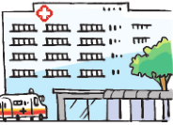
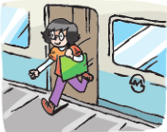
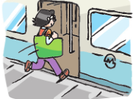


Play a game
Rules(规则)：
大声说出闪过的图片内容。
walk to Moon Street
go along this street

Slide 3
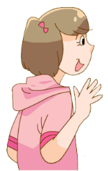
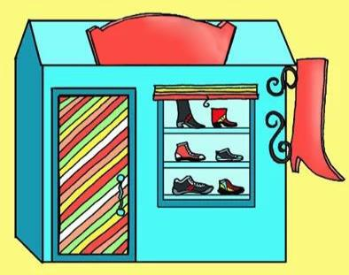
Hi, I’m Sharon.
Shoe Shop
Sharon

Slide 4

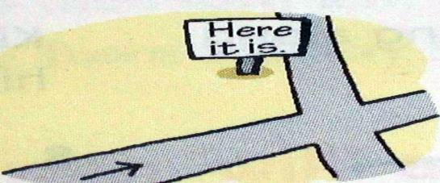
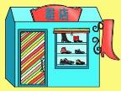

Look and say
How do I get to the shoe shop?
Shoe Shop
Moon Street
Go along … and turn ... at …
You can see...on your …

Slide 5
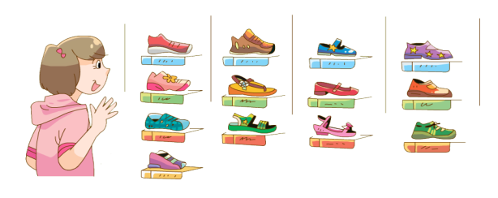
shiny shoes
闪闪发亮的鞋子
There are so many shoes. She has a problem. What is it?
鞋店里有这么多的鞋。她因此遇到什么麻烦了呢？

Slide 6

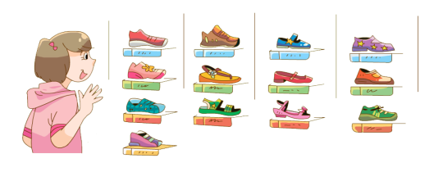
Sharon is in the shoe shop.
She likes shiny shoes,
But there are so many.
She doesn’t know which to choose! 选择哪个

Slide 7
Sharon is in the shoe shop.
sh
She likes shiny shoes,
But there are so many.
/ ʃ /
She doesn’t know which to choose!
sheep
ship
shoe
shop
你能说出有同样发音的单词吗？

Slide 8


根据发音规律读一读以下单词
shy(害羞的)
shell(贝壳)
shape(形状)
wish(愿望)
The girl is shy.
She likes colourful shells.
The shapes are very nice.
She has a wish,
To watch a film.
Notes:
8

Slide 9
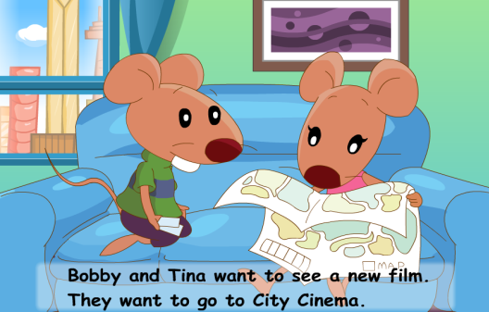
Cartoon time
Where?
film 电影
Bobby and Tina want to see a new film.
They want to go to City Cinema.

Slide 10
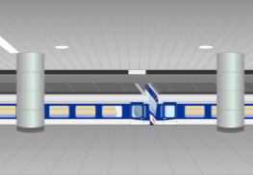
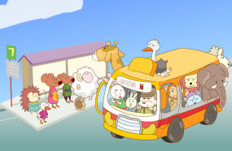

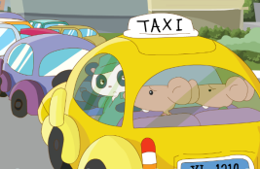
Look and say
How do they go to the cinema?

Slide 11
Watch and answer
How do they go to the cinema?

Slide 12

Check and order
Finally
First
Then

Slide 13



Look and say
First, they go by bus.
First
Why do they go to the cinema by taxi?
Because the bus is full(满的).
Then
Why do they take the metro?
Because there are too many cars in the street.
Finally

Slide 14
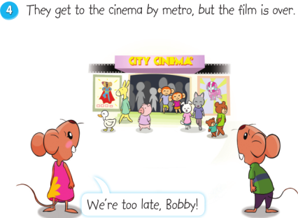
Think and say
What will Bobby say at last?
Bobby最后会说什么？
What a pity!
Let’s go home now.
Oh!
What a day!
(多么糟糕的一天啊!)
over(结束了)

Slide 15
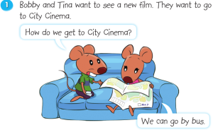
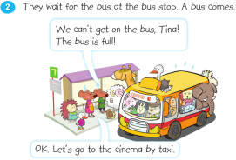
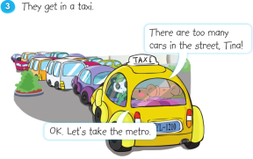

Let’s read
注意：人物的语气、动作和表情哦！

Slide 16



Happy reading
组内朗读，选择一种你们喜欢的方式朗读课文吧！
Read after one
跟读
Read together
齐读
Read in roles
分角色读

Slide 17
Happy acting
小组表演故事，
可以加入你的表情、动作以及创意结尾哦！

Slide 18

Think and talk
It takes them a lot of time to get to the cinema. How do they feel now?
他们花了很长时间来到电影院，他们现在是什么感觉呢？

Slide 19
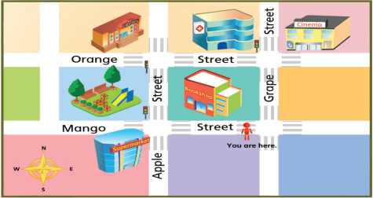


supermarket
Me too. Let’s go to the supermarket and buy some snacks.
Tina, I’m hungry now.

Slide 20
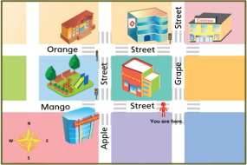



Think and talk
小组内创编对话，帮助Bobby和Tina找到超市吧！
Walk along …
Then, turn … at …
The … is on your …
Excuse me, how
do I get to …?
/Where is the …?
Tip: 结尾要记得礼貌感谢哦！

Slide 21
Homework
1.听录音，背诵Cartoon time。
2.预习Culture time、Checkout time和Ticking time。

