Slide 1
Art
第一课时
WWW.PPT818.COM

Slide 2
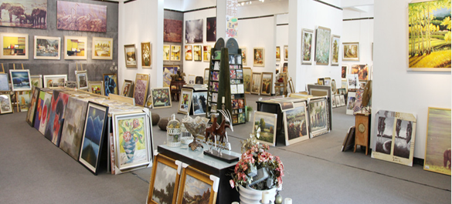
Warming
Do you like drawing / painting?
What do you use to draw/paint?

Slide 3
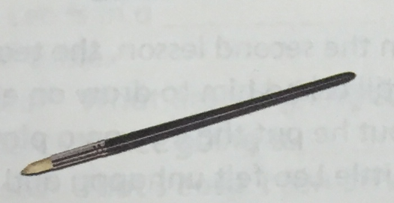
Presentation
What’s this?
It’s a brush.

Slide 4
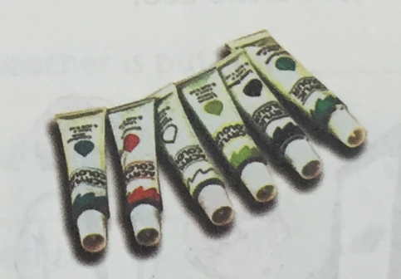
Presentation
What are these?
They’re paints.

Slide 5
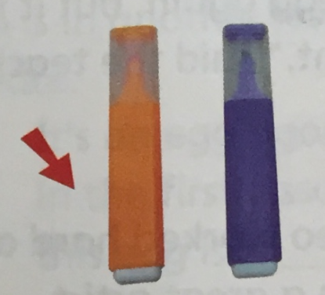
Presentation
There are two erasers.
Which one is on the left.

Slide 6
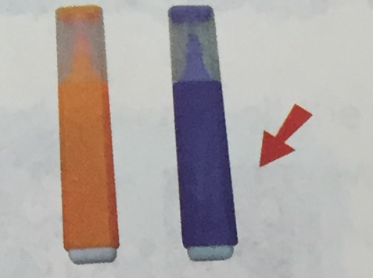
Presentation
Which one is on the right.

Slide 7
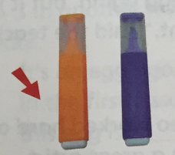
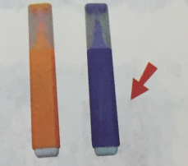
Match and say
on the right
paints
brush
on the left
Do you want to go to the art museum?
Follow me!

Slide 8
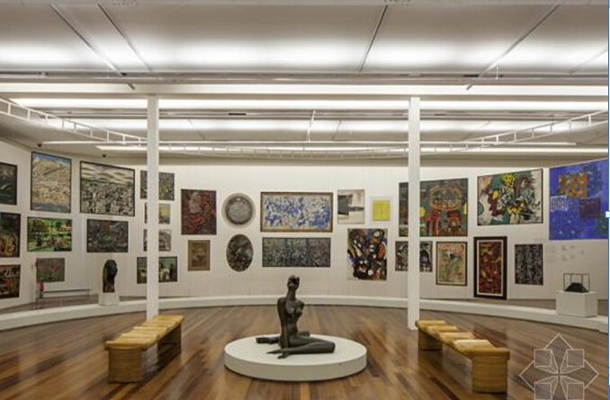
Wow! They’re great.

Slide 9
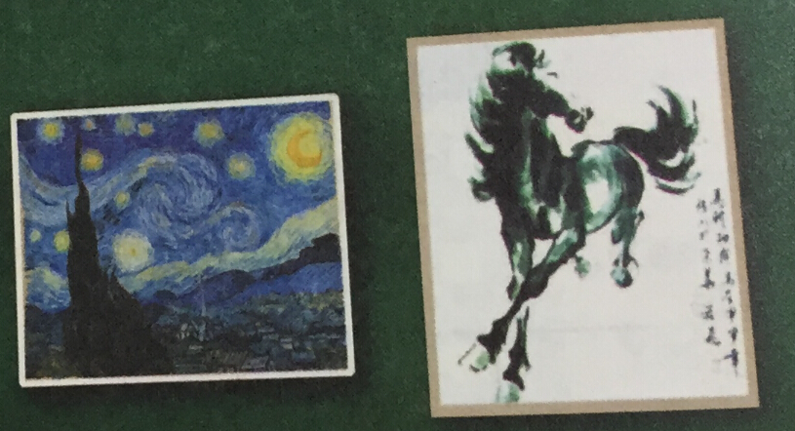
Presentation
Which one do you like?

Slide 10
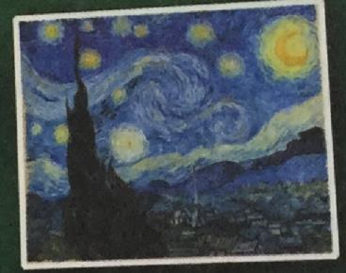
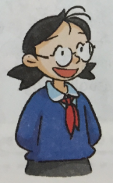
Presentation
I like the one on the left. I like the colours. The night sky is beautiful.
This is an oil painting. It’s colourful.

Slide 11
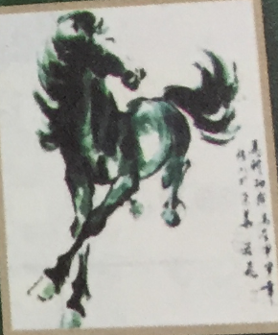
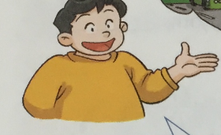
Presentation
I like the one on the right. I like horses. This horse looks powerful.
This is a Chinese ink painting. It’s usually in black and white.

Slide 12
Read and circle the correct answers.
1.Why does Kitty like the oil painting?
a She likes the colours.
b She likes the stars.
2.Why does Joe like the Chinese ink paintings?
a He likes the horses. The horse looks powerful.
b He likes the ideas.
3. A Chinese ink painting is usually_______?
a colourful.
b in black and white.

Slide 13
Enjoy reading.

Slide 14
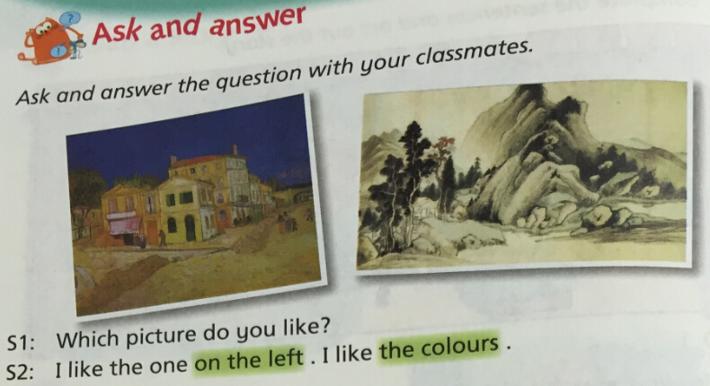
Work in pairs

Slide 15
Summary
本课重点句型：
Which one do you like?
I like the one on the left/ on the right.
I like the colours. The night sky is beautiful.
I like horses. This horse looks powerful.
学会询问及回答喜欢的物品，并简要说明理由。

Slide 16
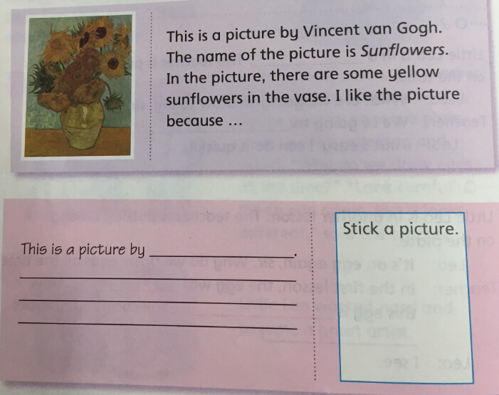
Homework.
选择自己喜欢的一幅艺术作品，并做简要介绍和说明理由。

Slide 17
The End

