Slide 1
Unit 6 Seasons
What Strange Weather!
WWW.PPT818.COM

Slide 2
Learning Targets
1. Be able to use the words and expressions: strange, notice, wild, wake, surprised, become, dark, ski, snowball,wake up, come out, go away, write a report about..., go swimming, go skiing/skating, have snowball fights, good work, change one's hair style
2. Know four seansons.
3. Learn to describe the weather .
4. Learn some key sentences:

Slide 3
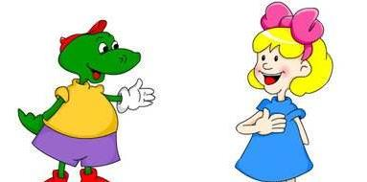
1. What strange weather!
2.Did you notice the wild weather today?
3.What a snowy day!
4.I woke up this morning and I was surprised!
5.The weather turns hot and I can go swimming.

Slide 4
Lead In
What is the weather like here?
Which season do you like best? Why?

Slide 5
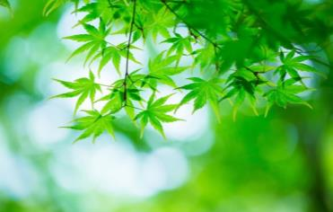
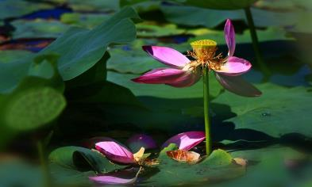
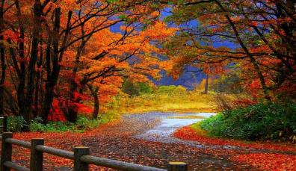
spring
summer
autumn
winter
four seasons

Slide 6
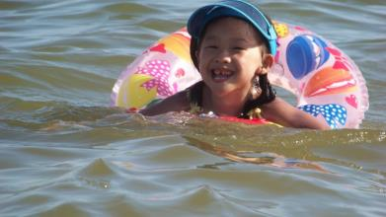
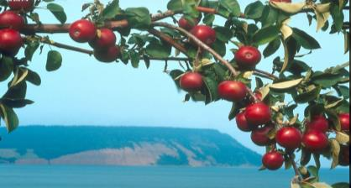
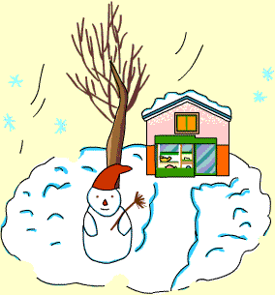
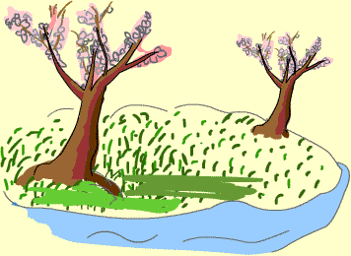
It becomes hot. go swimming
It turns cool. pick apples
The weather turns cold. make snowmen, have snowball fights, go skiing, go skating
It becomes warm. fly kites

Slide 7
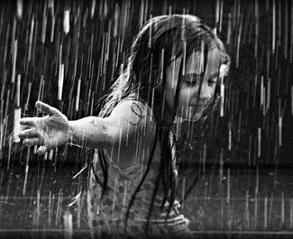
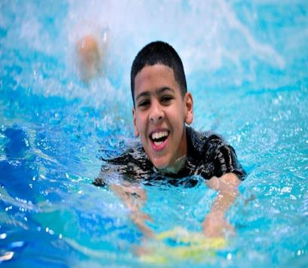
go swimming
play in the rain

Slide 8
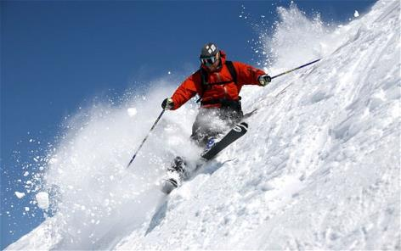
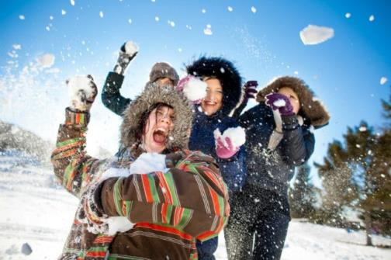
go skiing
have snowball
fights

Slide 9
Words and Expressions
strange
notice
wild
wake
surprised
become
dark
ski
adj. 奇怪的；奇特的；不熟悉的
v. 注意到；看到
n. 布告；启事
adj. 怪异的；荒诞的；野生的
v. (woke/woken)醒
adj. 感到惊讶的
v. (became/become)变得；成为
adj. & n. 黑暗(的)
v. 滑雪

Slide 10
snowball
wake up
come out
go away
write a report about
go swimming
go skiing/skating
have snowball fights
good work
n. 雪球
醒来；叫醒
出来
消失；离开
写一份关于……的报告
去游泳
去滑雪/冰
打雪仗
干得好；做得很棒

Slide 11
Presentation
Mr. Jones：Hello, class！Did you notice the wild
weather today?
Jenny：Yes, I did！I woke up this morning and I was surprised！What a snowy day!
Danny：Yeah！Then the sun came out and it became warm. All the snow went away.
Kim：And right now the sky is dark. It’s going to rain.
Mr. Jones：Yes, you’re right. What strange weather！We are experiencing almost four different seasons in one day！Now, class, I want you to write a report

Slide 12
about your favourite season. Why is it your favourite
season？What do you like about that season?
Steven：Well，I love spring！It is spring right now.
And spring usually means green trees, beautiful flowers
and playing in the rain.
Jenny：I like summer. The weather turns hot and I can
go swimming.
Kim：Autumn is my favourite season. It’s so colourful
and the weather is nice and cool.

Slide 13
Danny：Well，I like winter. The weather is cold and there is a lot of snow. You can go skiing and skating. You can also have snowball fights. But you have to wear warm clothes.
Mr. Jones：Good work, everyone！You are all going to write some wonderful reports.

Slide 14
Let’s Do It!
1. What are the students’ favourite seasons?
Listen and fill in the table.
Name | Favourite Season
Steven
Jenny
Kim
Danny
Spring
Summer
Autumn
Winter

Slide 15
2. What was the weather like that day?
Read the lesson and put the weather
descriptions in the correct order.
1. Right now the sky is dark.
2. All the snow went away.
3. The sun came out and it became warm.
4. What a snowy day!
5. It is going to rain.
The correct order is :_____________
4, 3, 2, 1, 5

Slide 16
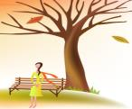
3. Match the pictures with the
exclamatory sentences.
What a snowy day!
What beautiful flowers they are？
What a hot, sunny day!
What cool weather it is!

Slide 17
4. Fill in the blanks with the words or
phrase in the box.
notice dark strange
wild wake up
The man always sleeps in the day and works at night. That is very ______.
It’s getting ______. I must go home.
What time do you usually _________ every morning?
strange
dark
wake up

Slide 18
4. Our teacher changed her hair style. Do
you _____ that?
5. Sometimes the sea is quiet and sometimes
it’s very ______.
notice
wild

Slide 19
Grammar
感叹句的用法
感叹句由what或how引导。
what引导的感叹句的构成：
What +a/an+形容词+单数可数名词(+其他)!
What +形容词+不可数名词/复数可数名词(+其他)!
例：What a beautiful flower (it is)!
多么漂亮的花啊！
What tall trees (they are)!
多么高的树啊！

Slide 20
how引导的感叹句的构成：
（1）How+形容词/副词+主语+谓语！
例：How big the room is！ （how+形容词）
这个房间好大！
How fast the boy is running！（how+副词）
这个男孩跑得真快!
Xi’an—the Walled City

Slide 21
（2）How＋形容词＋a/an＋可数名词单数
(＋主语＋谓语)！
例：How nice a girl she is！
她是多么好的一个女孩啊！
（3）How＋主语＋谓语！
例：How time flies！
时间过得真快呀！

Slide 22
Language Points
1. Did you notice the wild weather today?
notice v. 注意到；看到。
【探究总结】notice作及物动词的四个结构:
①notice sb. /sth. 注意到某人/某物
②notice+宾语从句 注意到/看到……
③notice sb. /sth. do sth. 注意到某人/某物做某事了
④notice sb. /sth. doing sth. 注意到某人/某物正在做某事

Slide 23
例：I noticed that he got up very early.
我注意到他起床很早。
Did you notice Tom come in?
你看到汤姆进来了吗？
When I went by the classroom, I noticed a student
doing his homework in the classroom.
当我经过教室时，我注意到有一名学生正在教室里
做作业。

Slide 24
【学以致用】
When the teacher came in, he noticed some students _______ in the classroom.
A. sleep B. slept
C. sleeping D. to sleep
C

Slide 25
2. I woke up this morning and I was surprised!
wake v. 醒。
【探究总结】wake的用法：
(1)wake用作不及物动词意为“醒；醒来”，常用于短语wake up。
(2)wake用作及物动词意为“唤醒，叫醒”，常用于短语wake sb. / sth. up。
例：My mother wakes me up at 6: 00 every morning.
我母亲每天早上六点钟把我叫醒。

Slide 26
【学以致用】
如果明天我六点醒，我将把你叫醒。
If I ______ ______ at 6: 00 tomorrow, I’ll ______ ______ ______.
wake up
wake
you up

Slide 27
3. Then the sun came out and it became warm.
become v. 变得；成为。
例: He became a teacher 10 years ago.
10年前他成了一名老师。
【探究总结】become作系动词，后跟形容词或名词。
（1）后跟_______（形容词/名词）时表示人或物的状态、外貌的变化，此时意为“变（得）”。
（2）后跟_____（形容词/名词）时常用来表示身份、职位、关系的变化，此时意为“成为”。
形容词
名词

Slide 28
【学以致用】根据汉语意思完成句子，一空一词。
成为中学生之后，她变得文静了。
She ________ quiet after she ________ a middle school student.
became
became

Slide 29
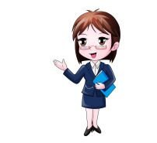
4. The weather turns hot and I can go swimming.
（1）turn在此作系动词，后面跟形容词作表语。
例：In spring, the trees turn green.
春天，树变绿了。
（2）go swimming去游泳。类似短语还有：
go shopping 去购物；
go boating 去划船；
go fishing 去钓鱼。
Xi’an—the Walled City

Slide 30
Exercises
Ⅰ. 选词并用其适当形式填空。
1. I ______ up early this morning, so I didn't get
to school late.
2. We are all _________ at his coming.
eat wake colour surprising ski
woke
surprised
3. Look! Some girls are ______ over there.
4. What a ________ autumn!
5. Summer means hot days and ______ ice-cream.
skiing
colourful
eating

Slide 31
Ⅱ. 单项选择
1. Mum, _______ before 5: 30 tomorrow morning.
A. wake up me B. wake me up
C. woke up me D. woke me up
2. My father _______ a worker in 1993.
A. becomes B. became
C. turns D. turned
B
B

Slide 32
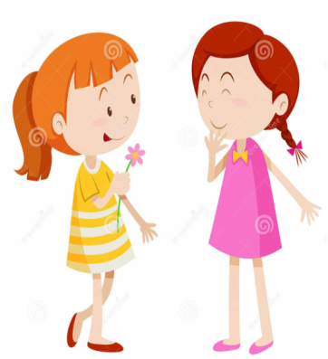
3. —________
—Yeah! Let’s have snowball fights.
A. What a snowy day!
B. What snowy day!
C. How a snowy day!
D. How snowy day!
A

Slide 33
4. — Here are our reports about favourite season, Mr.
Black.
—______
A. Good luck to you, everyone!
B. Goodbye, everyone!
C. Good work, everyone!
D. Good idea!
5. Open the window, and the bad smell will _____.
A. go out B. go off
C. go down D. go away
C
D

Slide 34
Summary
1. Learned something about four seasons and
learned to describe the weather;
2. Be able to use some important words and
expressions in this lesson.

Slide 35
Homework
1.Which season do you like best?
Write a report about it and share
your report in class next class.
2. Finish the exercises of this lesson.

