Slide 1
Unit12
I can swim fast.
WWW.PPT818.COM

Slide 2
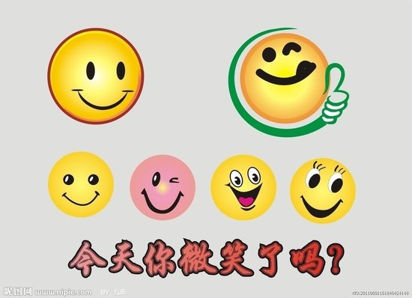
Have you smiled today?

Slide 3
can
能，可以
I can…
I can…
I can do it!
我行，我行，我一定行！

Slide 4
let's learn.
Let's learn sports words!
One, two, three, can, can, can!

Slide 5
swim
Swim, swim, 游游游
I can swim.

Slide 6
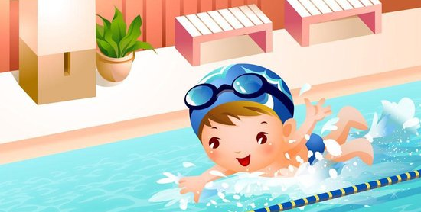
fast
Fast, fast,快快快
swim fast
He can swim fast.

Slide 7
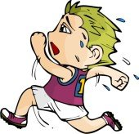
run
Run, run, 跑跑跑
I can run.

Slide 8
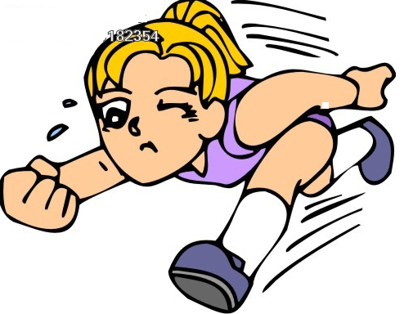
run fast
She can run fast.

Slide 9
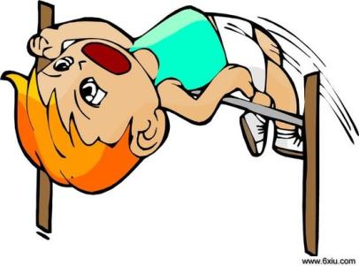
jump
Jump, jump,跳跳跳
I can jump.

Slide 10
high
High, high, 高高高
jump high
Peter can jump high.

Slide 11
fly
Fly, fly,飞飞飞。
fly high
I can fly high.

Slide 12
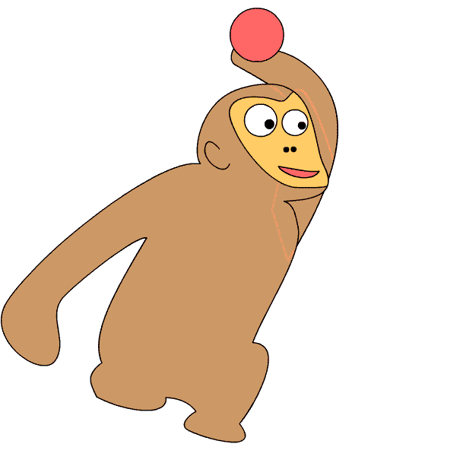
throw
Throw,throw，投投投。
I can throw.

Slide 13
far
Far, far , 远远远。
throw far
She can throw far.

Slide 14
let's pratice.

Slide 15
1.Let’s act and chant!一演，唱一唱。
Swim, swim, I can swim.
Run, run, I can run.
Jump, jump, I can jump.
Fly, fly, I can fly.
Throw, throw, I can throw.

Slide 16
let's listen.

Slide 17
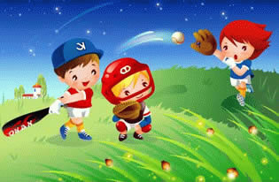
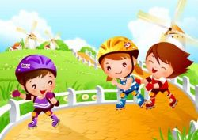
运动场上，Peter , Lingling , Anne ,Dongdong , 正在奋力拼博。

Slide 18
 | I can
 | run fast | jump high | throw far | swim fast
Peter
Anne
Dongdong
Lingling

Slide 19
Peter can jump high.

Slide 20
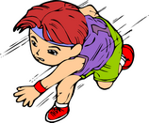
Lingling can run fast.

Slide 21
Anne can throw far.

Slide 22
Dongdong can swim fast.

Slide 23
Act and chant!
I can, I can, I can swim fast.
I can, I can, I can run fast.
I can, I can, I can jump high.
I can, I can, I can fly high.
I can, I can, I can throw far.

