Slide 1
Unit 1 This is me!
Reading II
WWW.PPT818.COM

Slide 2
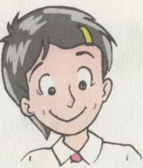
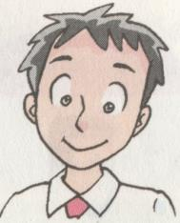
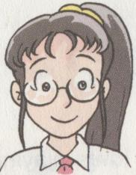
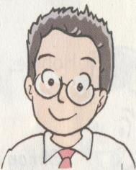
Who are they
Millie
Simon
Daniel
Sandy

Slide 3
My profile
What is your name? My name is _______________.
Where do you live? I live in_________________.
How old are you? I am_______________________.
What are you like?
Hair I have ____ hair and ____eyes.
tall… I am ________.
What do you like ?
I like___________________.

Slide 4
I’m 12 years old.
1) 12 years old 12岁
His father is 40 _____ _____ .
2) 12-year-old 12岁的
The ___________ girl lives with her
grandfather.
3) The boy is only ____________ (10岁),
but he has to look after his brother
Tommy, ____________(8岁) boy.
years old
12-year-old
10 years old
an 8-year-old

Slide 5
I have long black hair.
have long black hair 长着黑色长发
1)玛丽留短发, 戴眼镜。
Mary _____ _____ _____ and _____
glasses.
2)短发的那个女孩是玛丽。
The girl ____ _____ ____ ____ Mary.
3)穿兰色外套的那个男孩是谁？
Who is the boy _____ a blue coat?
has short hair
wears
with short hair is
in

Slide 6
She is good at swimming.
be good at… 擅长……
do well in…
be clever at…
do sth. well
be a good+名词

Slide 7
1)She is good at swimming.（同义句）
She _____ _____ in swimming.
She ______ _____.
She is a _____ __________.
2)Beckham is a good football player. （同义句）
Beckham ______ ________ ______.
Beckham ____ _____ ___ football.
does well
swims well
good swimmer
plays football well
is good at

Slide 8
He likes/loves/enjoys reading.
1) like/love/enjoy doing … 喜爱做……
My father likes/loves/enjoys _______ newspapers.
2) like/love/enjoy sth. 喜爱某物
All of us ________ the film last night.
3) enjoy oneself /have fun/have a good time 玩得开心
They always _____ _________ at the
party.
They always ____ __ ____ _____ at
the party.
reading
enjoyed
enjoy themselves
have a good time

Slide 9
用所给动词适当形式填空
1.She likes _______ (swim) in summer.
2.Tom’s mother _______ (enjoy) _______ (dance).
3.At the weekend, Tony ________ (usual) _______ (go) _______ (run) in the park.
4.You can _______ (call) _____ (his) John.
5.Daniel is _______ and he often ______ others.(help)
swimming
enjoys
dancing
usually
goes running
call him
helpful
helps

Slide 10
Translation
1、这个女孩来自北京。
comes /is from
The girl _______________ Beijing .
2、他们擅长画画。
are good at drawing
They _______________________ .
3、丹尼13岁。
is 13 years old.
Daniel _____________
4. 他喜欢放学后踢足球。
He likes
playing football after school.

Slide 11
Homework
Recite the text.
Remember the words and phrases.
Finish the exercises
Prepare for the next period.

