Slide 1
Unit 2
What time do you go to school?
R 七年级下册
第2课时
WWW.PPT818.COM

Slide 2
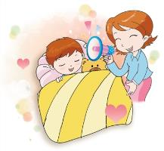
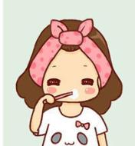
Lead-in
A:What time do you usually get up ?
B:I usually get up at six thirty.
A:What time do you usually brush
teeth ?
B:I usually brush teeth at six forty.

Slide 3
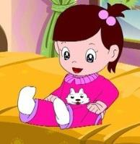
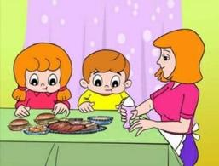
A:What time do you usually eat breakfast?
B:I always eat breakfast at seven o’clock.
A:What time do you usually get dressed?
B:I always get dressed at seven twenty.

Slide 4
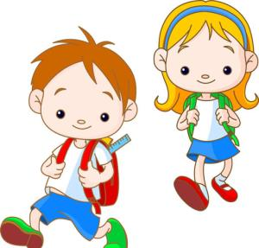
A: What time do you usually go to school?
B:I always go to school at seven thirty.

Slide 5
Grammar Focus
What time do you usually get up?
I usually get up at six thirty.
What time do they get dressed?
They always get dressed at seven twenty.

Slide 6
What time does Rick eat breakfast?
He eats breakfast at seven o’clock.
When does Scott go to work?
He always goes to work at eleven o’clock. He’s never late.

Slide 7
When do your friends exercise?
They usually exercise on weekends.

Slide 8
一、频度副词的用法
频度副词:副词的一种，通常和一般现在时连用，表示现在经常或反复发生的动作。
1.频度副词一般放在实义动词之前，be动词、助动词或情态动词之后。
例：我通常八点半洗淋浴
I ______ _____ _____ ______ at eight thirty. 
usually take a shower

Slide 9
例：露西有时很忙。
Lucy _________ _________ very busy.
is sometimes
2.对频度副词提问时，用how often。
例：— How often do you exercise? 你多久锻炼一次？
— Hardly ever. 几乎从不

Slide 10
本单元出现的频度副词:always, usually, sometimes, never。
always是频度最大的词，意为“总是；永远”
usually意为“通常”，即很少有例外，频度仅次于always;
sometimes意为“有时”
never意为“从不”

Slide 11
二、时间表达法
1.整点表达法(表几点钟 即整点):基数词+o’clock
(可省)
例：7:00
seven o’clock 或 seven
5:00
five o’clock或 five
2.顺读法:先读钟点数，再读分钟数
例：8:25
eight twenty-five
9:40
nine-forty

Slide 12
3.逆读法：先读分钟，再读点钟
(1)几点过几分:分钟+past+小时 (分钟数不能超过30分钟)
例：七点过五分 five past seven
八点过十分
ten past eight
(2)几点差几分:分钟+to+小时(分钟数限定在 29分钟以内)
例：七点五十分 ten to eight
八点四十分
twenty to nine

Slide 13
当分钟数正好是30时，常用half来表示；当分钟数正好是15时，常用quarter来表示。
例：十一点四十五分
a quarter to twelve
六点半
half past six

Slide 14
Write answers or questions. Use always, usually or never.
3a
1. What time do you get up on school days?
___________________________________________
2. ___________________________________________？
Rick always gets up at 6:20.
I usually get up at seven o’clock.
What time does Rick usually get up

Slide 15
3. What time do you have breakfast?
___________________________________________
3. ___________________________________________？
Anna never eats breakfast.
5. What time does your best friend go to school?
___________________________________________
I usually have breakfast at eight o’clock.
What time does Anna usually eat breakfast
She usually goes to school at six forty.

Slide 16
Write about something you always do,
something you usually do and something you never do.
3b
always
I always go to school at seven o’clock.
I usually play the guitar at 6:00 after school.
usually
never
I never watch TV on school days.

Slide 17
Interview three of your classmates. Find out what time they do these activities. Then give a report to the class.
3c
Student 1
Name:______
Student 2
Name:______
Student 3
Name:______
get up on weekends
exercise
eat dinner
take a shower
go to school

Slide 18
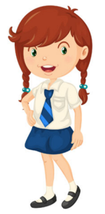
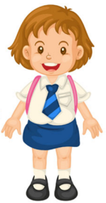
What time do you usually get up on weekends, Li Fei?
I always get up at nine o’clock on weekends.

Slide 19
What time do you usually exercise?
I usually exercise at six o’clock in the evening.

Slide 20
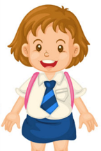
Student 1
Name:______
Li Fei
In our group, Li Fei always gets up late on weekends. She gets up at nine o’clock. She usually exercise at six o’clock in the evening …
get up on weekends
9:00 am
exercise
6:00 pm
eat dinner
……
take a shower
go to school

Slide 21
Language points
1. When does Scott go to work? 斯科特什么时候去上班？
本句是由when引导的特殊疑问句
when:什么时候，用于问时间。
常用的句型结构是：When+一般疑问句？
例：他什么时候吃午餐？
When does he have lunch?

Slide 22
go to work：去上班，固定结构。
go + to(+冠词）+名词：既可表示参加音乐会、聚会、会议等,也可表示去做某事。
例：go to the party 参加聚会 go to school 去上学
go的相关短语:
go home 回家 go on 继续；发生
go back 返回 go shopping 去购物

Slide 23
go out 出去 go over 仔细检查
go for a walk/swim去散步/去游泳
go on a trip 去旅游 go away 离开；走开

Slide 24
Exercise
1. —Where does your mother ______?
—In the hospital(医院）. She ______ at 8：00.
A. work； goes to work
B. work ； goes to school
C. works； go to work
D. works； goes to work
A

Slide 25
2. — ______?
— It’s nine thirty.
A. What time is it B. What it is time
C. What time they are D. What time it is
3. It’s bad for your eyes if you are _____ playing
computer games.
A. never B. always C. usually D. sometimes
A
B

Slide 26
4. 写出下列时间。
8:00 _________________________
7:50 _________________________
9:02 _________________________
10:20 _________________________
11:25 _________________________
eight (o' clock)
seven fifty / ten to eight
nine o two / two past nine
ten twenty
eleven twenty-five

