Slide 1
Unit 4 Friends forever
Section Ⅱ Language Points(Starting out & Understanding ideas)
WWW.PPT818.COM

Slide 2
语
言
基
础
自
测
Notes:
2

Slide 3
Click
advance
enable
digital
Notes:
3

Slide 4
site
maintained
significantly
tend
Notes:
4

Slide 5
advance
significantly
enable
meaningful
unusual
Notes:
5

Slide 6
of
with
in
to
Notes:
6

Slide 7
for
to
in
if
Notes:
7

Slide 8
longed for
Thanks to
even if
in advance
keep in mind
Notes:
8

Slide 9
What if
Notes:
9

Slide 10
Whether she will
come or not
Notes:
10

Slide 11
the way
he looks at me
Notes:
11

Slide 12
核
心
要
点
探
究
Notes:
12

Slide 13
Notes:
13

Slide 14
Notes:
14

Slide 15
Notes:
15

Slide 16
lost
with
Notes:
16

Slide 17
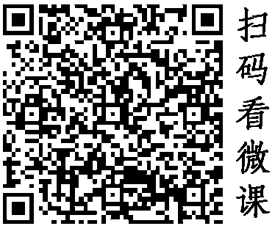
Notes:
17

Slide 18
advanced
had advanced
Notes:
18

Slide 19
Notes:
19

Slide 20
What
where
Notes:
20

Slide 21
Notes:
21

Slide 22
have maintained
at
Notes:
22

Slide 23
Notes:
23

Slide 24
Notes:
24

Slide 25
on
has clicked
Notes:
25

Slide 26
Notes:
26

Slide 27
to hear
to deal
Notes:
27

Slide 28
Notes:
28

Slide 29
Notes:
29

Slide 30
that/which
in
Notes:
30

Slide 31
剩下
留下
留待
遗迹
Notes:
31

Slide 32
Notes:
32

Slide 33
remaining
Notes:
33

Slide 34
to be seen
remaining
Notes:
34

Slide 35
Thank you for watching !

