Slide 1
Unit 1
Slow and steady wins the race
WWW.PPT818.COM

Slide 2
/ ‘stedI /
steady
/ W I n /
win
won
/WV n/
/ K Q r I /
carry
/ s V tS /
such
/ H V R I /
hurry

Slide 3
/ s I L I /
silly
/ H eE /
hare
/ t O: t E s/
tortoise
/ M i: n /
mean
/ M e n t /
meant
/p r au d/
proud

Slide 4
/ k eE L E s /
careless
/ P eI Snt /
patient
sad
/ s Q d /
remember
/ RI membE /
/ H A: d /
hard
/ k eE F L /
careful

Slide 5
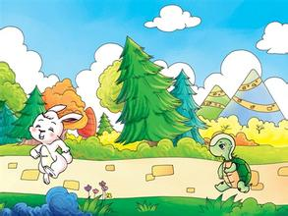
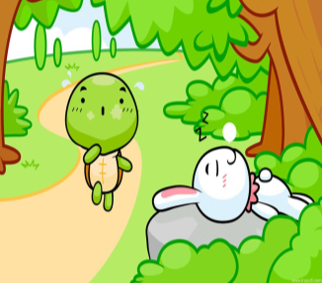
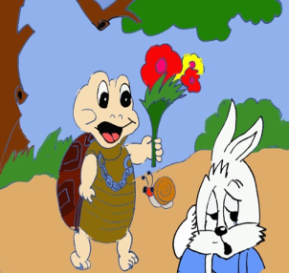
Free talk.
What's this story about ?
The Tortoise and the Hare

Slide 6
Slow and steady
wins the race.
One day a tortoise and a hare had a race. The hare was sure he would win so he took a rest. He was too proud and careless. The slow but careful tortoise won the race.

Slide 7
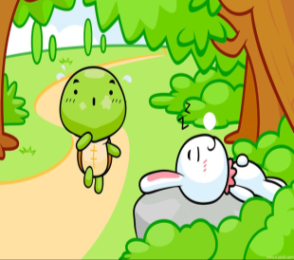
Let's talk.
Don't ...
You should / shouldn’t ...
Be...

Slide 8
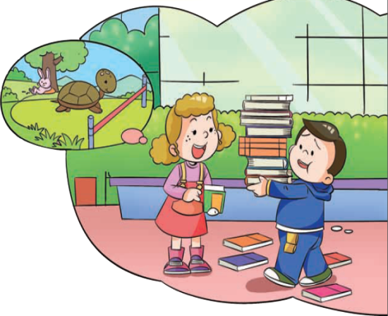
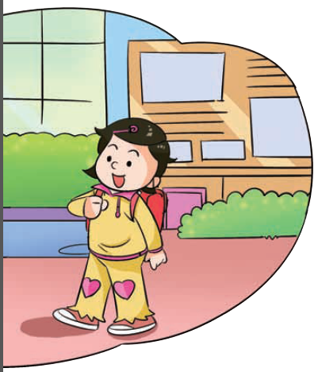
Let's talk.
Look, what's Jiamin doing?
Jiamin is carrying the books.

Slide 9
Let's read and judge.
1.( ) Jiaming tried to carry all the books beacuse he
thought the books were not heavy.
2.( ) Xiaoling thinks Jiamin is like the silly tortoise.
3.( ) In the story The tortoise and the Hare, the slow but careful tortoise won the race.
4.( ) Finally, Jiamin knows that he should be quick and careful if he wants to do something well.
F
didn't want to go back to the classroom again.
F
hare
T
F
patient

Slide 10
Let's practise.
to 后加动词原形
try to do something
=try one's best to do something
尝试去做某事 ( try-tries-tried)
want to do something 想去做某事
in a hurry （名词）
hurry（动词） to do something
急忙做某事

Slide 11
祈使句：Don’t…
Let’s…
Please…
后加动词原形
Be + 形容词
表示建议：
主语 + should / shouldn’t + 动词原形

Slide 12
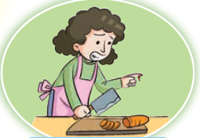
Let's talk.
Mrs.Chen cuts the carrots too fast, so she cuts her finger. You will say....
Don't cut too fast.
You should be patient.

Slide 13
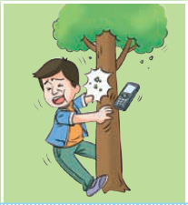
Talk in groups.
Don't ...
You shoud ... / Be...
Mr. Zhang walks fast and runs into a tree, he feels bad.

Slide 14
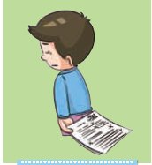
Talk in groups.
Don't ...
You shoud ... / Be...
Xiaoming doesn't do well in the
English test, he is very sad.

Slide 15
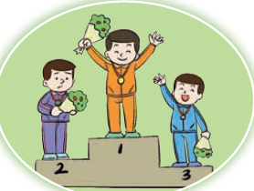
Talk in groups.
Don't ...
You shoud ... / Be...
Jack wins the race and he feels so excited.

Slide 16
Fill in the blanks.
careless，careful，silly，slow，
steady，proud， patient
1. Why are you in such a hurry? You are like that ___________ hare.
2. The hare was sure he would win so he took a rest. He was so ______ and____.
3. The slow but _________ tortoise won the race.
4. If I want to do something well, I should be _________ and _________.
5. Remember, ___________ and ____________ wins the race.
silly
proud
careless
careful
careful
patient
slow
steady

Slide 17
Let's match.
If you want to do something well,
you shoud keep a good diet.
If you want to speak good English,
you shoud listen and speak more.
If you want to be healthy,
you should be careful and patient.
If you want to win the race,
you should try to run very fast.
Make your own sentences:
If you want to ______, you should _________.

Slide 18
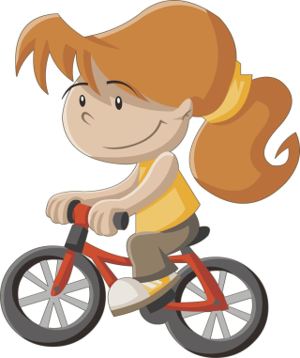
Look and say.
ride a bike
have a rest

Slide 19
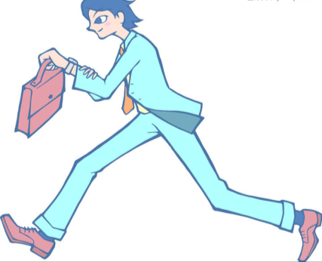
Look and say.
in a hurry
cut a finger

Slide 20
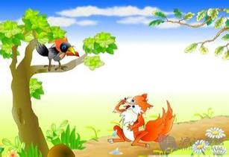
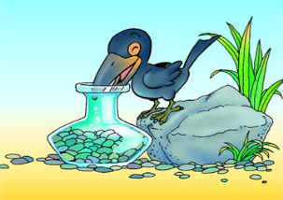
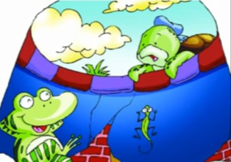
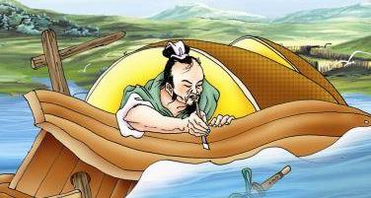
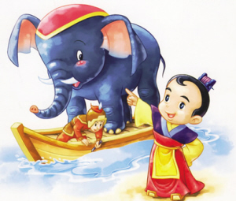
Free talk.
What are these stories about?
The Fox and the Crow
The Crow and the Pitcher
The Frog in the Well
Cao Chong Weighs
the Elephant
Making His Mark
The Little Match Girl

Slide 21
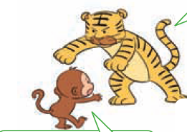
Look,read and match.
(2) Hey, little monkey. Don't move. I'll eat you up.
(4) That's all rihgt. But there's a strong tiger over there. He said he would eat me, too. If you eat me, he will not be happy.

Slide 22
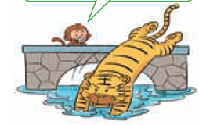
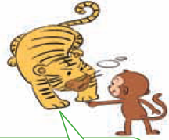
(3) He's down there,in the river.
(1) Where is he now?

Slide 23
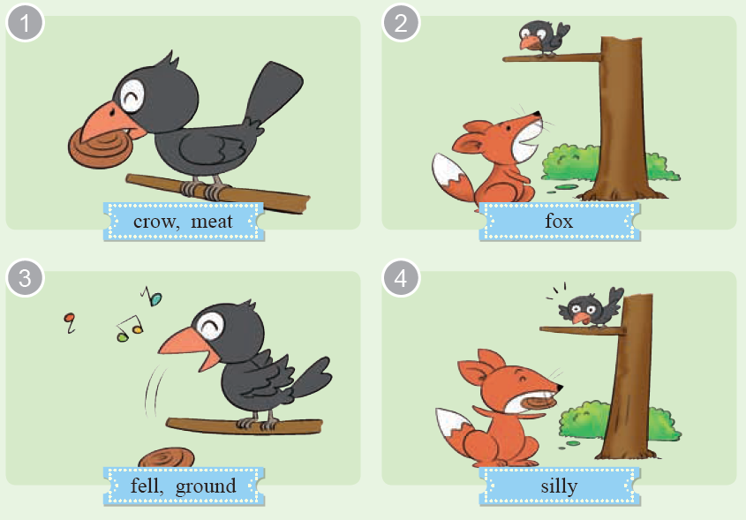
The fox and the crow

Slide 24
Sum-up:
在故事描述中，一般使用过去式。
但故事中的人物对话时，要根据情景需要，运用恰当的时态。

Slide 25
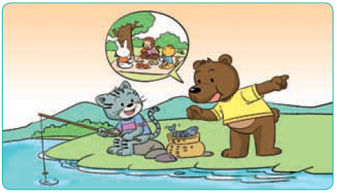
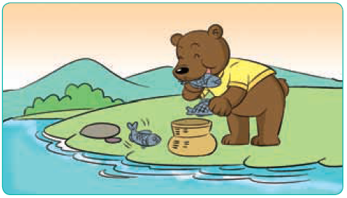
Look and guess.
What's the story about?

Slide 26
Let's read.
Read and judge T/F.
T
1.( ) Both the little cat and the bear like eating fish.
2.( ) Kitty's frends are playing in the old bear's garden.
3.( ) The old bear will look after the fish for Kitty.
4.( ) Kitty went to look for her friends because she
wanted to play with them.
5.( ) The old bear finally ate all the fish up.
F
F
T
T

