Slide 1
Topic
M9 Population
Arnwick was a city with 200,000 people.
WWW.PPT818.COM

Slide 2
01
Revision

Slide 3
Revision
Retell the report
Our growing population
Causes
Problems
many babies
traffic
noise

Slide 4
02
Lead-in

Slide 5
Rules
1
4 students in a group
3
the most points, the winner
Winner
2
points for the right answers

Slide 6
Learning Aims
Understand the passage with reading skills
Retell the passage and write a report
with the mind-map
Aims
Have the awareness of protecting environment

Slide 7
03
Pre-reading

Slide 8
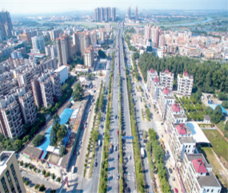
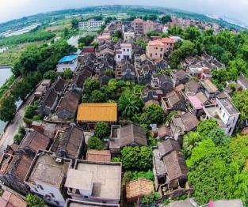
Changes
Danzao's changes
Before
It was a small village.
Now
It becomes a developing town.

Slide 9
Questions
Causes
01
Are you a local people of
Danzao?
02
Why do you move to Danzao?
03
Do you have flats in Danzao?

Slide 10
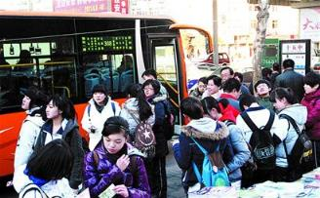
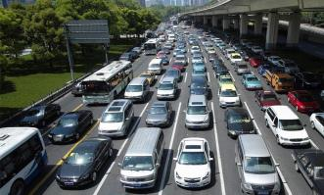
Problems
Traffic
In your daily life
1
When you go home every Friday,
By bus. You need to wait for a long time and it's crowded in the bus.
By car. There are traffic jams on the way home.

Slide 11
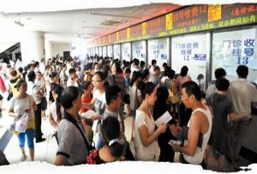
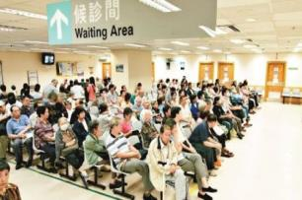
Problems
Hospitals
In your daily life
2
When you are ill,
You must make an appointment with the doctor in advance.
You have to wait for the doctor for so long.

Slide 12
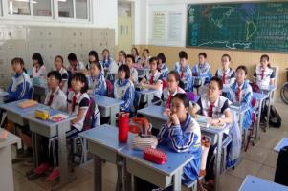
Problems
Schools
In your daily life
3
In our school,
11 classes
×
50 students
13 classes
×
50 students
Grade3
15 classes
×
50 students
Grade2
Grade1

Slide 13
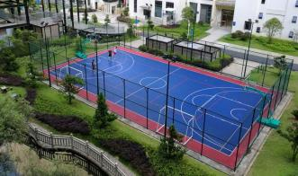
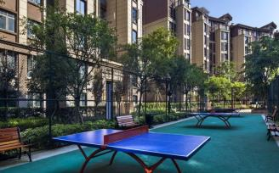
Problems
Neighborhood
In your daily life
4
If you do sports in your neighborhood,
You must go there earlier than others.
Because the pubic service isn't enough.

Slide 14
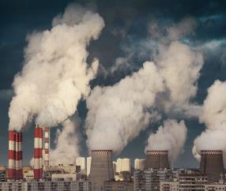
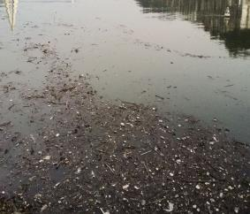
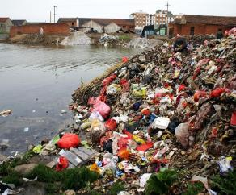
Problems
Pollution
In your daily life
5
There is too much pollution around us.
Air pollution
Water pollution
Rubbish pollution

Slide 15
Questions
What can we do to solve the problems?

Slide 16
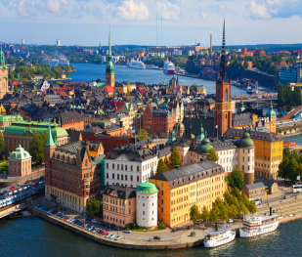
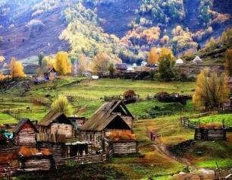
Jo's story
Jo's experience
Before
Parkville was a quiet village.
Now
It became part of a city--Arnwick.

Slide 17
04
While-reading

Slide 18
Skimming
Match the headings
New problems.
The lesson we got from the story.
C. The old Parkville.
D. The new needs.
E. The changes in Parkville.
Para. 1
Para. 2
Para. 3
Para. 4
Para. 5
Retell a report according to the mind-map.

Slide 19
Scanning I
1. What was Arnwick?
A. A village B. A town C. A city D. A country
2. What happened to Parkville?
A. It bacame smaller. B. It became more beautiful.
C. It became part of village. D. It became part of Arnwick.
3. How is Jo's family's living environment?
A. Crowded and dirty. B. Quiet and beautiful.
C. Comfortable and quiet. D. Noisy but clean.
4. Where is Jo's school now?
A. In Parkwille. B. In a village. C. In Arnwick. D. In New York.
5. Which of the following is TRUE according to the passage?
A. It's easy for Jo to go to school on foot.
B. The small local school in Parkville disappeared four years ago.
C. As Arnwick becomes bigger, it needs better public services.
D. There is a real Jo living in a real village called Parkville.
Skills:
1. Key words
2. Locate the scope
3. Infer the answer
Retell a report according to the mind-map.

Slide 20
Scanning II
The causes of population increase
Retell a report according to the mind-map.
Jobs
Places
Flats
Result
①
②
③
People moved to Arnwick to find jobs.
They need places to live, but it's expensive to live in the city centre.
The government built flats outside the city centre.
Soon Parkville became part of Arnwick, and Arnwick became a city with over a million people.

Slide 21
Careful Reading
Fill in the mind-map
Population
increase
causes
solutions
(needs)
schools,buses,
hostipals
Problems
1
fresh air, clean water
public services
2
crowded
rubbish
traffic
pollution
police
3
money
4

Slide 22
Read Aloud
1
Read after the tape
Read loudly and fluently!
3
Read together
2
Read in groups

Slide 23
05
Post-reading

Slide 24
Retell
Mind-map
Population
increase
causes
solutions
(needs)
schools,buses,
hostipals
Problems
1
fresh air, clean water
public services
2
crowded
rubbish
traffic
pollution
police
3
money
4

Slide 25
Retell
Pattern:
Arnwick is growing bigger and bigger because of the polupation increase.
The population increase causes many problems.For example, ______________. Besides, ________________________.What's worse(更糟糕的是）, _________________________________________.
In order to solve these problems, it's clear that Arnwick needs many things. First,___________________________________________.
Second,____________________________________________________.
Third,______________________________________.
Fourth,_______________________.
Retell a report according to the mind-map.
it is crowded
rubbish is a probem.
there is a lot of traffic and pulltion
it needs more schools, buses and hospitals
it needs fresh air and clean water and better public service
it needs more police to protect people
it needs more money

Slide 26
Brainstrom
The lesson we've learnt
Green Travel——by bike, by bus, on foot.
Solutions
Government: build more shcools, hostipals.
Don't throw rubbish about.
Plant more trees...

Slide 27
Writing
Requirements
如今，丹灶人口增长很快，引发很多社会问题。请你根据要点写一篇80词的短文。写作要点：
1. 引发的社会问题。（3点）
2. 解决这些问题的方法。（3种）
Pattern:
Danzao is growing bigger and bigger because of the population increase.
The population increase causes many social problems.
First,_______________. Second,_____________. Third,______________.
It's high time for us to solve these problems. First,_________.
Second,_______________. Third,________________.

Slide 28
06
Summary

Slide 29
Learning Aims
Understand the passage with reading skills
Retell the passage and write a report
with the mind-map
Aims
Have the awareness of protecting environment

Slide 30
07
Homework

Slide 31
Homework
1.
Finish the report
2.
Check the report with partners
3.
Make a survey of population increase in your hometown.

Slide 32
Protect our environment & earth
Thanks

